Slide 1
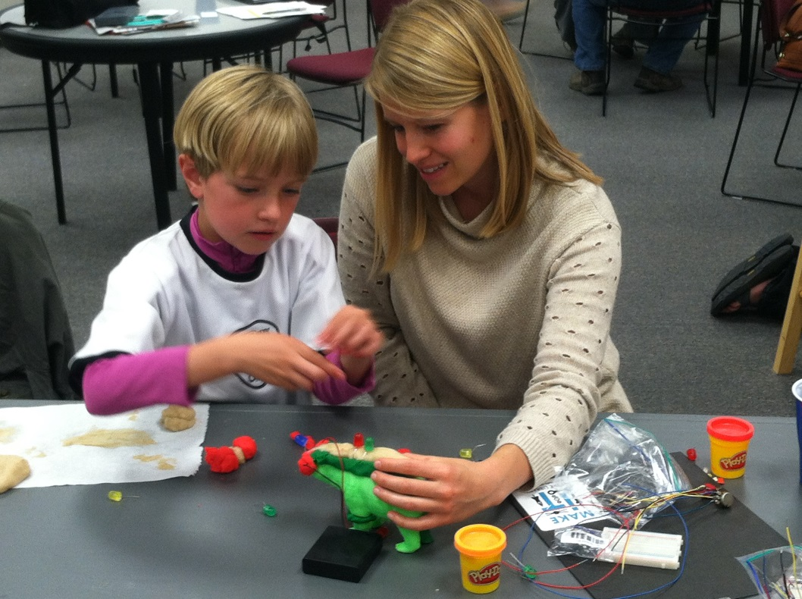
Building Young Makers
Erica Compton, Idaho Commission for Libraries erica.compton@libraries.idaho.gov
Notes:
Good afternoon and welcome to Building Young Makers! I am Erica Compton from the Idaho Commission for Libraries and lead coordinator on the Make it at the Library project. So trying to do a session with hands-on experience is a challenge with this many people, but I thought it was really important to give you a chance to get your hands dirty and play today. So I had to call in lots of favors to help make this happen! With me today I have Staci Shaw a fellow RTM colleague, staff from our Maker libraries – Cindy from Gooding Public, Morgan from Community Library Network, and Megan from Meridian District Library, Amanda from Portneuf. Also Jill Call a valued volunteer at the Commission and her son.
It really does take a village!

Slide 2
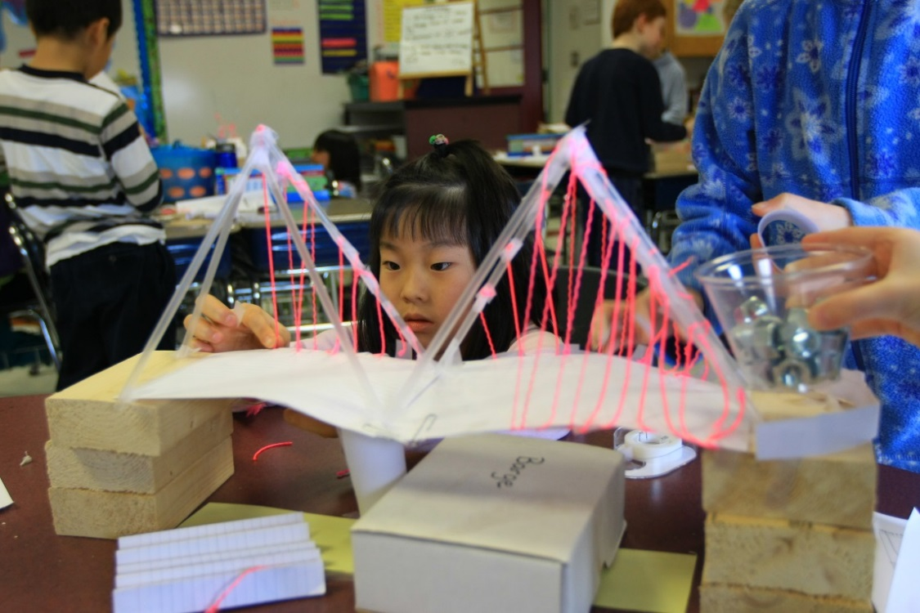
Desired Outcomes:
To inform participants about the importance of 'making' with young children.
To introduce participants to a variety of making activities with new tools and materials.
To discuss ways to implement making in early learning settings.
Notes:
We don’t have much time today to delve too deep in to making, but I am hoping to lay some groundwork for you on what making is and why it is so important. We will take at least 40-45 minutes to introduce you to some new tools and materials you might use with the children in your care. And finally we will save time at the end so that we can share out thoughts on how to implement making in early learning settings and answer any questions you might have.

Slide 3
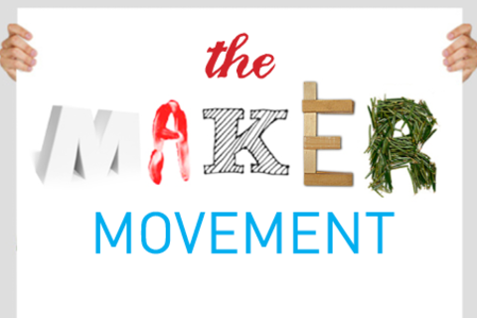
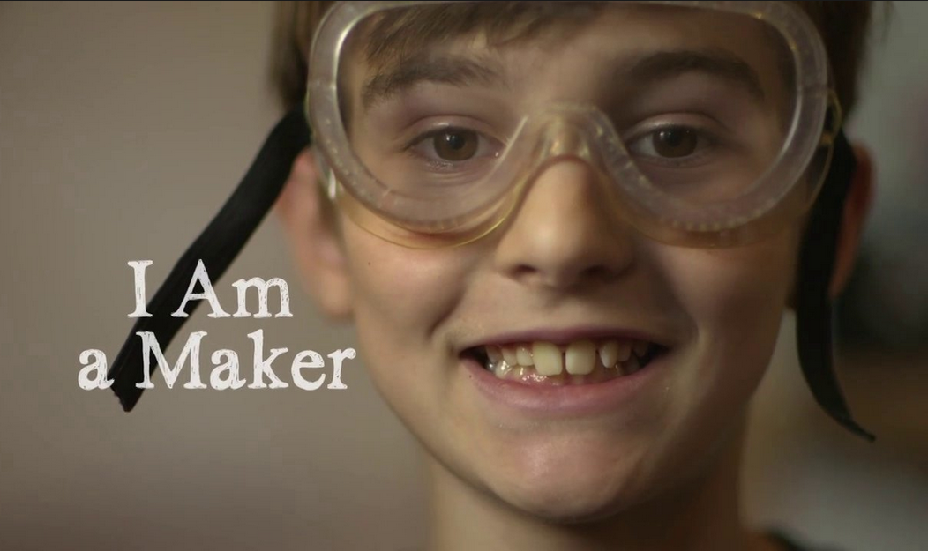
What’s Your Experience?
Notes:
I like to start by asking for a quick show of hands as I ask a couple of questions. Don’t be shy, this helps us frame our time together!
Who is brand new to making, makerspaces, and the maker movement??
Who has heard of these terms?
Who has been to a maker faire?
Who is a MAKER??? –
I would argue that everyone is a maker! And perhaps you will feel that way at the end of our time together.

Slide 4
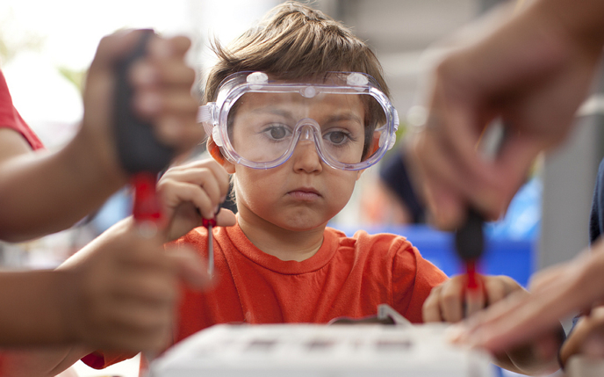
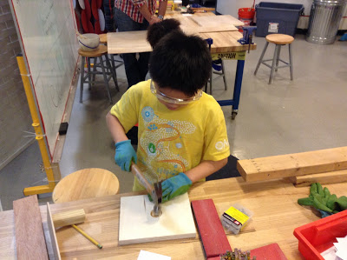
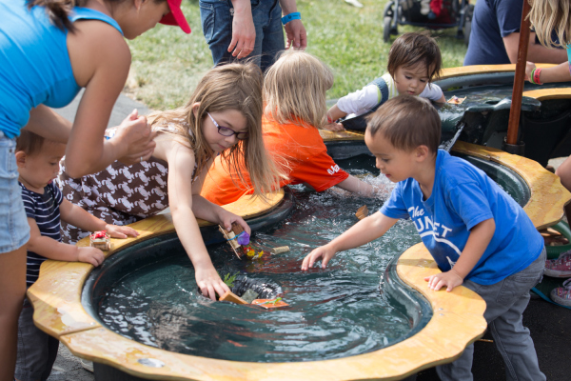
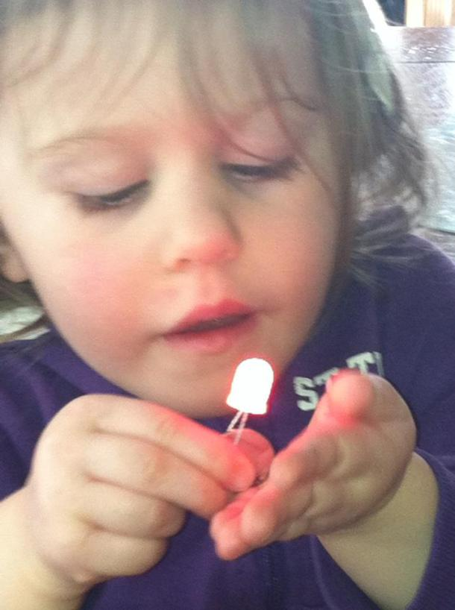
What is making and why is it important?
Notes:
So what is making, makerspaces, and the maker movement?
A makerspace is really just a workspace where people get together to make things, to share knowledge and help one another, to be creative, and innovative. And making is just that – it is taking stuff apart, tinkering, hacking, building, creating, and figuring out new ways to solve problems. It is not new! There have always been makers, but as we have become more of a “fast-food” and throw-away society, making has taken a backseat. SO why is it important to rediscover making and help foster it in our young children?
The research is quite clear that the best practice in early childhood education is to break away from passive instruction and allow for more play and investigation, and this kind of learning early in life builds skills and interests that serve children throughout their school years, and later in life. We need to allow students to be active, engaged, and take initiative in their own learning. Long-term research also indicates that being allowed opportunities to take initiative in your own learning is good for overall long-term academic success.
And really it’s easy because Children are naturally makers. They want to squish dough, tinker with machines, stack blocks, and create imaginary worlds. They love to ask WHY? They love to discover and explore. So what do we need to do? As caregivers and educators we need to provide the environment and the materials for them to explore, we need to push them outside their comfort levels at times and support their struggles, and we often need to just get out of their way so that they can make!
Another great thing about making is it is really GREEN!! There is a huge focus within the maker movement to recycle, reuse, and upcycle!

Slide 5
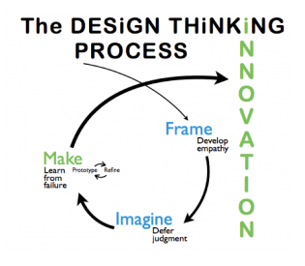
Design Thinking
Notes:
Another concept key to making is Design Thinking or the Design Process. This image is from the Stanford University’s d.school – a hub of innovation where student take on real world challenges and search for creative solutions. I want you to notice a couple of things at the heart of the design process – the first is that it incorporates empathy into the process – it takes a humanistic approach to designing – people centered. And the second I’d like to point out that it says “Learn From Failure.” This is perhaps one of the most important skills I believe that we can impart to learners of any age. You have to be comfortable failing. You have to take risks in learning. You have to be OK with failing if you are going to progress forward. You just have to realize that you need to FAIL FORWARD. We probably all know the famous quote by Thomas Edison -“I have not failed. I've just found 10,000 ways that won't work.” but he also said - “Our greatest weakness lies in giving up. The most certain way to succeed is always to try just one more time.” He understood the concept of failing forward. Of what is called HARD FUN. Of taking what you learned through a failed experiment and refining, reframing, redesigning and then trying again. So as you think about making remember that it is key to create an environment that lets new ideas grow and lets the group experiment without the fear of making mistakes.

Slide 6
Design Thinking…
deepdesignthinking.com/why-deepdt-as-a-design-thinking-process
Notes:
I found this graphic from a site I just discovered called Deep Design Thinking that has some content geared toward the younger students so I wanted so share it. I think it could be a great way to share the concept with these youngsters.
is multidisciplinary & applicable to any subject.
integrates imagination & analytical thinking.
encourages objective assessment & values.
promotes cooperation, socialization & humanistic understanding.
links information to experience & responsible action.
emphasizes constructive thinking over factual retention.
promotes the development of knowledge through creative learning experiences.

Slide 7
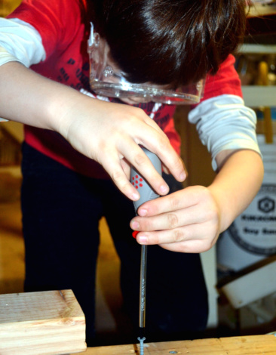
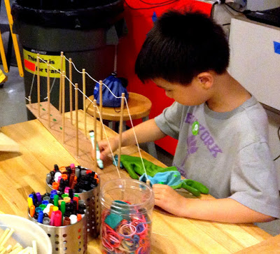
What does making look like?
Notes:
Making can look so different depending on the environment and the age of the child. It may be a child exploring blocks and figuring out how to stack them as high as they can go. Or building a bridge out of found objects and testing its strength by loading stuffed animals on top. It may be a child learning to hammer their first nail, fixing a nut to a both for the first time. Maybe a child is creating a catapult out of popsicle sticks and rubber bands. When making is happening you may lots of dialogue and questions – interesting vocabulary being thrown about. Or perhaps a child is silently pondering their experiment or creation trying to figure out why it isn’t working….
What ever it is, you can bet that the kids are engaged, excited, and invested in what they are doing.

Slide 8
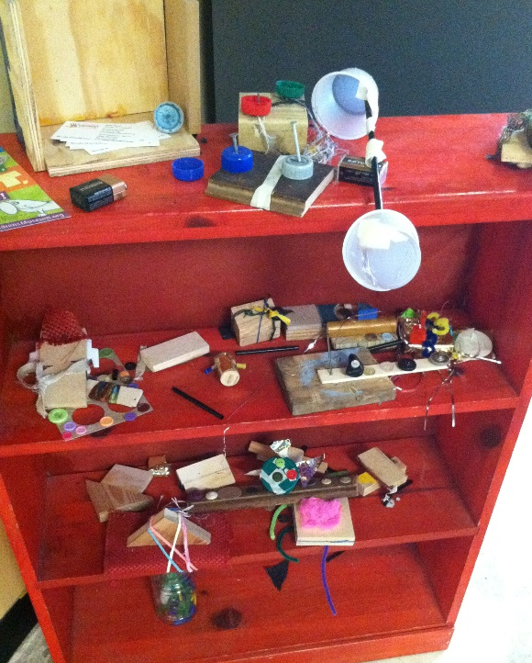
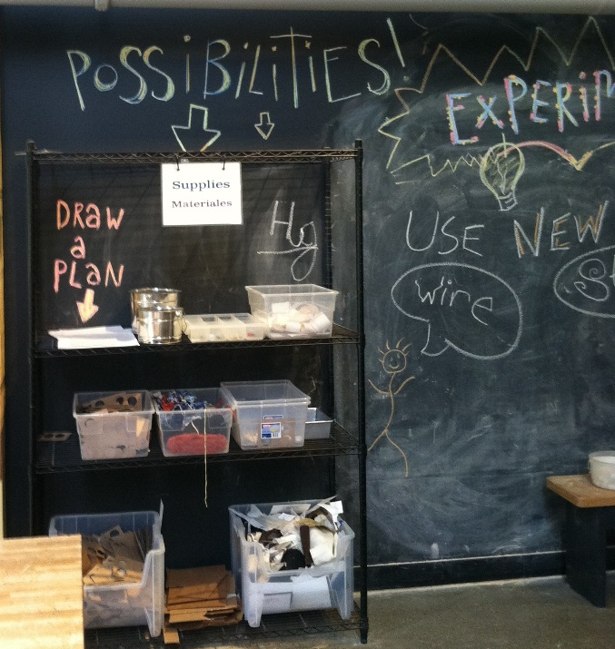
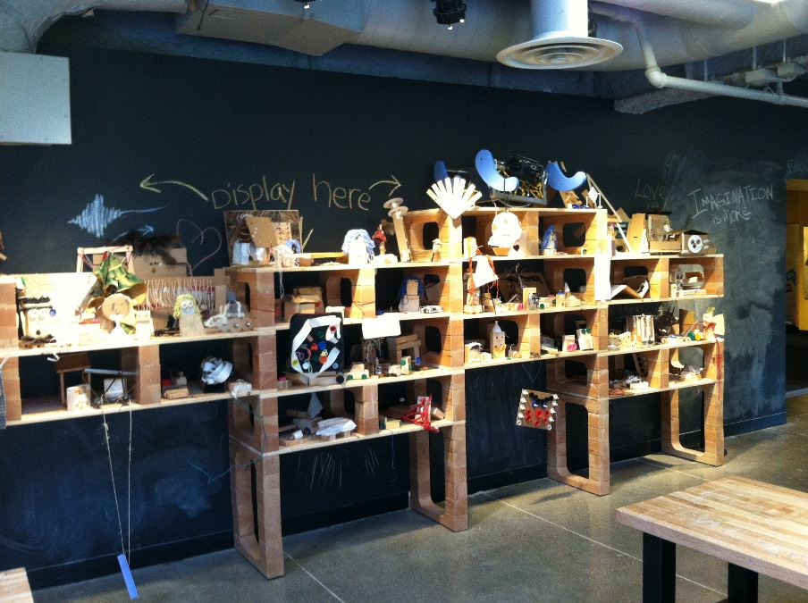
The Making Environment
It might be messy…
…and a bit noisier…
…but it sure is fun!
Possibility Walls!
Notes:
Inside MakerKids, a workshop space in Toronto’s west end, children are presented with what’s called the Possibility Wall. The shelves on the wall are filled with bins of just about anything a child might think to create with – motors, gears, crayons, glitter, electrical tape, scissors and even power drills. There’s also a 3-D printer and soldering guns in the space, along with several tables and computers.
Now of course not everyone can have a space like this….but you can take a few key lessons from this to incorporate. An area on the wall where kids can brainstorm or draw ideas. Have shelves so materials are visible and accessible when you need them. And you always want some space where you can celebrate and share their creations or store them while they are in the process of iterating and designing.

Slide 9
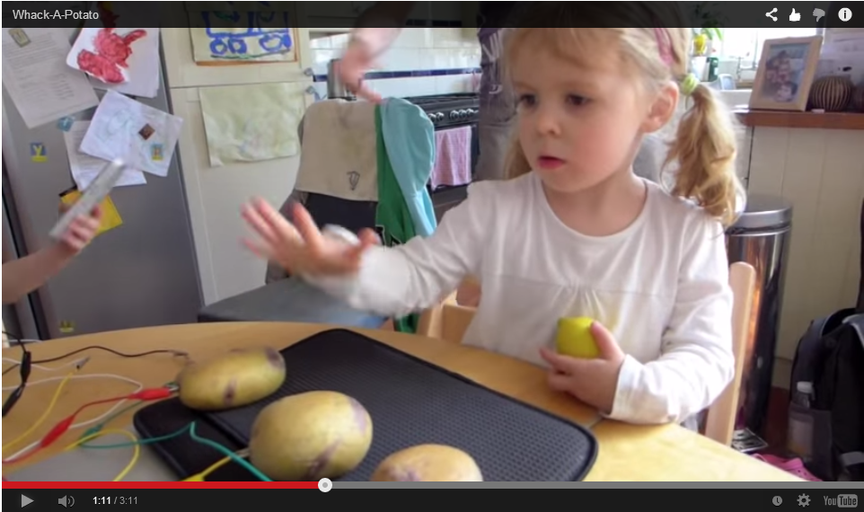
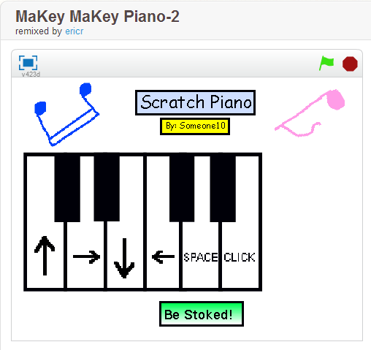
MaKey MaKey Mayhem
Whack-a-Mole with Potatoes
http://bluntbody.com/whack-a-potato/
Notes:
We are going to take about 45 minutes for you to explore a variety of activities, materials, and tools. Get hands-on and have some fun.
There are 11 stations throughout the room that are available for you to explore. Some are hosted and some are not. There won’t be time for everyone to visit every station, but just have fun, wander, play, and make.
So let’s talk a bit about what we have scattered around the room.
Talk with one another and with the hosts, ask questions, and be thinking about ways you might incorporate some of these activities into your learning environment. Notice that on the back of each of the signs the Early Childhood guidelines are listed that tie to the activity. Many thanks to Staci for pulling these all toghether for me!
We will then come together at the end and spend some time talking about what you experience, answer questions, and have you share your thought and ideas.
Makey Makey is an amazing tool that allows you to easily create an interface to the computer
I want to show a quick video to give you a glimpse of what is possible with this simple technology.

Slide 10
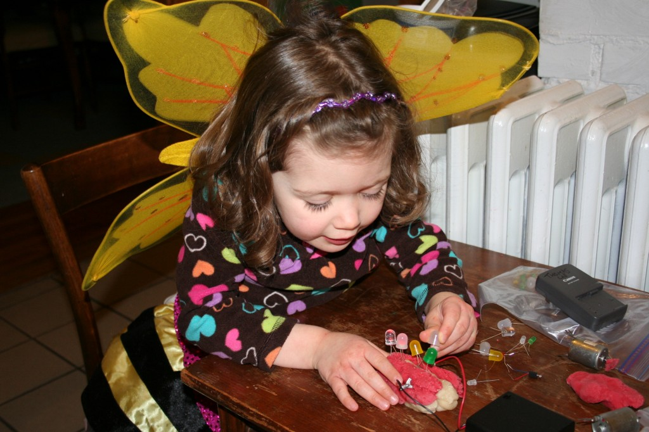
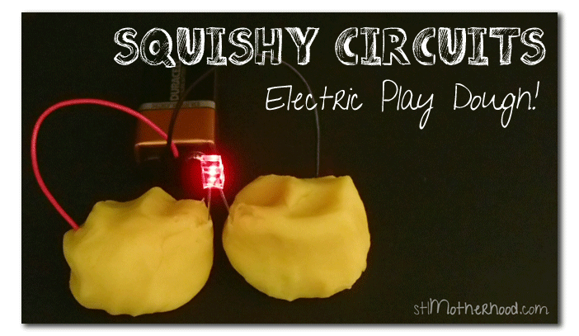
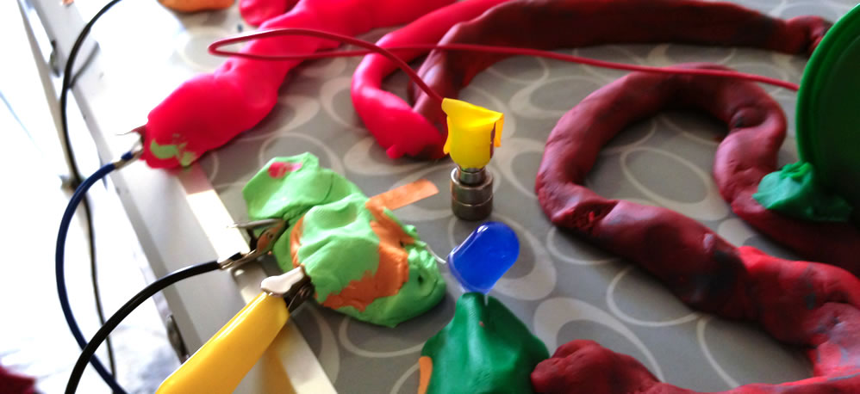
Squishy Circuits Fun
Teaching Basic Circuits
http://courseweb.stthomas.edu/apthomas/SquishyCircuits/PDFs/Circuit%20Basics.pdf
Notes:
Squishy Circuits – where you will learn how to conduct electricity through playdoh

Slide 11
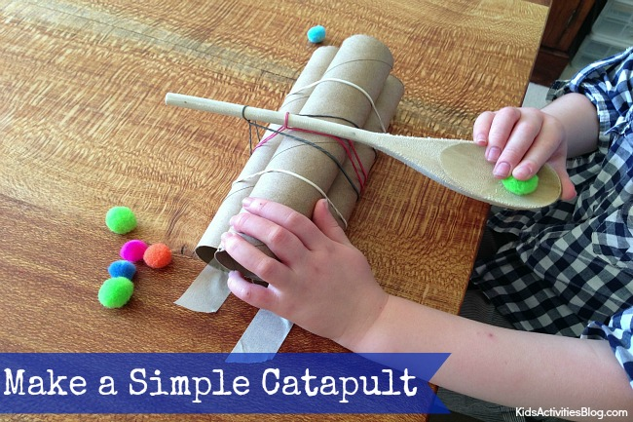
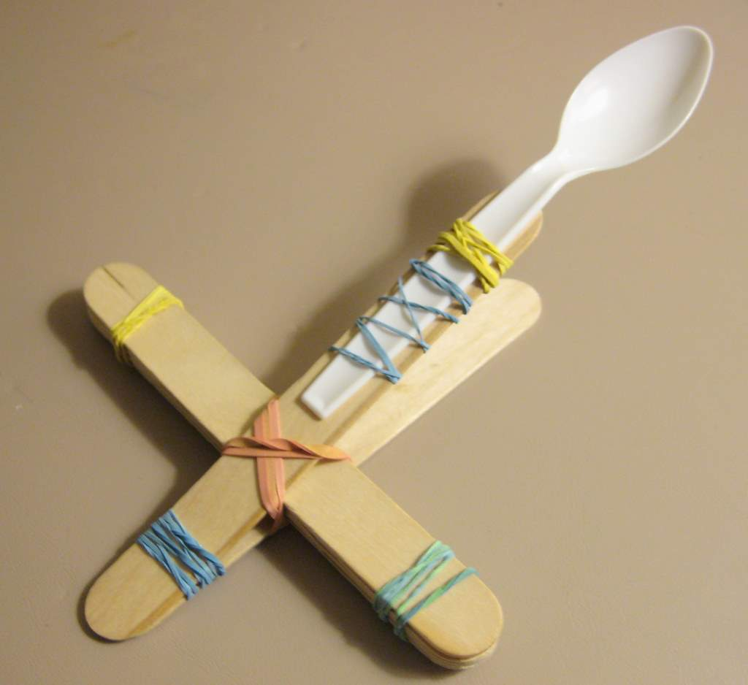
Catapults!!
http://kidsactivitiesblog.com/28664/building-a-catapult
http://www.pinterest.com/explore/catapult-craft/
Notes:
Catapults are a fun and engaging way to introduce youngsters to simple machines and other concepts in physics. This is not a hosted table but we have a picture of a simple catapult and the materials – try and build one – launch a mini marshmallow and if you have time see if you can redesign it to make it work better, Rember it is never one and done!!

Slide 12
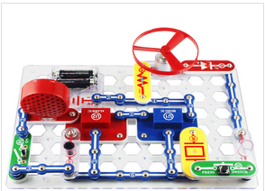
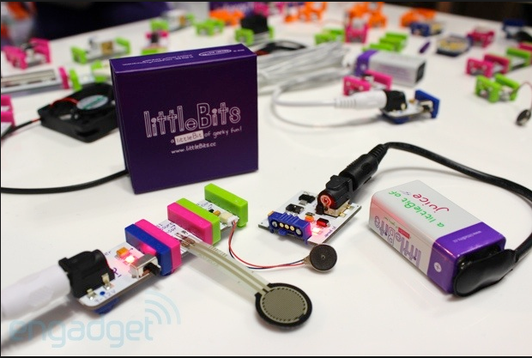
Snap Circuits & Little Bits!
Notes:
Morgan has a table full of Snap Circuits – an fun activity about electricity that is safe and easy to do

Slide 13
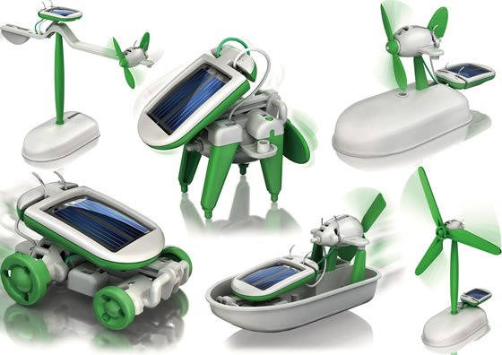
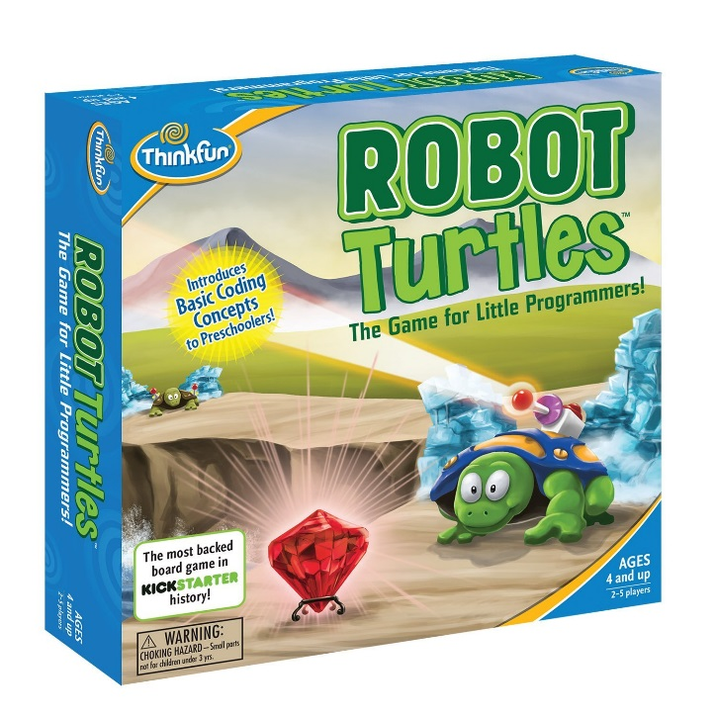
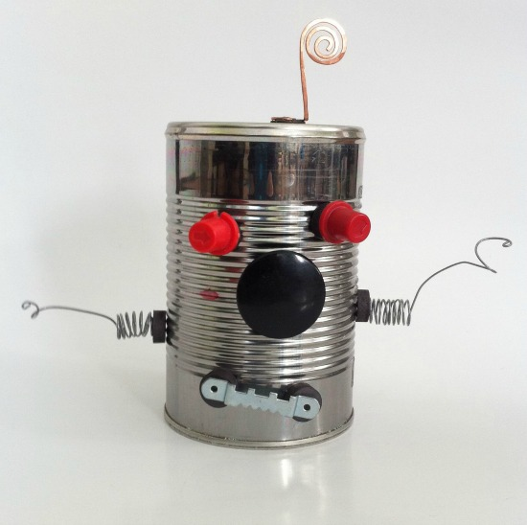
Robotics
Notes:
Cindy is in charge of robotics. You can build a simple tin can robot and explore a simple solar robot kit, and learn about a game called Robot Turtles which teaches the basic concept of coding or programming which is the language of robotics.
If you have not heard of Scratch Jr – check it out. It is free and available online and teaches coding through a very interactive and game-based methodology.

Slide 14
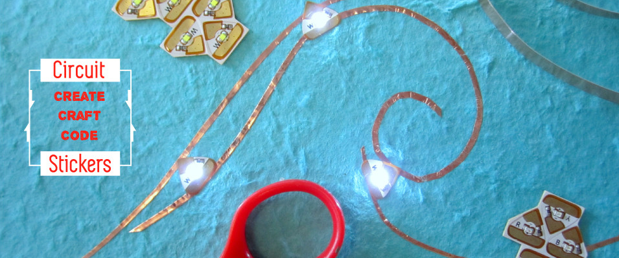
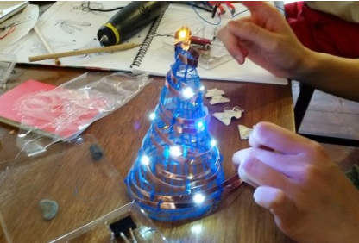
Circuit Stickers… Crafting with Electricity
http://chibitronics.com
Notes:
Circuit Stickers are brand new and I have not even had the opportunity to play with them yet!! So – help me out and go explore this new technology and let us know what you think!

Slide 15
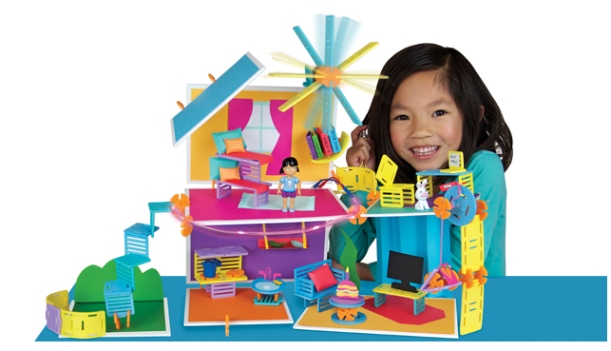
Roominate
A building toy for girls…
http://www.roominatetoy.com/
Notes:
Roominate is a new building toy designed by 2 women engineers out of Stanford and that is specifically designed to engage young girls. However Staci’s son was our helped for this and put some of the pieces together and apparently loved it!

Slide 16
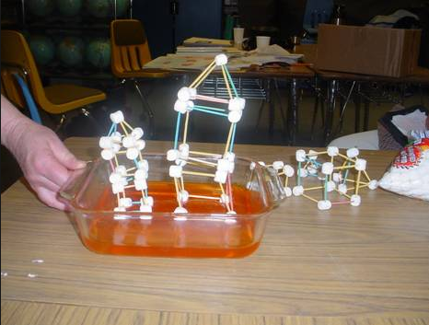
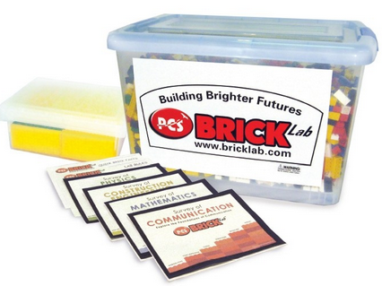
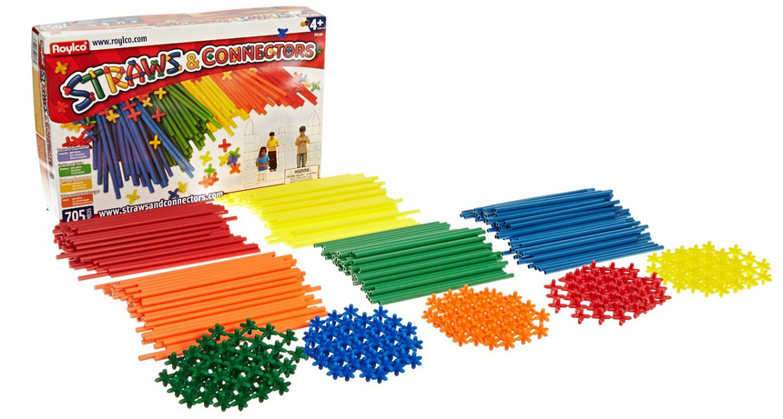
More Stations…
Notes:
We have 3 stations all about structures and building. We have a BrickLab which is made by an Idaho company called PCS Edventures.
Straws and Connectors – which lend themselves to quick and large scale building for all ages. And finally marshmallows and toothpicks – a great way to explore geometry, structures and design.
Another station is all about sorting and classifying – this might seem to be a really fundamental activity, but it is foundational to so many skills they will need to acquire.

Slide 17
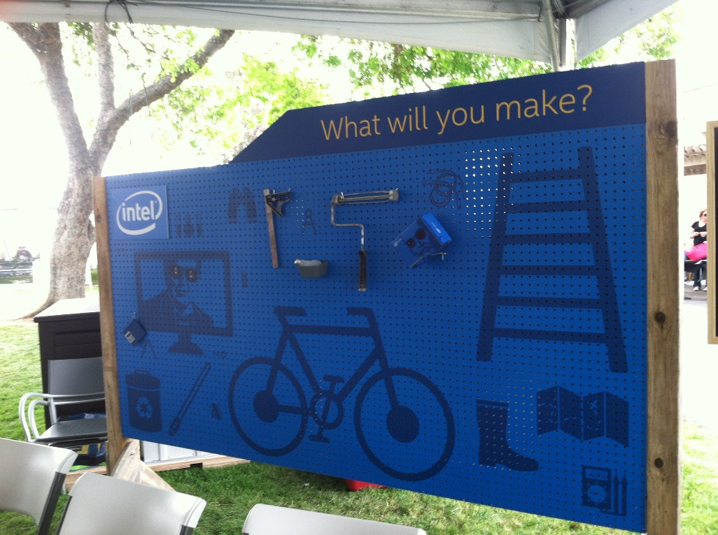
Let’s Play!
Notes:
Ok – so let’s go!! I will call you back together about 2:30 so we have time to debrief. And again – while you are engaging in these activities please be thinking about how it might work in your setting and what you might like to share about your experience.

Slide 18
Discussion Time
What did you think?
How do you see this working in your classroom or learning environment?
Any concerns about making with young children?
Any Questions?

Slide 19
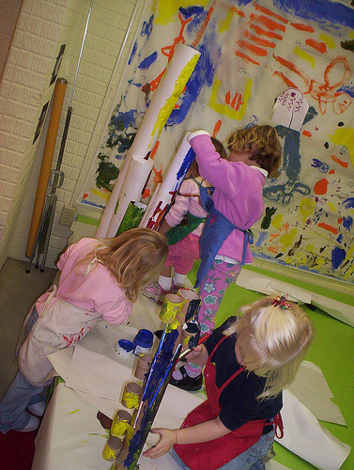
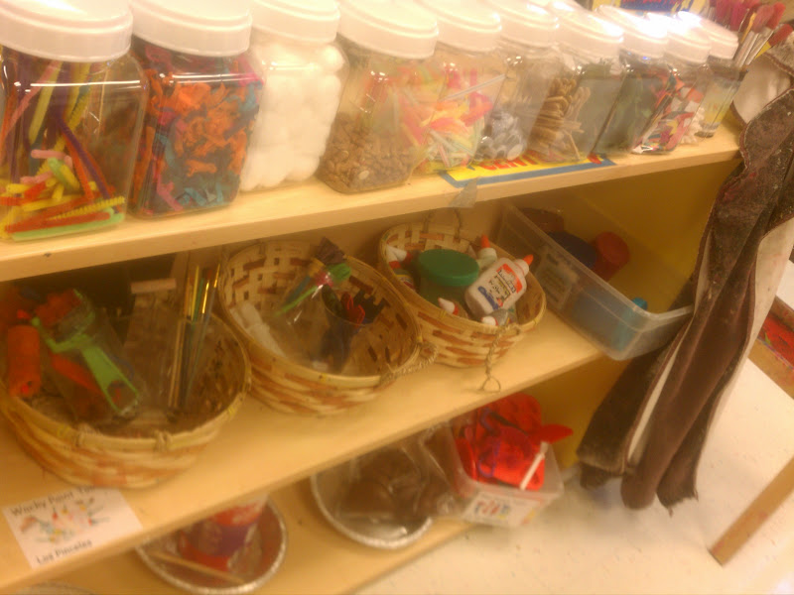
Integrating Making into the Classroom
weareteachers.com/blogs/stem
sdpk.stvrain.k12.co.us/stem.html
weareteachers.com/hot-topics/special-reports/stem-for-elementary-school
Notes:
1) This can be as simple as changing the kinds of questions we ask our students. “By adding a few words to your classroom questioning vocabulary—words like design, experiment and model—a whole world of STEM learning can be opened up for students."
2) Community partnerships—both with education businesses and higher education institutions, are a key factor in the success of STEM programs.
All you have to do is open the door and reach into the sandbox.
What are STEM Practices in Preschool?
Instruction supports overall academic growth and acceleration of students, while it enhances later interest in solving real world problems in STEM fields.
Instruction fosters designing, experimenting, problem-solving, and social interaction. In STEM there is the recognition that instruction occurs best in a social atmosphere of cooperation and collaboration.
Children are presented with real-world challenges, and they are encouraged to solve problems and present their ideas. These projects and challenges promote real life application of 21st century skills, such as critical-thinking and reasoning, collaboration, and creativity, necessary for learning now and in the future. These activities inspire children’s reasoning and learning over a long period of time.
In addition to teacher-designed challenges, preschool STEM allows for an experience where we focus on children’s questions and purposes, and engage them in authentic exploration and experimentation.
STEM instruction provides classroom opportunities and environments for using concrete objects to build and explore the world. This allows for opportunities for children to change variables and observe results immediately.
The integrated curriculum gives students opportunity to apply their literacy and numeracy skills in purposeful ways.
Students develop technology skills and experiences, which are integrated and interactive, age appropriate, and enhance children’s cognitive and social abilities.
The staff seeks to develop partnerships with parents, business, and community-based organizations, which extend learning opportunities in creative and unique ways.

Slide 20
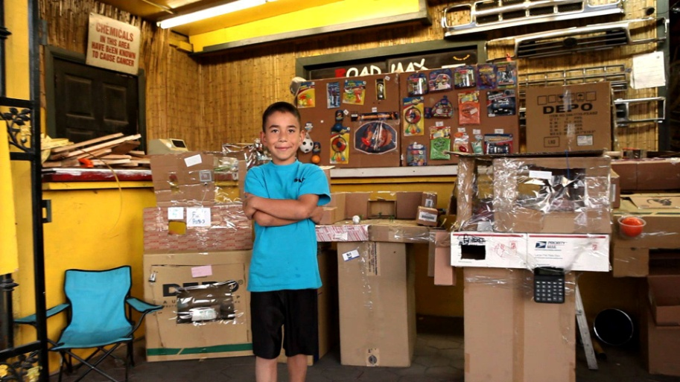
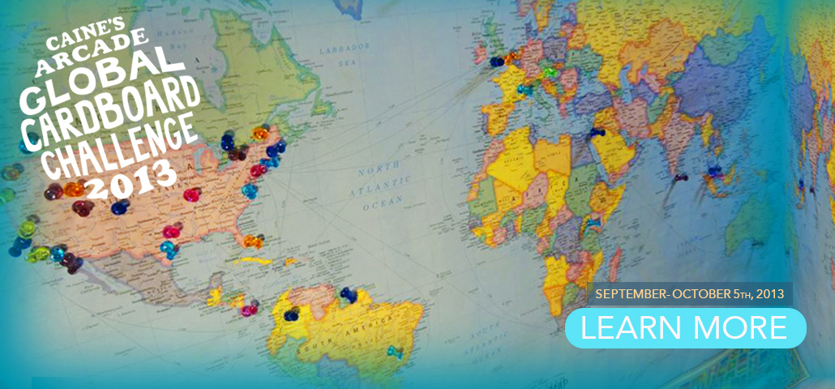
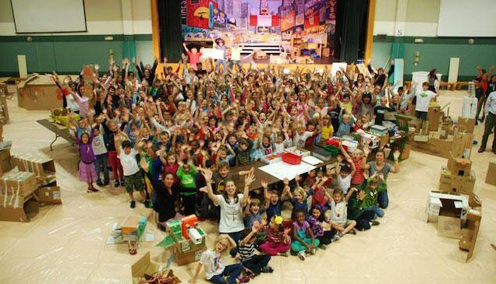
Global Cardboard Challenge
http://cainesarcade.com/
Notes:
Join the challenge this October and inspire imagination and creativity!

Slide 21
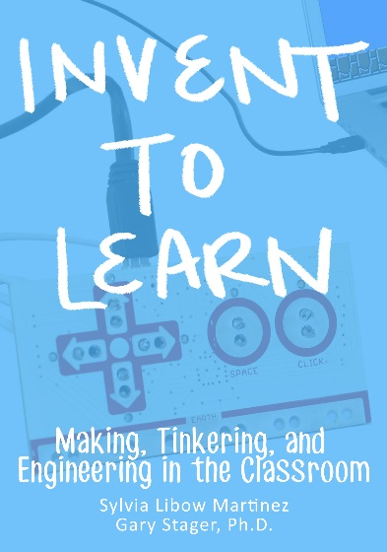
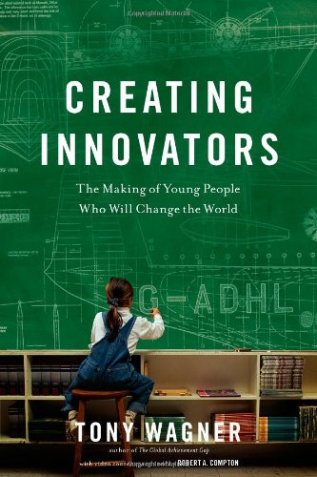
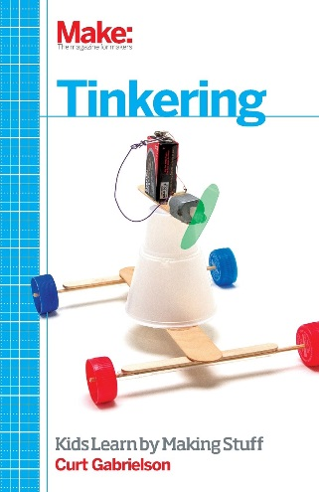
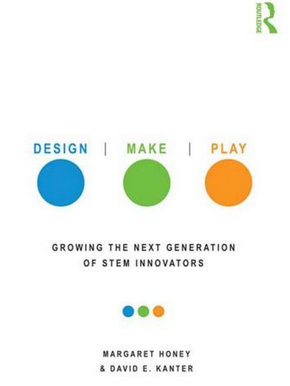
Resources
http://www.bostonchildrensmuseum.org/sites/default/files/pdfs/STEMGuide.pdf
http://www.pbs.org/wholechild/providers/play.html
http://ecrp.uiuc.edu/beyond/seed/katz.html
http://makeymakey.com/guides/
http://www.makerkids.ca/

Slide 22
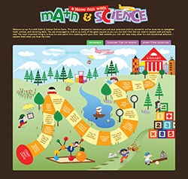
Online Resources
Virtual Storytimes!
Online Gameboard!
Online Books!

Slide 23
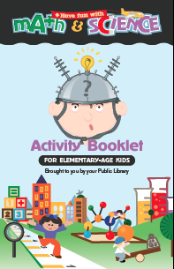
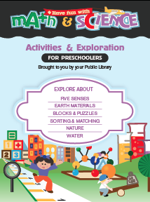
Other Resources Available

Slide 24
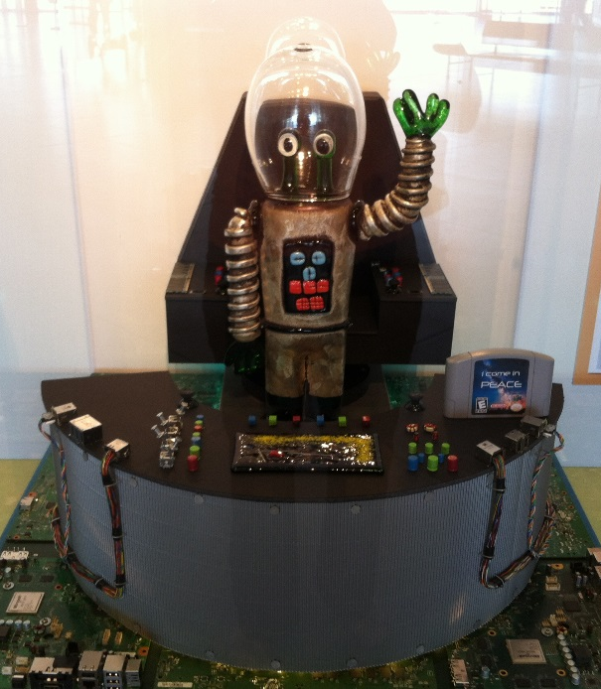

Slide 25
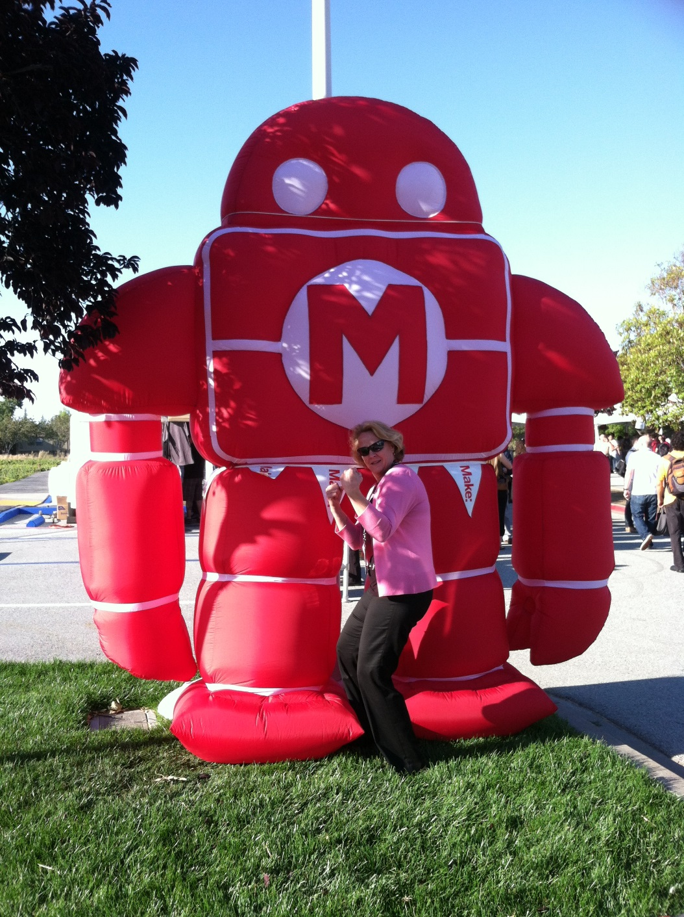
WHAT WILL YOU MAKE?

