Slide 1

A Framework to Become a
Brain Health Center
Stephen Ristau
Purposework
stephenristau@gmail.com

Slide 2
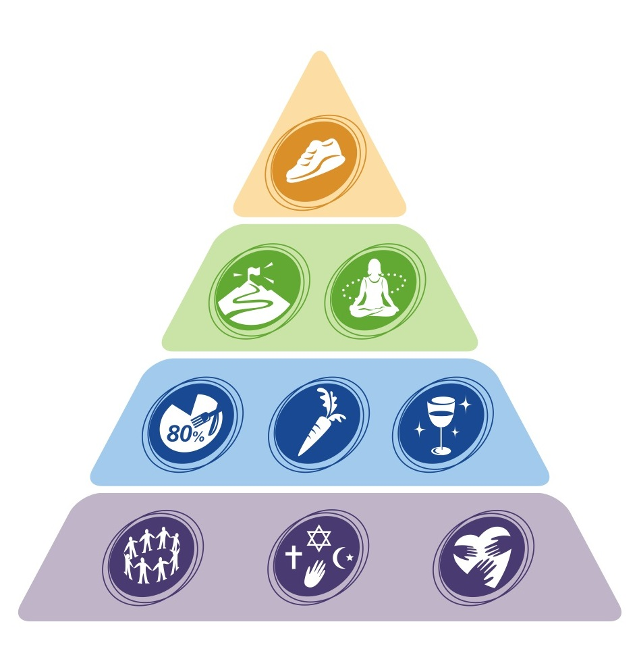
Blue Zones - Keys to Longevity
Move Naturally
Right Outlook
Eat Wisely
Belong to the Right Tribe
SOURCE: Dan Buettner, www.bluezones.com
Notes:
to identify pockets around the world where people are living MEASURABLY better lives. In these Blue Zones, they found people who reach age 100 at rates 10 times greater than in the United States, where people suffer a fraction of the rate of heart disease and cancer than we do and where people are getting the extra 10 years that we're missing.
These are the lifestyle characteristics that they posit as the keys to longevity:
Move Naturally – Make your home, community and workplace present you with natural ways to move. Focus on activities you love, like gardening, walking and playing with your family.
Right Outlook – Know and be able to articulate your sense of purpose, and ensure your day is punctuated with periods of calm. Pray, meditate, reflect slow down and do inward. The two most dangerous years of your life are the year you are born, because of infant mortality, and the year you retire. People in the Blue Zone study have a sense of purpose and that adds about 7 years to their life expectancy.
Eat Wisely – Instead of groping from fad diet to fad diets, use time-honored strategies for eating 20% less at meals. Plant-based diets, avoid meat and processed food and drink a couple of glasses of wine daily.
Belong to the Right Tribe – Surround yourself with the right people, make the effort to connect or reconnect with your faith practices and put loved ones first. The foundation of all this is how they connect - they put family first, take care of their children and their aging parents. They all tend to belong to a faith-based group which adds between 4- 14 years to your life expectancy if you practice at least 4 times a month.
These people add more years to their life and more life to their years.

Slide 3
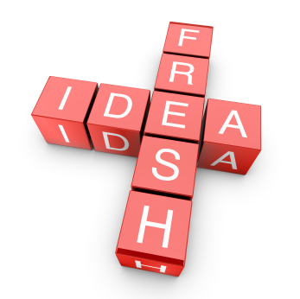
SIX P’s OF LIBRARY INNOVATION
Philosophy
Partnerships
Programs
Place
Promotion
Position
Notes:
STEPHEN:
Philosophy- what is the underlying foundation you build you library on- community, service, engagement, lifelong learning are all concepts that attract midlife adults.
Partnerships – What new partners and new partnerships, including those with midlife adults 50+, might be established as you transform life after 50 in your community?
Programs: mean engagement strategies – What programs and engagement strategies might you employ?
Promotion: New brands – How do you brand your initiative and how do you promote it? What new social media do you use?
Place: Re-visioned space – How do you use the physical and virtual spaces of the library? How is library as place used?
Position – How does this position your library in the community as a leader addressing this issue? How does it expand your outreach to an important population segment in your community?

Slide 4
Become a Brain Health Center
Library staff is trained to understand the basics of the human brain and the keys to a brain healthy lifestyle.
Library patrons complete a brain health lifestyle survey to identify their strengths/ weaknesses and design a brain health lifestyle plan.
Library volunteers are trained as “brain health ambassadors” to support patrons navigate their path to healthier lifestyles.
A kiosk of information and interactive online resources and games on brain health promotion is accessible to patrons.
The library’s existing resources and programs can be designated within one of the five brain health lifestyle domains.
Outcome measures are tracked over time.
Funding opportunities help the program become self-sustaining.
Content experts assist with the development, branding, training, and measurement of the brain health lifestyle program.

Slide 5
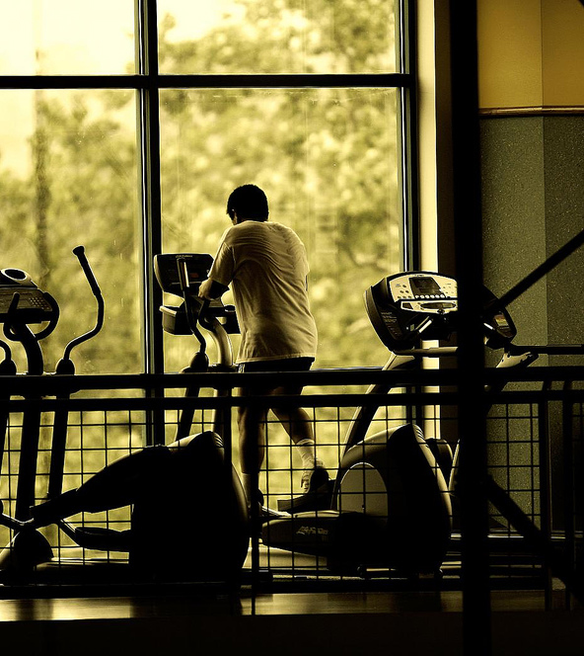
Physical Activity
Critical factors to your enriched environment
Walk 10,000 steps daily
Dance
Knit
Garden
Write with non-dominant hand
Aerobic Exercise
Notes:
Exercise has widespread effects on the brain.
Moderate intensity exercise several days a week is sufficient for improving brain health.
Starting to exercise in late life is not futile: even those who are sedentary can improve function.
Exercise may have long term health consequences for diseases of the brain.

Slide 6
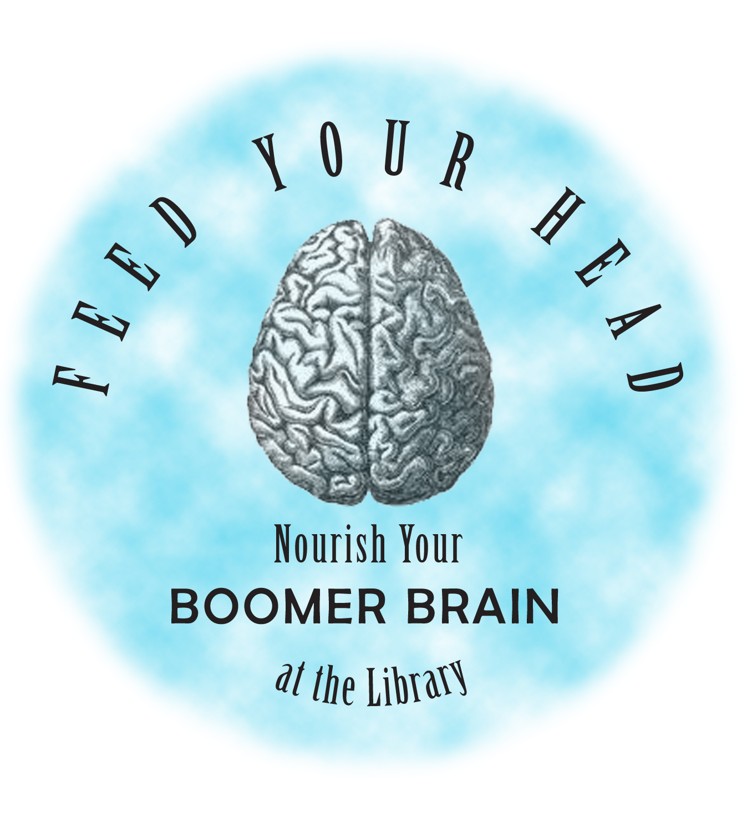

Promoting Brain Health
Notes:
Palo Alto Public Library offered lunch-time Feed Your Head programs that featured experts on brain fitness and healthy aging from Stanford University Medical Center. Podcasts of the brain fitness programs were also created. Fresno (CA) expo

Slide 7
Alameda Public Library
BE HEALTHY:
Physically
Mentally
Financially
Socially
Spiritually
Notes:
Alameda (CA) Public Library designed and delivered BeHealthy5 – a weekly, adult program series and monthly activities checklist that promoted financial, mental, social, physical and spiritual health.

Slide 8
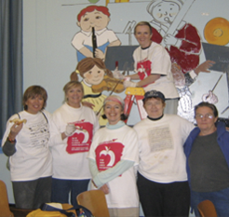
Socialization
Critical factors to your enriched environment
Remain integrated & involved
Develop hobbies
Build friendship & family networks
Do not retire – maintain meaning/role
Socialization

Slide 9
Socialization and Purpose
Social connections mitigate the effects of cognitive pathology
Sense of purpose enhances daily living and mobility
Libraries.volunteermatch.org
Notes:
The California State Library launched Get Involved: Powered By Your Library in 2008 due to the significant interest in engaging skilled volunteers in libraries. It has resulted in new volunteer opportunities being created that tap into the talent and experience of midlife adults and the generations that follow. Idaho has just signed on to join this initiative- for a look at the branded Get Involved website, go to http://libraries.volunteermatch.org.
Research Findings:
Social connections mitigate the effects of cognitive pathology (2006)
- David Bennett, Rush Alzheimer’s Disease Center
Pro-social activities delay onset of brain disorders (2008)
- Valerie Crooks, Kaiser Permanente California
Sense of purpose enhances daily living and mobility (2008)
- David Bennett, Rush Alzheimer’s Disease Center

Slide 10
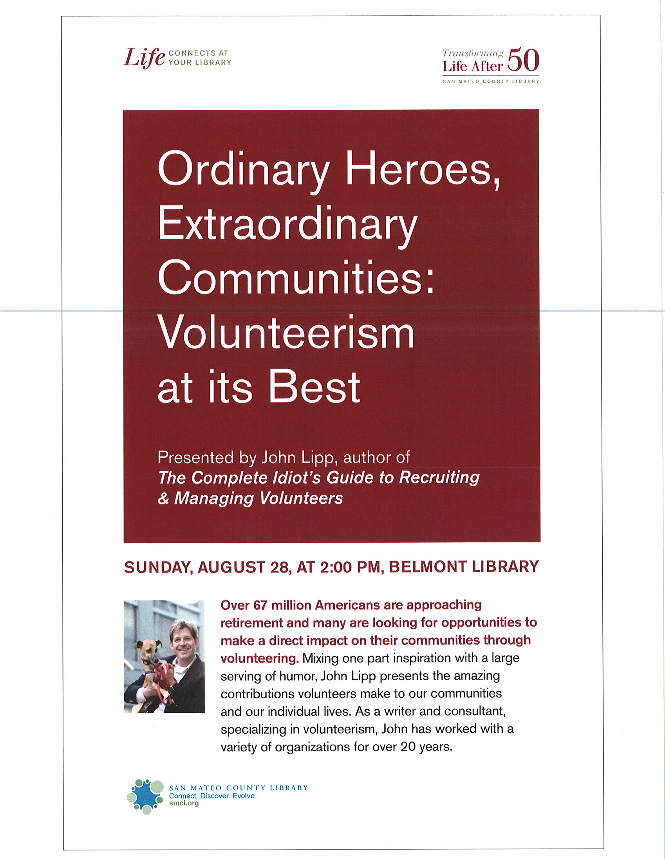
Notes:
Socialization…“influences not only our happiness in everyday life but the ways in which our brains process information, the levels of hormones circulating in our bodies and our physiological responses to stress.”
-Laura Carstensen, PhD
founding director,

Slide 11



Virtual Connections

Slide 12
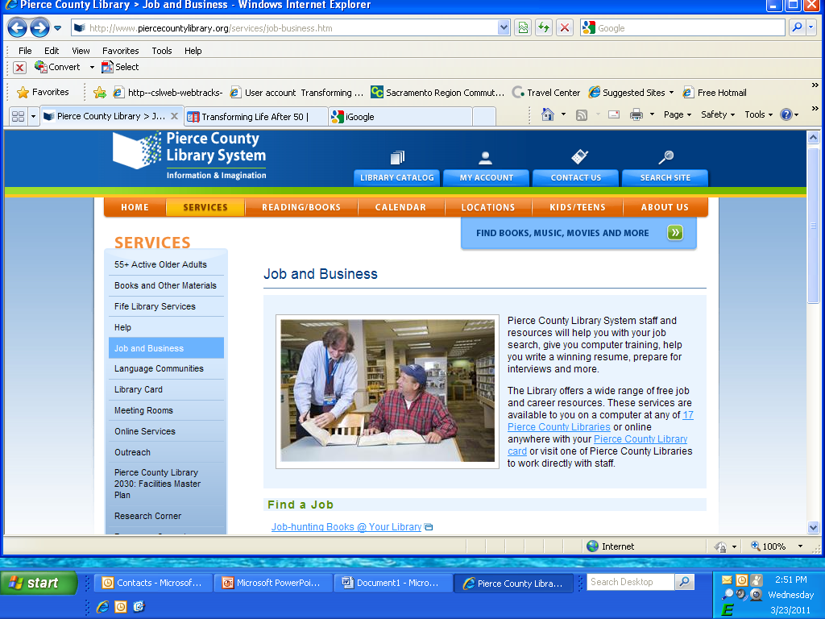
Notes:
Pierce County Library System(WA) has adapted to changing times and recently partnered with the community college, the local business incubator and other community organizations to provide a job resource center.

Slide 13


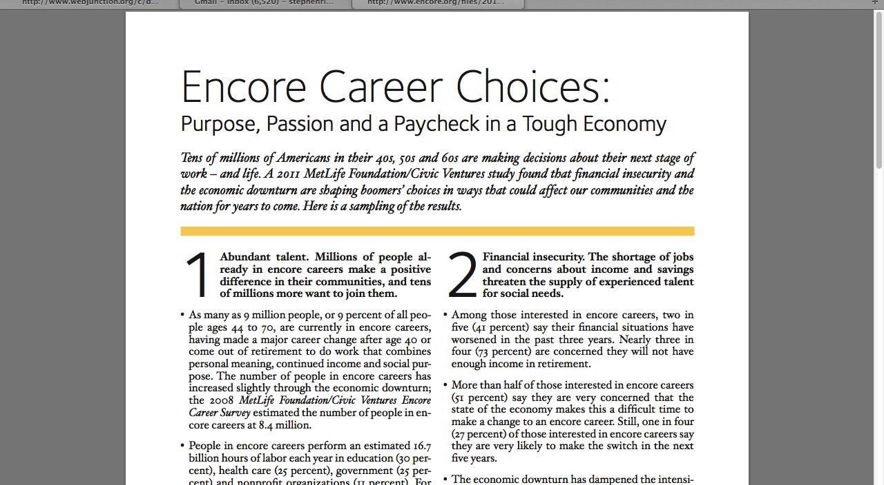
www.encore.org
Notes:
I highly recommend you acquaint yourself with its encore.org website. They have a number of studies about boomers, work and retirement along with online resources, tools, blogs and social media that engage and support midlife adults in career and life transition. And I highly recommend you read the most recent book written by Civic Ventures founder Marc Freedman- The Big Shift.
13

Slide 14
Mental Stimulation
Critical factors to your enriched environment
Learn a second language
Sign language
Travel
Play online games/puzzles
Fitbrains.com
Power of Music
Surf the Web
Novel & Complex
Mental
Stimulation
Notes:
Mentally stimulating activity can enhance cognitive health in old age and minimize the cognitive morbidity of late life dementia.
Activity related changes in brain function and structure appear to underlie activity related cognitive enhancement and may also increase resilience to incipient neurodegeneration.
Context of mentally stimulating experience likely important:
- meaningful long term goals
- determined pursuit of goals
- adaptability

Slide 15
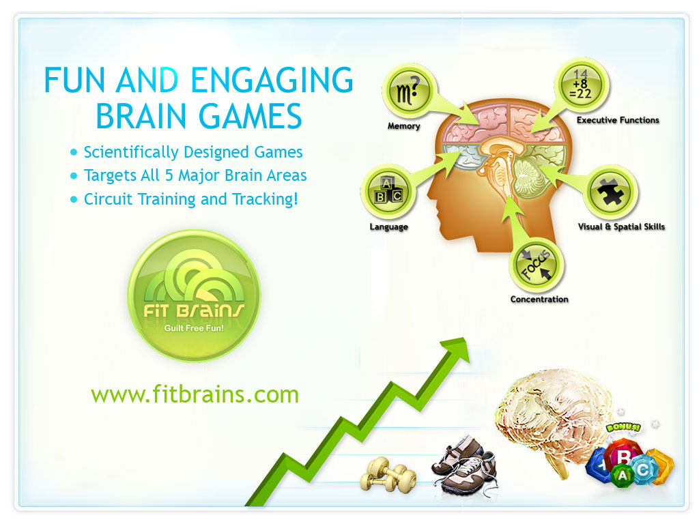
Mental Stimulation
Paul D. Nussbaum, Ph.D.

Slide 16
Gaming
Notes:
Jane McGonigal- gaming expert and best selling author New York Times bestselling book Reality is Broken: Why Games Make Us Better and How They Can Change the World now.
Says: games can boost our resilience, help us experience post-traumatic growth, and even give us 10 extra years of life.

Slide 17
Games to Promote Health
Notes:
SuperBetter, a game that has helped more than 120,000 players so far tackle real-life health challenges like depression, anxiety, chronic pain and traumatic brain injury.

Slide 18
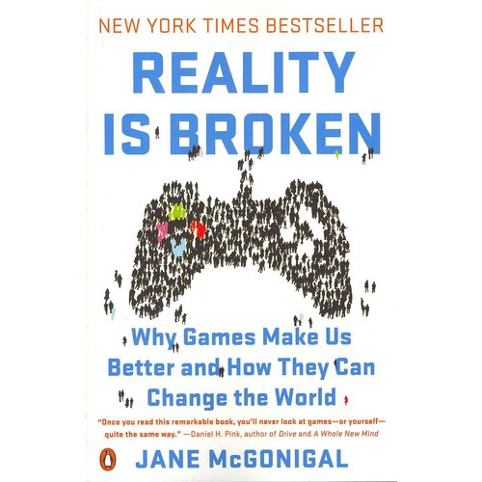
http://janemcgonigal.com

Slide 19
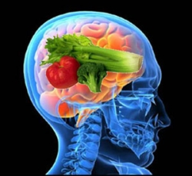
Nutrition
Critical factors to your enriched environment
Increase OMEGA-3 fatty acids
Decrease processed foods/bad fat
Increase anti-oxidants
Eat with utensils to reduce calories
Nutrition

Slide 20

Notes:
Here’s a great example of how to brand to a lifestyle not a chronological age. Denver’s Fresh City Life brand appeals to active adults of all ages- people who are hip and urban with interests in arts and culture, food, books and authors, and performance.

Slide 21


Nutrition

Slide 22
Spiritual Activity
Critical factors to your enriched environment
Slow
Down!
Learn relaxation procedures
Learn how to meditate
Pray daily
Attend formal places of worship regularly
Say NO!
One family/group meal daily
Spirituality
Paul D. Nussbaum, Ph.D.
Notes:
Cultivating your spiritual side can be very valuable to your brain
Practices such as prayer and meditation can reduce anxiety and depression and may help improve memory
Deriving social support and enhanced coping via religious and spiritual beliefs can aBeing religious has been shown to be associated with lower levels of stress, anxiety, and depression
Something inherent vs specific effects
Religion and spirituality provides mechanism for coping, social support, and reducing ontological anxiety
lso support the brain’s functions

Slide 23
Multnomah County Library

Slide 24
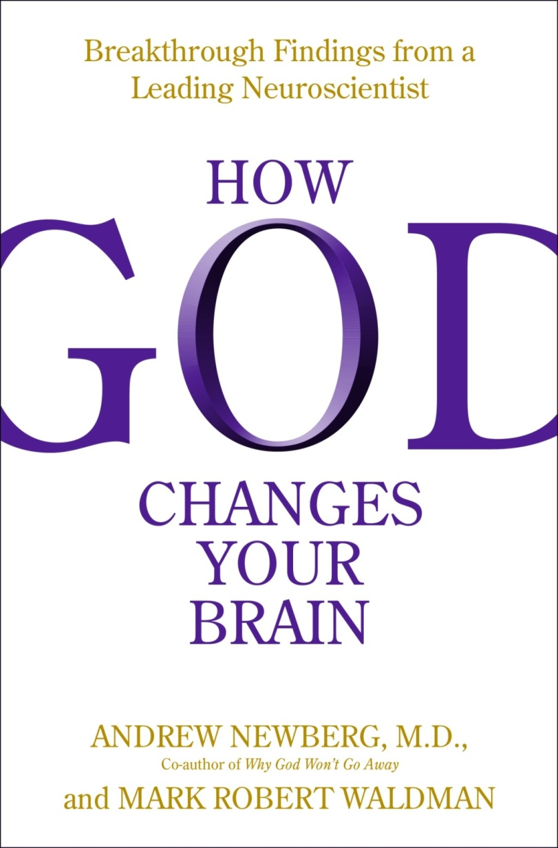

Notes:
Purpose in life modifies the association of pathology with cognition- High purpose, better cognition even given greater burden of path

Slide 25
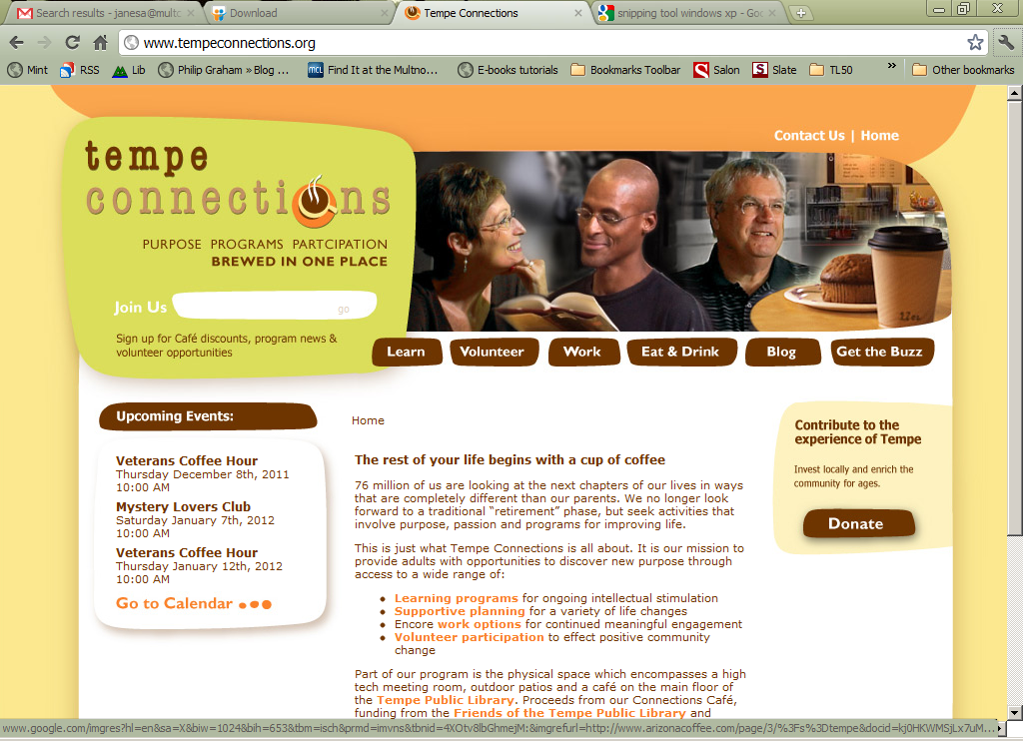
Notes:
Another collaboration, Tempe Connections resulted from strategic efforts by the Tempe city government, led by the public library, to respond to the growing numbers of people in retirement transition who were relocating to their area. Promoted as “purpose, programs and participation brewed in one place,” Tempe Connections offers a physical space that includes a high tech meeting room, outdoor patios and a café on the main floor of the Tempe Public Library. Partnerships with community organizations bring expertise, access to markets, and volunteer opportunities.

Slide 27
Work Group Instructions
Join a group focused on one of the five domains of the brain healthy lifestyle.
Select a recorder and a reporter for the group. 5 mins
Identify/ define an outcome(s) that your Library as Brain Health Center seeks to achieve for your lifestyle domain. 10 mins
Brainstorm and list the “resources” (see worksheet- collections, database, websites, web-based tools and games, partners, and programs/events) that will help you achieve the outcome(s) defined above. 35 mins
Define the metrics by which you will measure your success/ progress in building your Library as Brain Health Center. 10 mins
Prepare your key findings, strategies, gaps and recommended next steps for presentation to the full group. 15 mins

Slide 28


Questions? Aha’s!

Slide 29

For more information, please contact
Stephen Ristau
PurposeWork
stephenristau@gmail.com
503-281-4305

