Slide 1
Dinosaurs, Dogs and Dump Trucks: Informational Text for Our Youngest Learners
Lisa Sensale Yazdian, Ph.D. Youth Services Manager-Outreach
Cindy Yeager, Collection Development Librarian
Customized for ICfL, 2015
Jeannie Standal

Slide 2
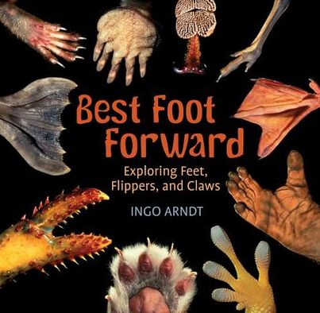
What is informational text?
Subset of the larger category of nonfiction.
Purpose is to inform readers about the natural and social world (Duke & Bennett-Armistead, 2003)
Notes:
Not all nonfiction is informational text. Informational text is a subset of nonfiction.

Slide 3
What is informational text?
Common features:
Table of contents, index, glossary
Specialized vocabulary
(sometimes bolded or in italics)
Different text structures
Notes:
All kinds of informational text have some common features, and some of them are also common to other types of non-fiction:

Slide 4
What is informational text?
Different Text Structures
Description
Cause/effect
Sequence
Problem/solution
Compare/contrast
Notes:
According to Dr. Joanna Williams at the Teacher College at Columbia University, informational text is more difficult for new readers to understand than narrative text because it can be more abstract and more formal. Unlike fictional narrative text, there are a number of text structures in informational texts, and students must learn to identify them while reading. As they are able to identify the text structure, they also learn to use clue words, ask questions, and use graphic organizers to better comprehend the information in their reading.
These are the different Text Structures:

Slide 5
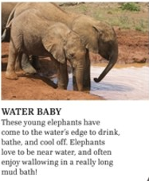
What is informational text?
Generalized nouns and timeless verbs
Fish live in water vs. That fish…
Elephants are equally at home in thick forests or dry grassland.
Realistic illustrations or photos
Notes:
Some other common features are:

Slide 6
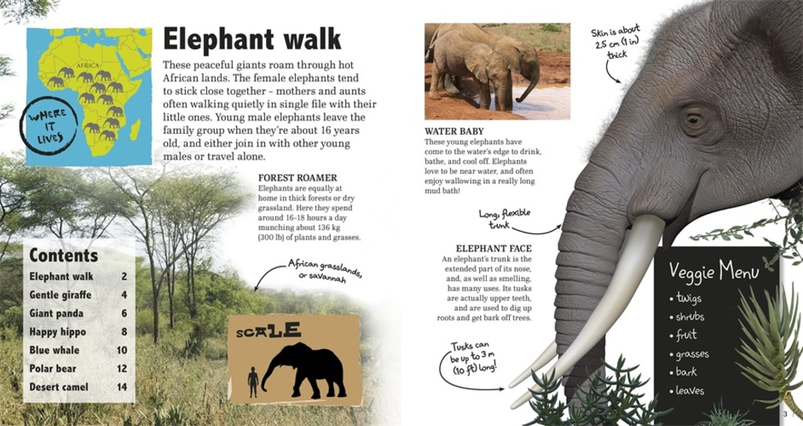
What is informational text?
Labels and captions
Notes:
Labels and Captions are another common feature in informational text.

Slide 7
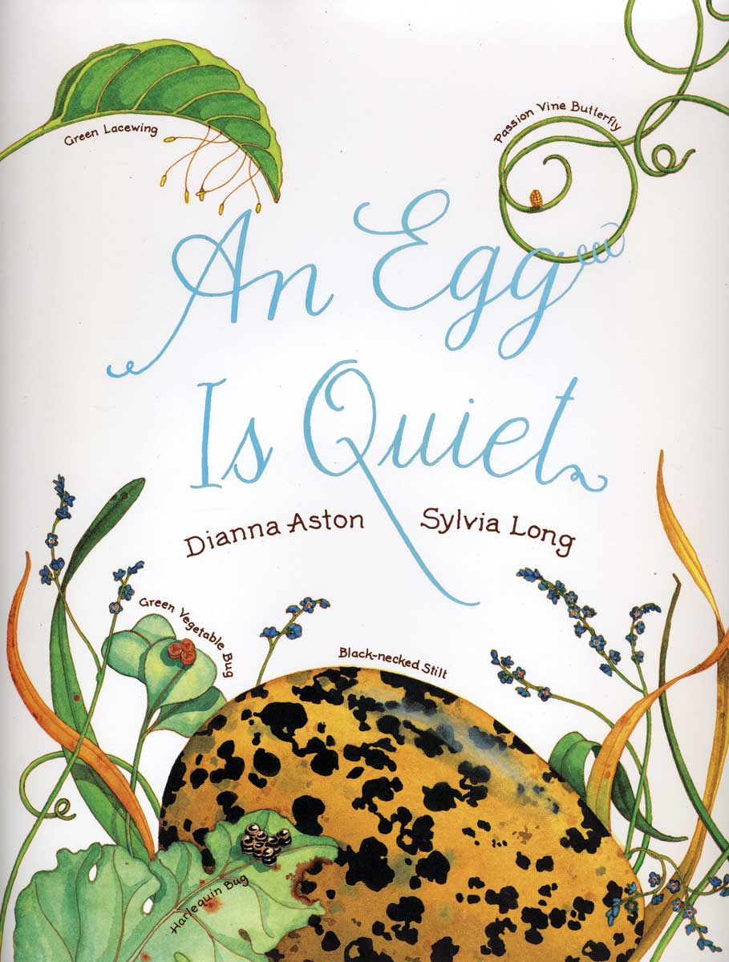
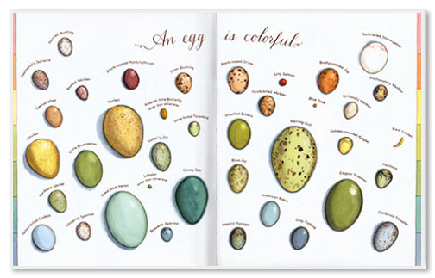
What is informational text?
Topic/Theme Based
Notes:
There is usually a specific topic or theme. Reference books, like encyclopedias, have lots of topics, but regular monographs like these usually stick to one thing.

Slide 8
What is informational text?
Books do not have to include all features in order to be considered informational.
Notes:
Every book does not have to have everything.

Slide 9
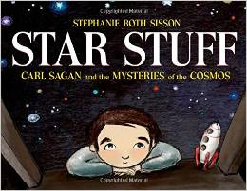
What is informational text?
What isn’t Informational Text?
Does not include [under Duke & Bennett-Armistead (2003)]:
Biography
Procedural
Nonfiction Narrative
Notes:
According to Duke and Bennett-Armistead, types of nonfiction that are not information text are Biography, procedurals or how-to’s, and narrative nonfiction like true stories.

Slide 10
“Informational Text” per CCSS
Et al.
Explanatory/
Informational Text
Persuasive
Text
Procedural
Text
Biography & Autobiography
Nonfiction Narrative
*All types are important!
*Have different purposes and features.
*Read and composed differently.
(Duke, 2013a)
Reference Books
“All about” informational texts;
Process informational texts;
Informational poetic texts, etc.
Encyclopedias;
Field guides;
Atlases, etc.
(Duke, 2013a)
Notes:
However, The Common Core State Standards take a broader view of information text, to include most of nonfiction. And there are some gray areas between the narrower definition and the CCSS definition.
Use Amazing Giant Wild Animals: informational text all the way. Has a variety of texts, realistic pictures, captions, labels, table of contents, maps, lists! It is fabulous informational text.
Star Stuff is top notch non-fiction about Carl Sagan. Very much a biography with some space and science stuff in there.
But The Right Word falls somewhere in the middle. It is about Roget and the development of the Thesaurus. It is heavy on the biographical information, but it also covers how a “thing,” the Thesaurus, came about. It has a bibliography, cites its sources, It is a Sibert winner and a Caldecott Honor book. I would certainly include it in my elementary school collection and promote it as informational text.

Slide 11
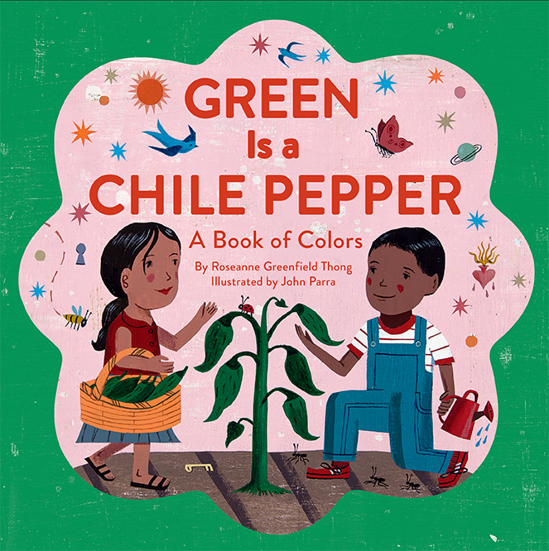
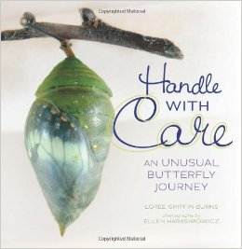
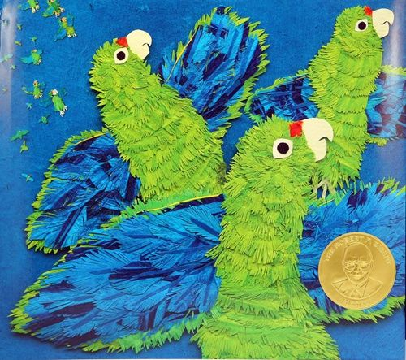
Why is it important to share informational text with our youngest learners?
Notes:
Why is it important to have all of this nonfiction and informational text available to our students?
To start, the first shift of the Idaho Core Standards says “Students will build knowledge and academic language through a balance of content rich, complex nonfiction and literary texts.” For our youngest students, that means about a 50/50 split between informational and literary text. And keep in mind that they will be getting some of that 50% of informational text in their classroom work.
Next, Shift Two says students will participate in Reading/Writing/Speaking that is grounded in evidence from the text across the curriculum. In order to support that, they need to become skilled at reading texts with evidence, not just opinion and narrative.
Plus, kids love it!

Slide 12
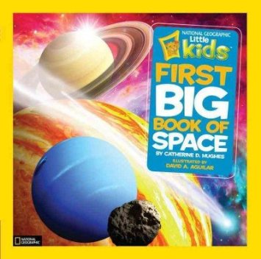
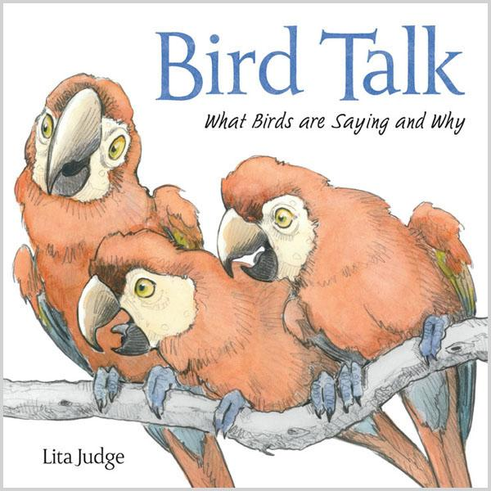
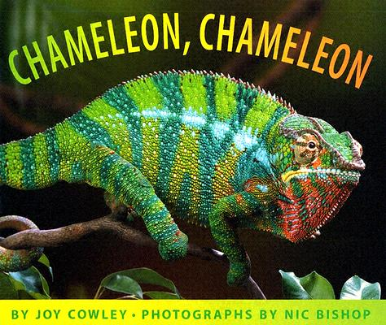
Motivation
Kids are inherently curious about the world around them (Duke, 2003)
Notes:
Young kids want to know about real things. Animals, sports, ballet, science, planets, colors, numbers. They are motivated to read nonfiction because they are super interested.

Slide 13
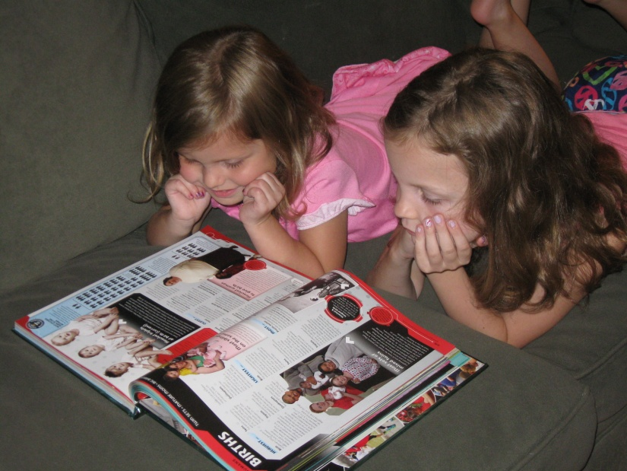
Motivation
Different kids have different reading preferences and topic interests (Duke, 2003)
If they are interested in the topic, they are likely to persist with the text (Caswell & Duke, 1998; Jimenez & Duke, 2011, as cited in Duke, 2013)
Notes:
Along those lines, different kids are interested in different things. We probably didn’t need a study to tell us that different kids have different reading interests and if they like reading about a topic, they are likely to want to read more about it. Even without data to verify, we can observe this every day in our libraries.

Slide 14
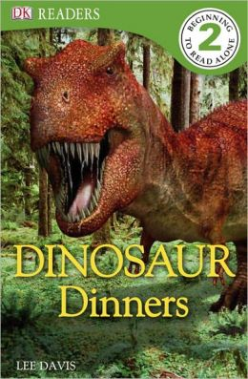
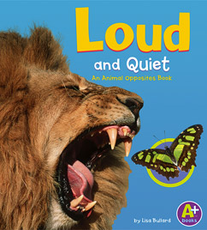
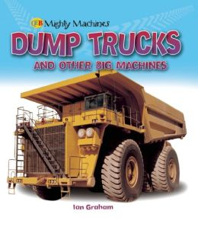
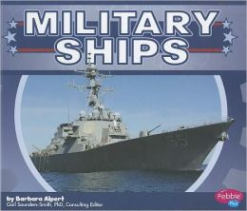
Motivation
May help at risk kids and those struggling to read (Duke, 2003)
May help boys find a niche (Pentimonti, et al, 2010, Grawemeyer)
Bridges home and school (Duke and Purcell-Gates, 2003)
Notes:
Nonfiction of all types, including informational texts can be the very stuff that appeals to those reluctant readers. Lots of boys find their passion for reading in nonfiction.
Like those World Records books – can you keep those on the shelves?

Slide 15
World/Background Knowledge
Influences overall reading comprehension and use of comprehension strategies (Cromley & Azevedo, 2007)
Informational text teaches children about the world around them (Anderson & Guthrie, 1999, as cited in Duke, 2003; Duke & Kays, 1998; Mantzicopoulos & Patrick, 2012; Sackses, Trundle & Flevares, 2009)
Reading and writing is used to communicate and obtain information (Duke, 2003).
Science (Baker, 1998, as cited in Mantzicopoulos & Patrick, 2011)
Connected to everyday life
Not too difficult
Women can have STEM careers
Notes:
Informational text helps kids practice those comprehension strategies that are connected with the text structures we talked about earlier.
Helps kids learn about the world around them and the world that is not immediately around them.
Kids can also connect science to everyday lives and, through books, see all kinds of people in those careers. They might see someone who looks like them in a career they hadn’t considered.

Slide 16
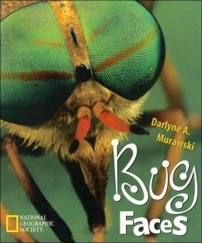
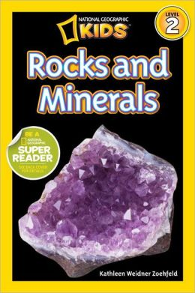
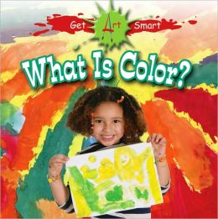
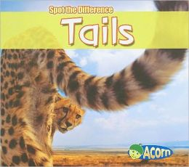
Oral Language and Vocabulary
More varied and technical words related to content helps build vocabulary (Pentimonti, 2010, Wixson)
Good captions and illustrations help with inferential language skills (Pentimonti, 2010)
Notes:
Vocabulary and language building is a huge reason for young children to read informational texts. There are rare and technical words in them, and since good informational texts for young readers have realistic pictures and captions, kids can infer the meanings of the words. Cool!

Slide 17
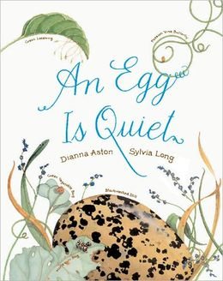
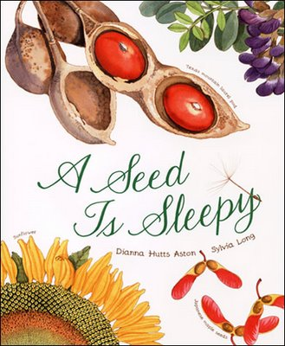
Oral Language and Vocabulary
Helps with comprehension by building background knowledge (Korbey, 2013, Wixson)
Teachers and parents discuss vocabulary and concepts more (Duke, 2003)
Notes:
More reading of informational text, (but not just informational text) means kids are building background knowledge, which makes comprehension easier. It is always easier to understand and remember the meaning of a text when we have background knowledge and familiarity with the terms used for that subject.
Teachers and parents can talk with the students more about what they’ve read. While out and about they can identify eggs, butterflies and seeds, and other things they may have read about. It helps the new vocabulary stick.

Slide 18
Later Schooling
“Read to learn”
Must learn to read, write and understand multiple genres.
96% of the text on the WWW is expository (Kamil & Lane, 1998)
Most of what adults read in and out of work is informational.(Venezky, 2000)
Notes:
Early vocabulary building helps with reading to learn in the upper grades and into adulthood. Everyday we have to read and understand all kinds of different texts.
Think about what you read yesterday. How much was informational text? Who read the newspaper or a magazine article? Who followed a recipe? Read the nutritional information on a box of cereal?
96% of text on the WWW is expository. Some of my most used sites: imdb, Wikipedia, blogs. I don’t read literature online.
If your students are interested in STEM careers, they will have to be really good at reading informational text.

Slide 19
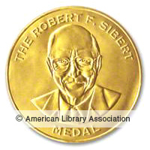
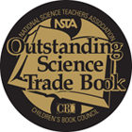
selecting great informational texts students want to read:
Reliable sources for nonfiction for young readers:
School Library Journal Best Books: Nonfiction.
NCTE Orbis Pictus Award for Outstanding Nonfiction for Children
ALSC’s Sibert Informational Book Medal
NSTA Outstanding Science Trade Book for Students K-12
Notes:
So, we have the characteristics of informational text and nonfiction, we know what it is and we know why we want it. And there are a lot of wonderful materials out there, but how do we identify the best ones, and the materials that maybe aren’t so good. But how do we know if those materials are worth our precious, hard-earned book dollars?
We can start with sources we trust like award winners.
What are some of your favorites for the younger kids?

Slide 20
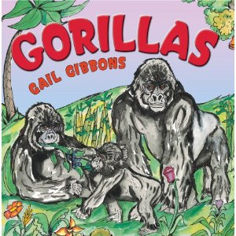
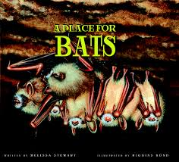
Correll Book Award for Excellence in Early Childhood Informational Text
Established 2011; first award given 2012
Bring attention to outstanding informational text written for children birth-8.
Be available in the U.S. and published in English year prior to award.
Have been designed for children birth to age 8
Serve as an exemplar of features and format of Informational Texts
Can be part of a series
Winner 2012
Winner 2013
http://umaine.edu/edhd/professionals/mels/correll-book-award/
Notes:
And here is a newer award to check out.
What are some of your favorites?

Slide 21
selecting great informational texts students want to read:
Some reliable publishers:
National Geographic
Capstone (especially their Pebble Plus titles for this age group)
DK
Others?
Notes:
Here are some reliable publishers. Are there others you really like?

Slide 22
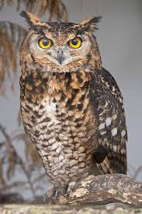
Good informational texts are:
Accurate and Authentic:
Is the author qualified to address this topic? Is the source reliable?
Are the facts supported by other resources?
Is the writing current?
If there are generalizations, are they supported by facts?
Does the author avoid stereotyping and anthropomorphism?
Is the topic thoroughly covered?
(from Lynn Johnson, M.E.T. at https://sites.google.com/a/sd244.org/ljnonfiction/home - next 5 slides)
Notes:
What about after we exhaust our tried and true sources? There are wonderful titles available that are not award winners. We’ll quickly go through a checklist to help identify good informational texts. I borrowed this checklist from Lynn Johnson, who has all this available on a website right here.

Slide 23
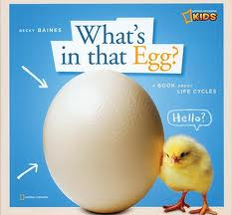
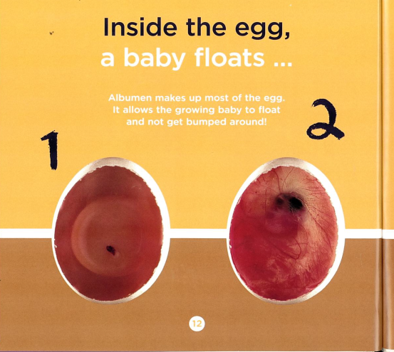
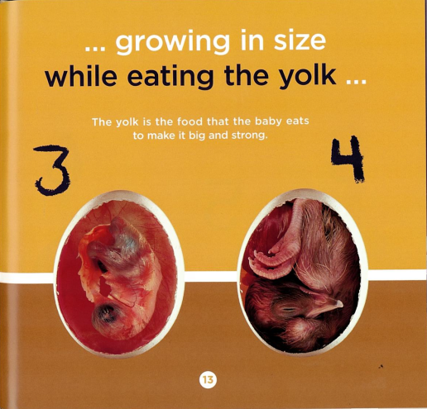
Good informational texts are:
Well Organized
Are there subheadings, highlighted key words, and sidebar explanations?
Do graphics & definitions aid reader understanding or clutter the page?
Does the information flow from beginning to end?
Are there other reference aids including a table of contents, index, bibliography, glossary, or appendix?
Is the text font easy to read and appropriate for the reader? Should be able to effortlessly follow the text along each page (Stephens, 2008)
Notes:
Is the page easy to read and understand. Does it flow well?
Can you easily find the sources of the information?

Slide 24
Good informational texts are:
Supported by Clear Illustrations
Is the book attractive and would I want to read it based on the illustrations?
Do the illustrations include captions or labels when appropriate?
Do the illustrations make the work seem cluttered or too busy?
Do the illustrations add to the text or clarify the main idea?
Are size relationships made
clear by the illustrations?
Do the illustrations make you want to
pick up the book and learn more?
Notes:
Illustrations can make or break an informational text. They are very important, especially for the younger set.

Slide 25
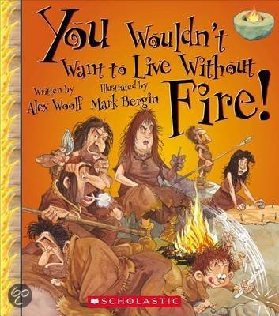
Good informational texts are:
Appropriate for the Audience
Is the information easy to understand?
Does the style of presentation entice the reader to learn more?
Does the style of presentation match the topic?
Does the author use interesting and appropriate language aligned with topic and reading level?
Does the overall presentation seem attractive and inviting to the intended audience and purpose?
Notes:
Of course, we would think about if a book is appropriate to our age group. Another thing we might consider is if the style of presentation is appropriate for the topic. It would be pretty tough to use a funny style like “You Wouldn’t Want to Live Without Fire!” with a topic like “Animals Helping to Detect Diseases.”

Slide 26
Good informational texts are:
Clear in Content and Perspective
What is the purpose of the book?
Is the topic of the book thoroughly addressed and does it include a variety of viewpoints?
Does the book encourage inquiry?
Are interrelationships examined within the book?
Does the book aid in the understanding of the scientific method?
Is the author attempting to persuade the reader?
Do you feel the topic is covered in a balanced manner?
Notes:
This is a lot of information to consider while evaluating a book. Not every one of these points will be applicable to every book you look at.
If the author is attempting to persuade the reader, it may not be great informational text.

Slide 27
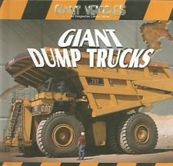
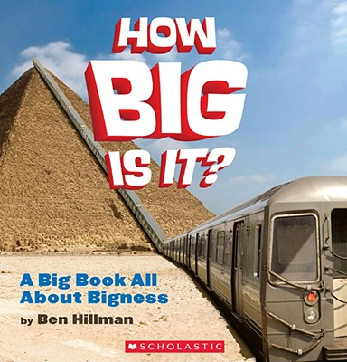
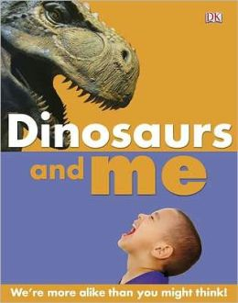
Selecting Informational Text for Young Learners
Covers
Crisp, colorful illustrations or photographs
Short, enticing title (Stephens, 2008)
Notes:
And the cover should be intriguing and be an invitation to find out what is inside the book!

Slide 28
Activity: what’s best for your collection?
Good informational nonfiction is:
Accurate and Authentic
Well Organized
Supported by Clear, Realistic Illustrations
Appropriate for the Audience
Clear in Content & Perspective
Notes:
Take a look at some of the books on your table, that you’ve brought with you, or some that have been won as door prizes.
What grades would they work best for? Would you purchase those titles for your library? Why or why not?
You can use the check list in the back pocket of your binder. If you find it useful, you can make copies of the backside.
We’ll share our findings in about 20 minutes.

Slide 29
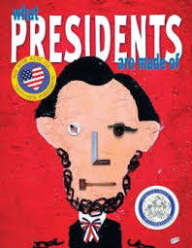
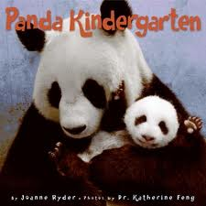
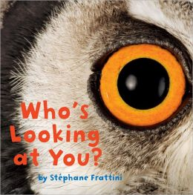
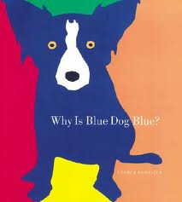
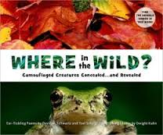
Why Read Informational Text Aloud?
Benefits of reading aloud to children
Develop content knowledge
World knowledge
Vocabulary (Duke, 2003)
Notes:
A few words about reading aloud: It isn’t easy to read some of these books aloud. Some of the very things that make good informational text make difficult read alouds.
The great thing that you don’t have to read every caption and side bar. You can gage your audiences interest and time frame and go from there.
Another bonus: when you don’t read all the text aloud, when the kids read the book themselves, they discover things in the book on their own. Use The Right Word as an example.

Slide 30
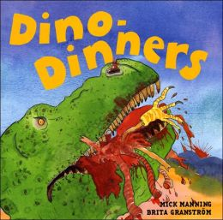
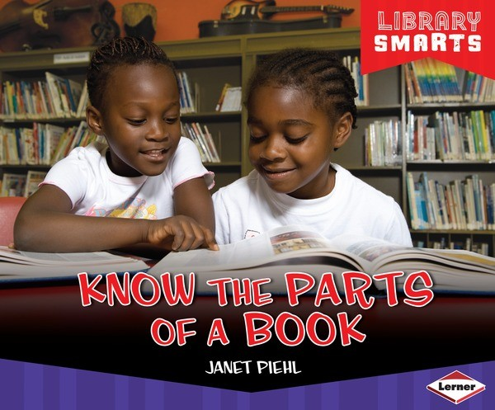
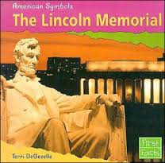
Selecting and Preparing Good Titles to Read Aloud
How to select (Duke, 2003)
Select topics they are curious about (Grawemeyer)
Relevant to lives and experiences (Pentimonti, 2010,
Yopp, et al, 2012, Grawemeyer)

Slide 31
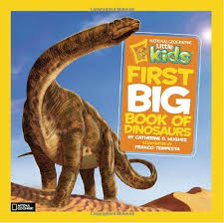
Selecting and Preparing Good Titles to Read Aloud
How to Prepare
Practice!
Pronunciation
Know your dinosaurs!
Learn rhythm of book
Enthusiasm
If you don’t like it, don’t read it (Yopp, et, al, 2012, Grawemeyer)
Notes:
In addition to knowing your dinosaurs, (because you know they do!) you will want to model the correct pronunciation of other words.
Kaliope example.

Slide 32
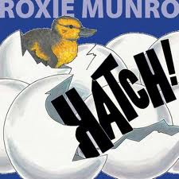
Before Reading Aloud
Why did you choose book? (Duke, et, al, 2003)
What do they know? (Grawemeyer)

Slide 33
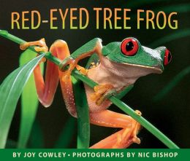
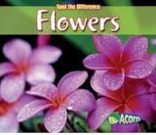
How to Read Aloud
As you are reading:
Tease or make predictions
Show a picture
What might happen?
Encourage participation
(Yopp, et, al, 2012)

Slide 34
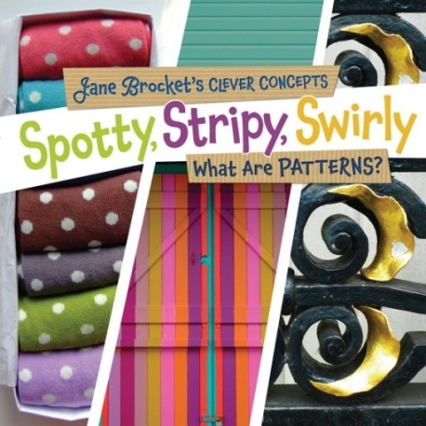
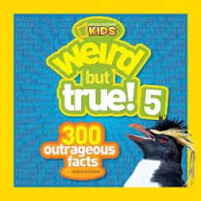
How to Read Aloud
As you are reading (cont)
Highlight new words
Share graphs, etc
Paraphrase if needed
Re-read an important passage (Yopp, et, al, 2012, Grawemeyer)
Use ice breakers (Johnson, 2013)

Slide 35
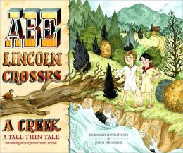
After Reading Aloud
What new thing did you learn?
Show other books on topic (Grawemeyer)
Notes:
You can use Novelist K-8 to find read-alikes.

Slide 36
Other Uses
Pair with narrative text (Grawemeyer)
Notes:
Pairing with narrative or fiction is a great way to help students entrenched in either fiction or nonfiction cross over to the other side.

Slide 37
Authentic Literacy: Setting the Stage
Demonstrations, Investigations, Discovery Centers
Provide experiences that spark interest and questions about a topic.

