Slide 1
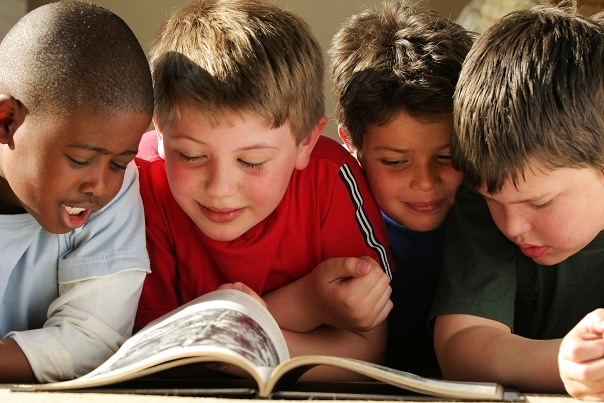
Motivating kids to read
Choice
Voice
Time

Slide 2
Importance of self-selection
Free, voluntary reading is essential to helping students become better readers, writers, and spellers.
Students read more when they can choose materials based on their own interests.
It is important that students read things that are important to them socially--items related to movies and books that are popular with their friends.
Self-selection of reading materials is an extremely important factor in motivating struggling readers, and is a key component for most summer library programs.
Kim, Jimmy. March 18, 2004. Summer Book Reading and the Achievement Gap The Role of Public Libraries. Harvard, MA: Center for Evaluation, Harvard University Krashen, Stephen. "Time Out." School Library Journal September 1, 2006. McGill-Franzen, A. and R. Allington. "Lost Summers: For Some Children, Few Books and Few Opportunities to Read." Classroom Leadership. August 2001. The Center for Summer Learning at Johns Hopkins University. McGill-Franzen, Anne and Allington, Richard. "Use Students' Summer-Setback Months to Raise Minority Achievement." Education Digest. November 2003, Vol. 69:3.

Slide 3
Factors that Influence book selection
From Summer Reading: Closing the Rich/Poor Achievement Gap. Richard Allington and Anne McGill-Franzen, 2013. Chapter 3, “The Importance of Book Selections: Enticing Struggling Readers to Say, ‘I Want to Read That One!’”
Media and Mass Marketing (Give me books about musicians and superheroes)
Other People (What you read and do impacts my book selections)
Life Experiences (I want to read about where I’ve been and where I want to go)
Notes:
Media: Not specifically just musicians and superheroes, but what kids are seeing in pop culture. What is “trending.”
Other people: Includes peers, but this is also where book talks by peers and adults can advocate for high-quality literature kids may not pick up on their own.
Life experiences: Personal connections, personal interests, the “unusual” like volcanoes and sharks.

Slide 4
The Reading Teacher published an article called “Recreational Reading: 20 Years Later,” by Cathy Collins Block and John Mangieri in 2002. In 1981 surveyed 571 elementary educators from three states to determine teachers’ knowledge of
Current children’s literature
Children’s books in six literary genres
Activities that could be used to promote students’ recreational reading
Did the same survey again in 2001.

Slide 5
Students who spent more time in recreational reading activities:
Scored higher on comprehensive tests in grades 2, 4, 8, and 12
Had significantly higher grade point averages
Developed more sophisticated writing styles than peers who did not engage in recreational reading
Even when elementary students read for only 15 minutes a day they significantly increased their reading abilities. Average and below-average readers experienced the greatest gains.
(Source: Reaching Reading Sourcebook)

Slide 6
% of teachers who could name three children’s books published within the past five years:
1981 Study
2001 Study
9%
71% could not name a single book published within the last five years
36%
17% could not name a single book published within the last five years
Study showed teachers were either VERY knowledgeable about recently published children’s literature and diverse things they could do to motivate students to read or NOT knowledgeable about that.
Teachers who had a high knowledge of these areas (about one-third) were lifelong readers themselves.

Slide 7
Your Turn:
List three children’s books written in the past five years.
Name a children’s book written in the past seven years in each of the following categories
Fiction
Biography
Poetry
Fantasy/science fiction
Picture book
Mystery/adventure
Nonfiction/Information text (not on survey – Stephanie added ☺)
3. Identify three or more activities used to promote recreational reading for students.

Slide 8
Novelist K-8
Your new best friend

Slide 9
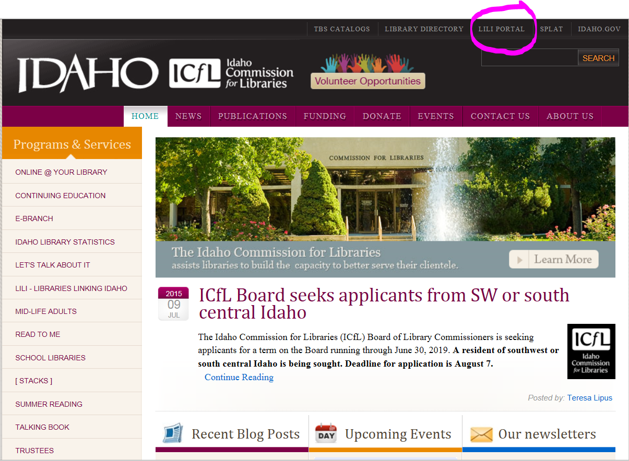
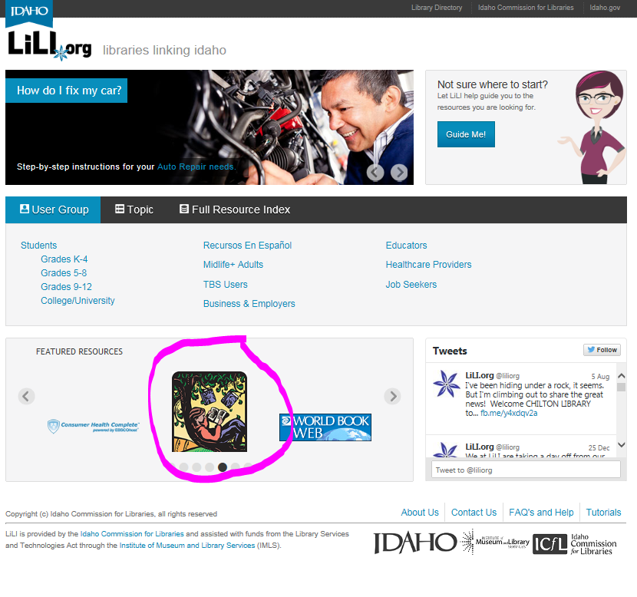
Libraries.Idaho.gov

Slide 10
Table discussions
How can we share literacy and literature resources with
Teachers
Parents
Students?

Slide 11
How to share this information with families
Consider participating in Idaho Family Reading Week, November 15-21. “Curl up with a Classic!”
It’s great when you can partner with your public library. We’d like every child to have a public library card and make use of those services.
Other ideas: Dads and Donuts, Moms and Muffins, having a presence at Parent Teacher Conferences, other ideas?

