Slide 1
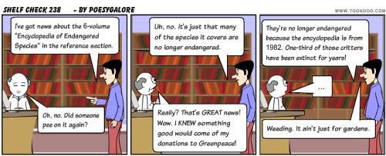
A Word (or two) About Weeding

Slide 2
Collection Development
Funding
Selecting
Assessing
Weeding
Marketing
Collaborating
Policy
Notes:
This graphic represents the collection development cycle. We see that there is not a beginning or end to the cycle. It is never finished – like laundry. So lets go with a clothing analogy for a minute.
Different pieces enter into the cycle (hello beautiful new summer dress), and some pieces must exit the cycle (good-bye wide-collared polyester disco print from 1978). Same with library materials.
It is essential to eliminate outdated and damaged items from the collection to keep it relevant (fashionable and not too worn) and to keep the size of the collection appropriate to the size of the physical space (must fit into the closet).
Each library’s plan for these elements will be different, depending on their circumstances. But each of these elements must be addressed in a Collection Development policy.
Today, we address weeding.

Slide 3
Develop a Weeding Policy:
Includes the purpose for weeding your collection and why weeding is necessary.
Sets criteria for weeding using best practices.
Describes the process for weeding and who is responsible.
Sets process for disposing of weeded materials.
Is part of your Collection Development Plan.
And, it helps you decide what gets weeded.

Slide 4
Sample Weeding Section:
“Deselection, the act of removing materials from the library is a necessary practice in order to preserve the quality of the collection by removing items that are outdated, worn/ broken or no longer needed. This also frees up space for materials that will better serve the patrons.
Library Staff will use the CREW method throughout the year to remove items on an as needed basis. At the conclusion of each school year, library staff will conduct a large scale weeding project to remove items that need removed, but have been missed. Staff will use the MUSTY acronym to determine weeding. Items will be removed if they are: misleading or obsolete, ugly or worn out (physically unappealing), superseded by a newer version, trivial, or the collection no longer needs the item. “
From Boone County Schools in Florence KY http://www.boone.k12.ky.us/docs/building/14/depts/94/library%20collection%20development%20policy.pdf

Slide 5
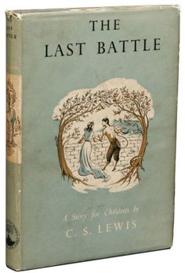
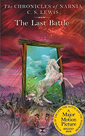
Weeding Methods to use together:
CREW:
MUSTIE:
Continuous Review, Evaluation & Weeding.
Uses a formula developed from information in the Weeding Policy.
Misleading (and/or inaccurate).
Ugly (worn and beyond repair).
Superseded (new and/or better edition).
Trivial (of no discernible literary or scientific merit).
Irrelevant to the needs and interests of your library.
Elsewhere (through LiLI databases).

Slide 6
Decoding CREW:
CREW Formula uses 3 figures: 5/3/MUSTIE
The first figure denotes the age of materials that can be considered for weeding.
The second figure refers to the last circulation of the item. Items that haven’t been checked out for that number of years can be considered for weeding.
The third figure refers to the MUSTIE factors.

Slide 7
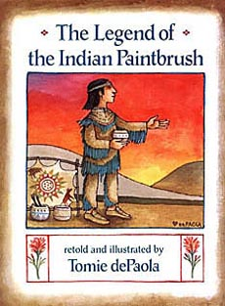
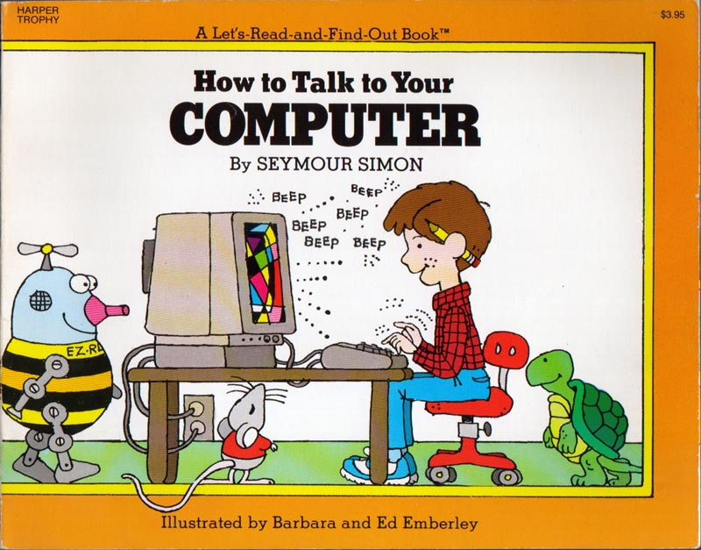
Examples of CREW formulas:
398s – Folklore 10/3/MUSTIE
age of materials =10 years
last circ =3 years
MUSTIE factors
004s – Computers 3/1/MUSTIE
age of materials =3 years
last circ =1 years
MUSTIE factors
Notes:
Some items can be kept indefinitely, like folk tales. The X means there is not definite number of years after which this book should be weeded because of outdated information. If it hasn’t circulated in 3 years, it should considered a candidate for weeding.

Slide 8
Examples of CREW formulas:
900 – History & Geography
3/2/MUSTIE
Watch for changes in country names and for political changes that result in new or reformed countries.
Example: Weed books that still refer to USSR.
Notes:
This doesn’t seem like a category that should have a short life, but borders and governments can change very quickly in some parts of the world.
We don’t want a book on our shelves that still refers to the former Soviet Union rather than the individual countries they are today.
So here we look at books that are older than 3 years old, haven’t circulated in 2 or more years and/or fail the MUSTIE test.

Slide 9
Examples of CREW formulas:
Fiction – circulation is the primary factor for weeding fiction. Discard extra copies of titles that are no longer heavily circulated. X/2/MUSTIE
Series - consider discarding all titles in a series if you are not able or willing to replace missing titles, especially if the books do not stand along.
Graphic novels are a format, not a genre and can be classified anywhere depending on content. X/1/MUSTIE
X=not an issue

Slide 10
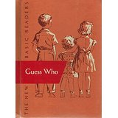
Some considerations for School Libraries:
School library collections should always support the curriculum, both formal and informal.
Take care of your faculty by keeping the books they always use in stock and in good condition.
Notes:
School library collections should always support the curriculum – especially as the curriculum changes.
We are experiencing that a little bit the shift to the Idaho Core Standards and more emphasis on informational text and non-fiction.

Slide 11
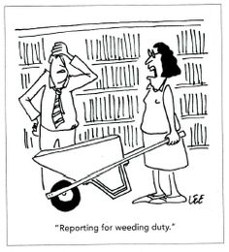
How do you do it???
Get your policy out, review it, and go to work. If you don’t have a policy-write one NOW!!!!
Weed continuously throughout the year.
Weed a few books at a time.
Stamp “withdrawn” or “discarded”. Otherwise, they will come back to you.
Make sure that you remove the holding from your online catalog-or card catalog.
Notes:
You’ve done a huge weeding project. You are done!
Then someone spies you hauling boxes of books out to the dumpster. Yikes!
So how do you get this done? Here are some suggestions:

Slide 12
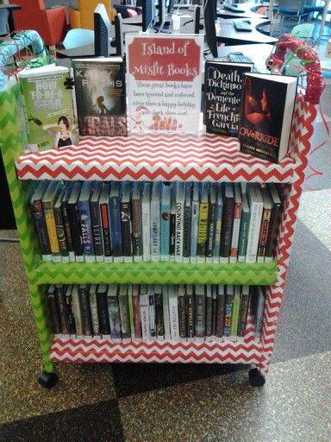
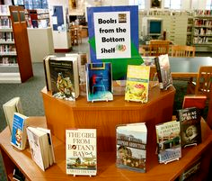
A book’s last chance:
Display and promote:
“One Foot in the Grave” : a book display at Halloween gets the students involved in choosing which low circulating books will be resurrected.
Ignore the Cover

Slide 13
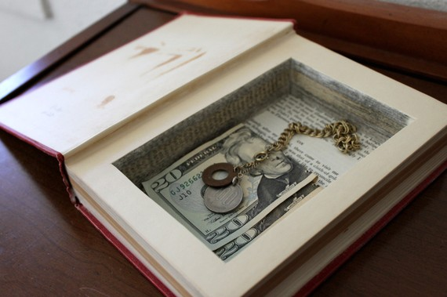
A book’s second life:
Offer them to staff and students.
Have a book sale.
Send them to another library.
Use them for book crafts.

Slide 14
Let’s play a game: Weed it or Keep it
I pity the fool that weeds this book!

Slide 15
Let’s play a game: Weed it or Keep it
Using the MUSTIE method, determine if you would weed it or keep it
Misleading (and/or inaccurate).
Ugly (worn and beyond repair).
Superseded (new and/or better edition).
Trivial (of no discernible literary or scientific merit).
Irrelevant to the needs and interests of your library.
Elsewhere (through LiLI databases).

Slide 16
For More Information:
For the complete CREW: A Weeding Manual for Modern Libraries, go online at the Texas State Library and Archives Commission website. https://www.tsl.texas.gov/sites/default/files/public/tslac/ld/pubs/crew/crewmethod08.pdf
Or Google CREW: A Weeding Manual for Modern Libraries.
Take a free online course on collection development (a section on weeding is included) http://libraries.Idaho.gov/page/able

Slide 17
Motivating kids to read
Choice
Voice
Time

Slide 18
Importance of self-selection
Free, voluntary reading is essential to helping students become better readers, writers, and spellers.
Students read more when they can choose materials based on their own interests.
It is important that students read things that are important to them socially--items related to movies and books that are popular with their friends.
Self-selection of reading materials is an extremely important factor in motivating struggling readers, and is a key component for most summer library programs.
Kim, Jimmy. March 18, 2004. Summer Book Reading and the Achievement Gap The Role of Public Libraries. Harvard, MA: Center for Evaluation, Harvard University Krashen, Stephen. "Time Out." School Library Journal September 1, 2006. McGill-Franzen, A. and R. Allington. "Lost Summers: For Some Children, Few Books and Few Opportunities to Read." Classroom Leadership. August 2001. The Center for Summer Learning at Johns Hopkins University. McGill-Franzen, Anne and Allington, Richard. "Use Students' Summer-Setback Months to Raise Minority Achievement." Education Digest. November 2003, Vol. 69:3.

Slide 19
Factors that Influence book selection
From Summer Reading: Closing the Rich/Poor Achievement Gap. Richard Allington and Anne McGill-Franzen, 2013. Chapter 3, “The Importance of Book Selections: Enticing Struggling Readers to Say, ‘I Want to Read That One!’”
Media and Mass Marketing (Give me books about musicians and superheroes)
Other People (What you read and do impacts my book selections)
Life Experiences (I want to read about where I’ve been and where I want to go)
Notes:
Media: Not specifically just musicians and superheroes, but what kids are seeing in pop culture. What is “trending.”
Other people: Includes peers, but this is also where book talks by peers and adults can advocate for high-quality literature kids may not pick up on their own.
Life experiences: Personal connections, personal interests, the “unusual” like volcanoes and sharks.

Slide 20
Students who spent more time in recreational reading activities:
Scored higher on comprehensive tests in grades 2, 4, 8, and 12
Had significantly higher grade point averages
Developed more sophisticated writing styles than peers who did not engage in recreational reading
Even when elementary students read for only 15 minutes a day they significantly increased their reading abilities. Average and below-average readers experienced the greatest gains.
(Source: Reaching Reading Sourcebook)

Slide 21
The Reading Teacher published an article called “Recreational Reading: 20 Years Later,” by Cathy Collins Block and John Mangieri in 2002. In 1981 surveyed 571 elementary educators from three states to determine teachers’ knowledge of
Current children’s literature
Children’s books in six literary genres
Activities that could be used to promote students’ recreational reading
Did the same survey again in 2001.

Slide 22
% of teachers who could name three children’s books published within the past five years:
1981 Study
2001 Study
9%
71% could not name a single book published within the last five years
36%
17% could not name a single book published within the last five years
Study showed teachers were either VERY knowledgeable about recently published children’s literature and diverse things they could do to motivate students to read or NOT knowledgeable about that.
Teachers who had a high knowledge of these areas (about one-third) were lifelong readers themselves.

Slide 23
Your Turn:
List three children’s books written in the past five years.
Name a children’s book written in the past seven years in each of the following categories
Fiction
Biography
Poetry
Fantasy/science fiction
Picture book
Mystery/adventure
Nonfiction/Information text (not on survey – Stephanie added ☺)
3. Identify three or more activities used to promote recreational reading for students.

