Slide 1


Don’t Let the Babies Rattle You: tips and tools for shaking up your infant storytime
Julie Patricia, Associate Librarian
Ada Community Libraries, Victory Branch
Boise, Idaho
jpatricia@adalib.org
Notes:
SLIDE ONE
Hello! My name is Julie Patricia, and I’m an associate librarian at the Victory Branch of the Ada Community Libraries.
Five years ago I became a long-term substitute for the infant storytime (we call it Baby Rhyme Time) at the Lake Hazel Branch of the Ada Community Libraries. I brought the program with me when I moved to the Victory Branch in January 2016, but the basic format I developed is still being used by my successor at LHB, and today I’m going to share it with you.
There are, of course, any number of ways to conduct a lapsit storytime for the two-and-under crowd, but today I’m here to share with you the program that I’ve evolved through trial and error over a period of five years. My hope is that you’ll walk away from this session with at least a few creative solutions to the special challenges of infant storytimes.

Slide 2
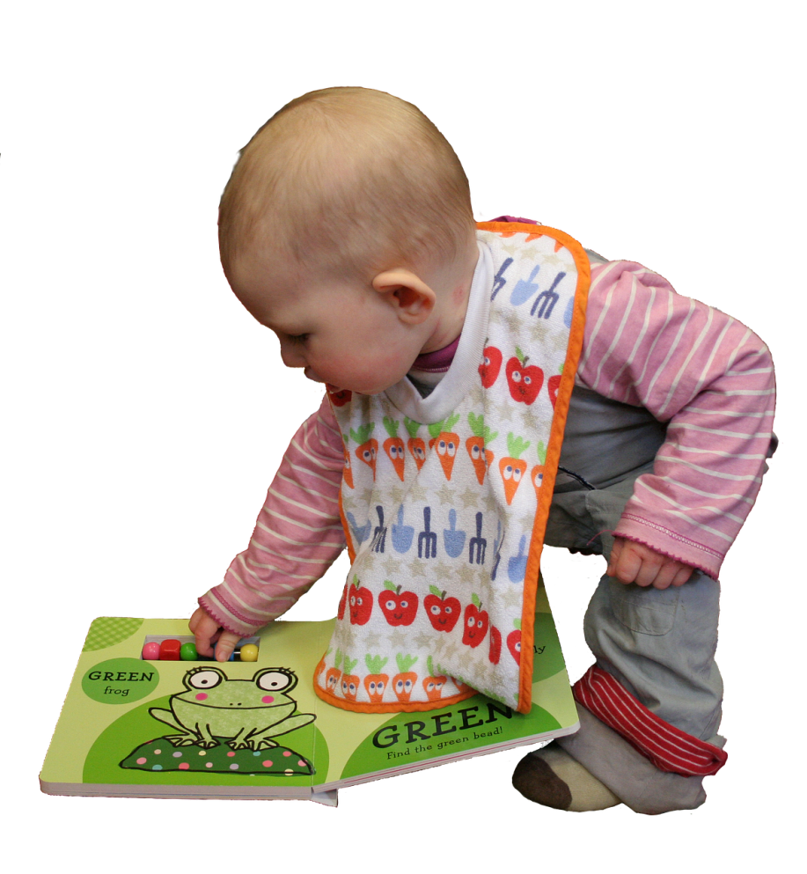
“Developing language and literacy skills begins at birth through everyday loving interactions . . . The first—and best—tip for sharing books with young children is to have fun together!” www.zerotothree.org
Notes:
SLIDE TWO
As I’m sure you all know, the foundations of language learning and literacy start from day one.
Here’s a quote from the website Zero to Three: “Learning to read and write doesn’t start in kindergarten or first grade. Developing language and literacy skills begins at birth through everyday loving interactions, such as sharing books, telling stories, singing songs and talking to one another ...The first—and best—tip for sharing books with young children is to have fun together! If children are engaged and enjoying themselves, they are learning.”
Remember the quote attributed to Jean Piaget: “Play is the work of childhood!”

Slide 3

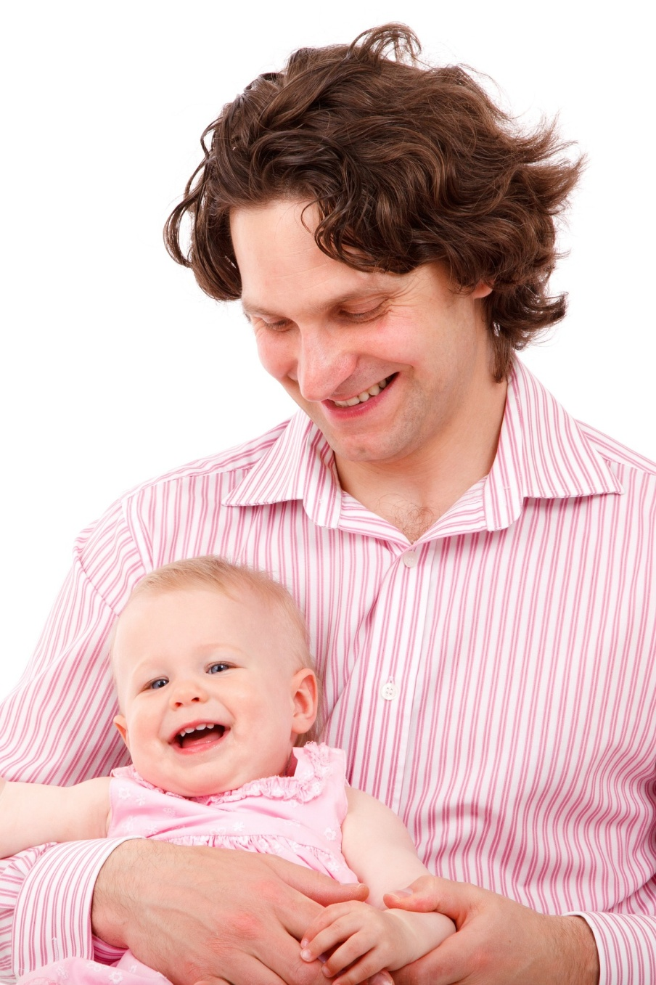

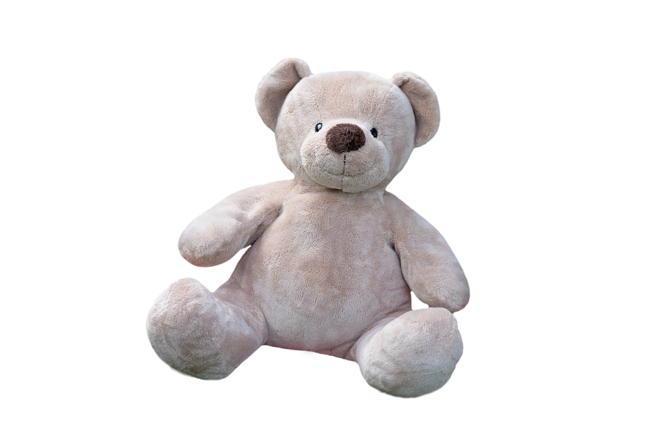
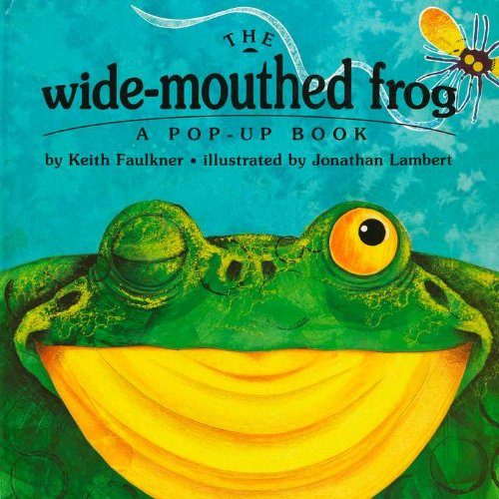
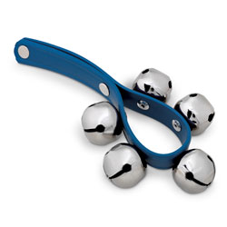
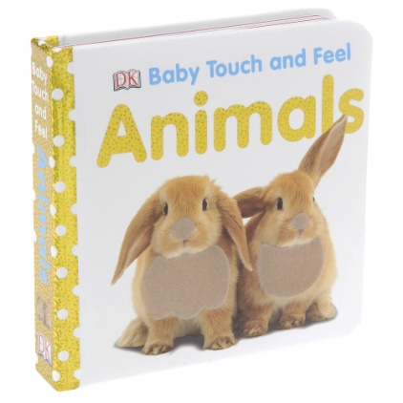
Notes:
SLIDE THREE
Typically at lapsit storytimes, babies are exposed to books, songs, rhymes, lap bounces, fingerplays, flannel board, and sometimes to other elements such as bells, bubbles, soft toys, and board books to hold. Importantly, they’re also exposed to other babies, and for many of them it’s the only chance they have to see other people just like them.

Slide 4
Five Practices of Early Literacy
sing
talk
play
write
read
Notes:
SLIDE FOUR
Infant storytimes nourish intellectual, emotional, and social development, and support at least four of the “Five Early Literacy Practices,” which are … (click through slide)

Slide 5
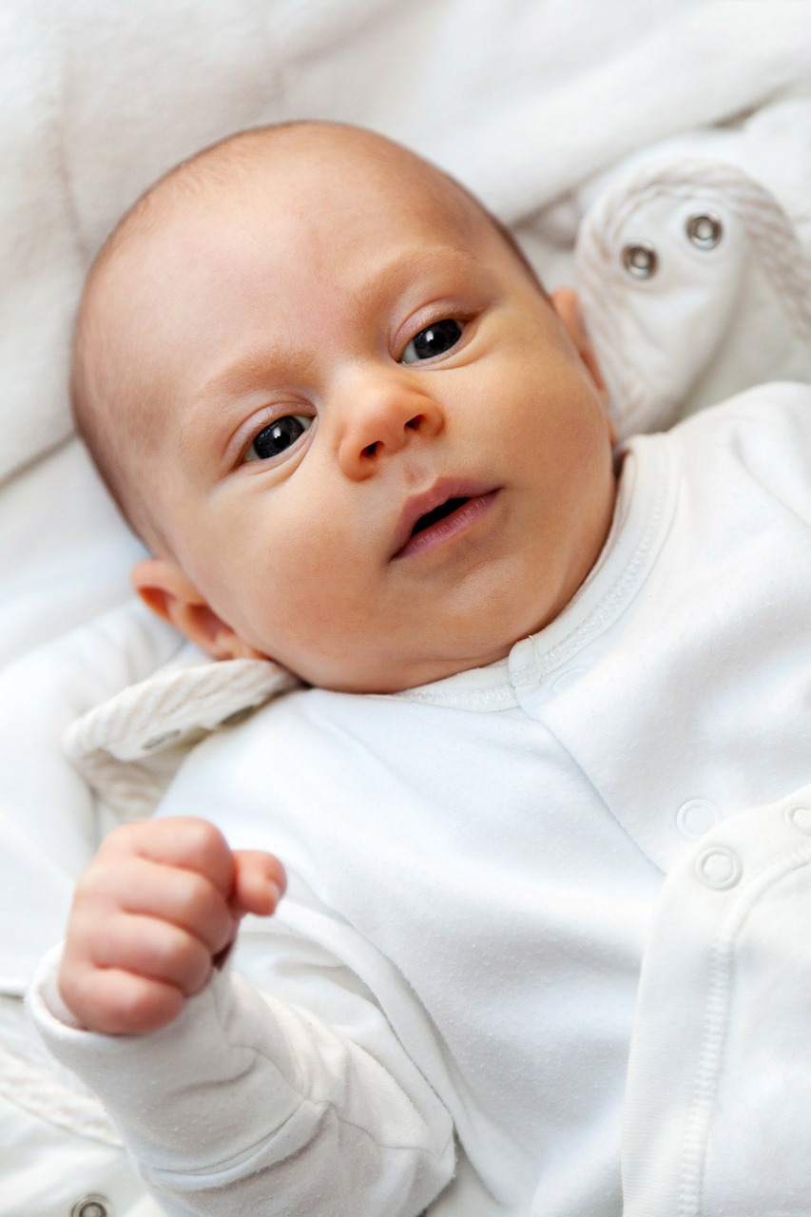
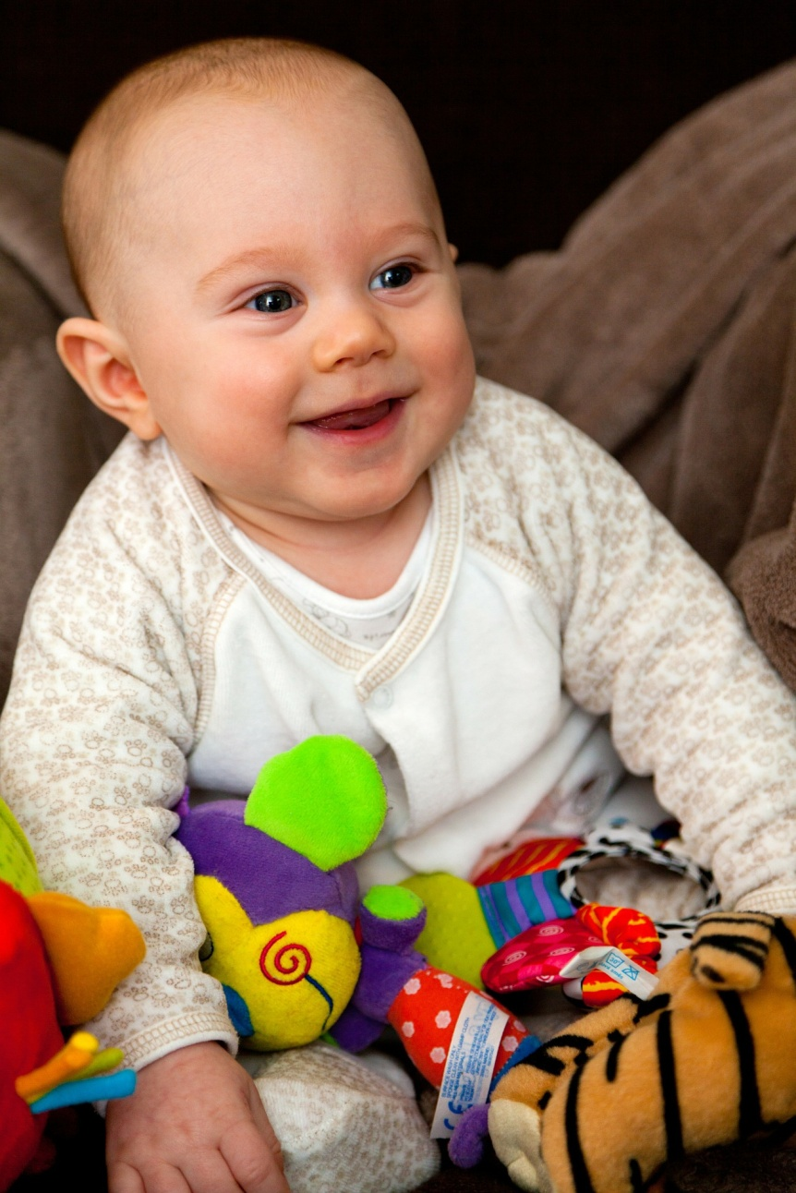
Notes:
SLIDE FIVE
Infant storytimes can be quite a challenge. Babies often do not give specific and immediate feedback, so you have to trust what you know to be true: that they are constantly absorbing and learning. With babies, it’s all about delayed gratification, but I assure you that there’s no greater reward that watching a baby go from the blank face on the left, to the happy face on the right, as they visibly respond to your program with smiles and clapping. (This change happens OVER TIME – don’t expect it right away!)
I’ve heard some people say that lapsit storytimes are not for the babies, but for the grown-ups who attend, because we’re showing them ways to interact with their little one at home. But I hope when people say that, they mean that it’s for the babies AND the grown-ups – because I believe there’s a very real value for the babies themselves in the experience of attending baby storytime. (Social, verbal, etc.)
One of the most surprising discoveries I’ve made in my time conducting an infant storytime program is how many library staff express reluctance to take on an infant storytime. As one of my former managers once told me, “People are scared of babies!” Some of you may share my surprise, but probably at least a few of you secretly harbor that same feeling. Lapsit storytime can certainly be scary at first!
Baby storytimes present several unique challenges. Here are some that I've identified, and the solutions I've come up with:

Slide 6

Challenge #1
A room full of preschoolers.
Notes:
SLIDE SIX
Challenge #1: A room full of preschoolers
A staff member from another library once came to observe my program. Afterwards she said to me, “That’s all very well and good, but you don’t understand what I’m dealing with at my library -- I get mostly three and four-year-olds coming to my program, so I really CAN’T do lap rhymes and fingerplays for babies. The kids just lose interest.”
But I do understand. It’s very similar to the situation that I inherited when I began to lead the program five years ago. My predecessor even told me, “Gear your program toward whoever comes. Our mission is to be inclusive.” But something seemed wrong to me about that philosophy. If I gear the material toward the interests of preschoolers, I’ve lost the interest of the very people I’m supposed to be serving --the babies-- and I don’t consider that very “inclusive,” do you? After all, there are usually several library programs geared toward preschoolers, but usually only one for the babies!
So what’s the solution?

Slide 7

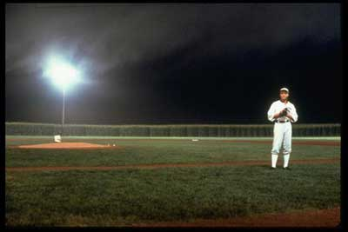
If you build it, they will come.
Notes:
SLIDE SEVEN
Recognize what movie this still is from? It’s from Field of Dreams, which had that famous quote, “If you build it, they will come.” I believe that that’s a pretty good general rule. In the case of baby storytime, that means that if you gear your program toward babies, babies will eventually come. It may take a month or four, but they will eventually come. My focus is on the babies, so the stories, rhymes, and songs I choose are always very baby-oriented.
Will the preschoolers (namely, those who attend without a younger sibling) get bored and stop wanting to attend your program? Most likely, yes. Should you feel bad about that fact? I don’t think so. Like I said, there are probably at least a few other programs that they can enjoy at your library.
I do allow well-behaved older siblings to join the circle; I expect them to quietly allow the babies and grown-ups to have their special time. The older siblings who attend get something valuable from the experience too, not least of which is being a supportive family presence for the important work that their baby sibling is doing.
That being said, Baby Rhyme Time can be boring for older children, and bored children can be squirmy and fussy. If at all possible, have another staff member run a preschool storytime concurrently with your infant storytime. This arrangement worked wonders for us at both of the library branches where I’ve led this program.

Slide 8
A program isn’t “inclusive” if it excludes your primary audience.
Gear the program toward the needs and interests of babies, even if no babies are in attendance at first.
Allow older siblings to attend if their behavior permits the focus to remain on the babies.
Ask if your library can run a preschool program concurrently.
Notes:
READ SLIDE EIGHT

Slide 9
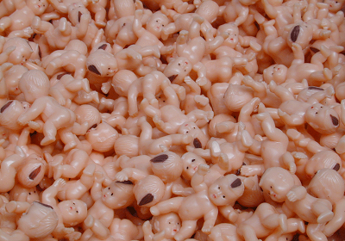
Challenge #2
We want attendees…
but not TOO many, please!
Notes:
SLIDE NINE
Challenge #2: We want attendees, but not TOO many, please!
If your program takes off, and you find your room bursting at the seams with caregivers and babies, you’ll probably also find that the quality of the program itself is suffering.
So I recommend keeping the program on the smallish side for the sake of the little ones. (More on this to follow…)

Slide 10
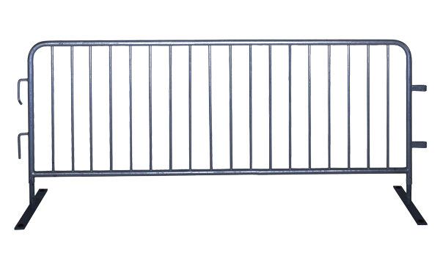
Creative Crowd Control
Notes:
My library space is large enough to accommodate a circle of 15 chairs, which allows a maximum of about 30 attendees (grown-ups + babies). Your library may have less space to work with; if you have more space to work with, congratulations -- but a cap of 30 attendees still seems reasonable in my experience. I find that when there are more than about 30 attendees, it's simply too much; there's a chaotic feeling to the program, and the babies are constantly distracted.
At my former library, when the program grew to the point where we were pulling several more chairs into the circle each session, we took it as a cue to split the program into two back-to-back sessions. We’ve recently added a second, afternoon, session at my current library, which works wonderfully for working parents.
Growing your program is great, but it makes no sense to subject the babies to a chaotic environment where their learning and enjoyment are inhibited; a little crowd control can be a beautiful thing.
You might also consider using a sign-up sheet or offering a certain number of advance tickets to your program.
(Of course, staffing and room availability are always concerns, so two sessions may not work at your library.)

Slide 11
A chaotic environment will negatively impact the babies and the quality of the program you offer.
Consider capping attendance at 30 (caregivers + babies) or fewer, depending on your space.
Use a circle of chairs.
If attendance stays high, consider splitting the program into two sessions.
Consider using a sign-up sheet or a ticket system.
Notes:
READ SLIDE TEN

Slide 12
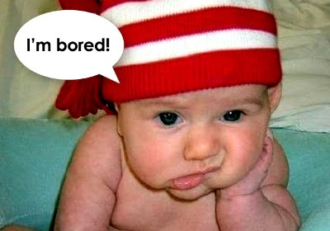
Challenge #3
30-second attention spans
in a 30-minute program.
Notes:
SLIDE ELEVEN
Challenge #3: 30-second attention spans in a 30-minute program
As we all know, babies have extremely limited attention spans, and when they’re bored they don’t act like the baby in this image, do they? No, they fuss, they squirm – they do whatever it takes to stimulate themselves if you’re not doing something that they find stimulating.
I make it my personal challenge to hold the babies' attention for a full 25 to 30-minute session, and although I've never 100% succeeded in that goal, I've come surprisingly close at times! And here’s how….

Slide 13
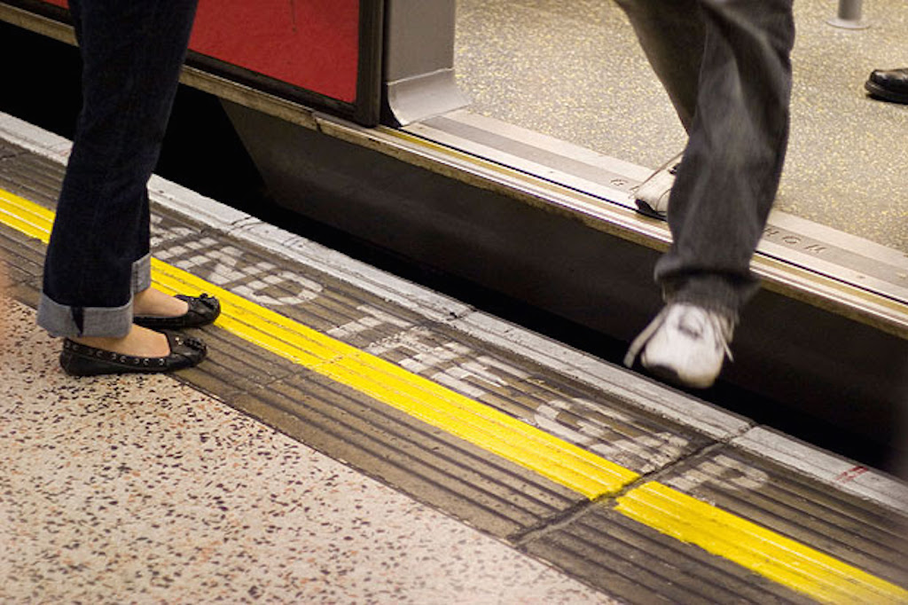
Mind the Gap
Notes:
SLIDE TWELVE
“Mind the Gap”
…By which I mean: Try to reduce the gap between activities, when babies’ attention may wander, never to return. I try to keep "down time" to an absolute minimum. This does not mean speeding through the stories, songs, and lap rhymes themselves, but preventing any gaps between them whenever possible. So the moment I finish a lap rhyme, I move on to the next one, then I’m right into a story, etc.

Slide 14
Keep “down time” to a minimum
Don’t race through the stories and rhymes themselves, but move quickly from one to the next.
Keep your own energy level high, and don’t be afraid to ham it up!
Notes:
READ SLIDE THIRTEEN
So if there’s little-to-no time-killing occurring, how on earth can you actually FILL a half-hour program?

Slide 15
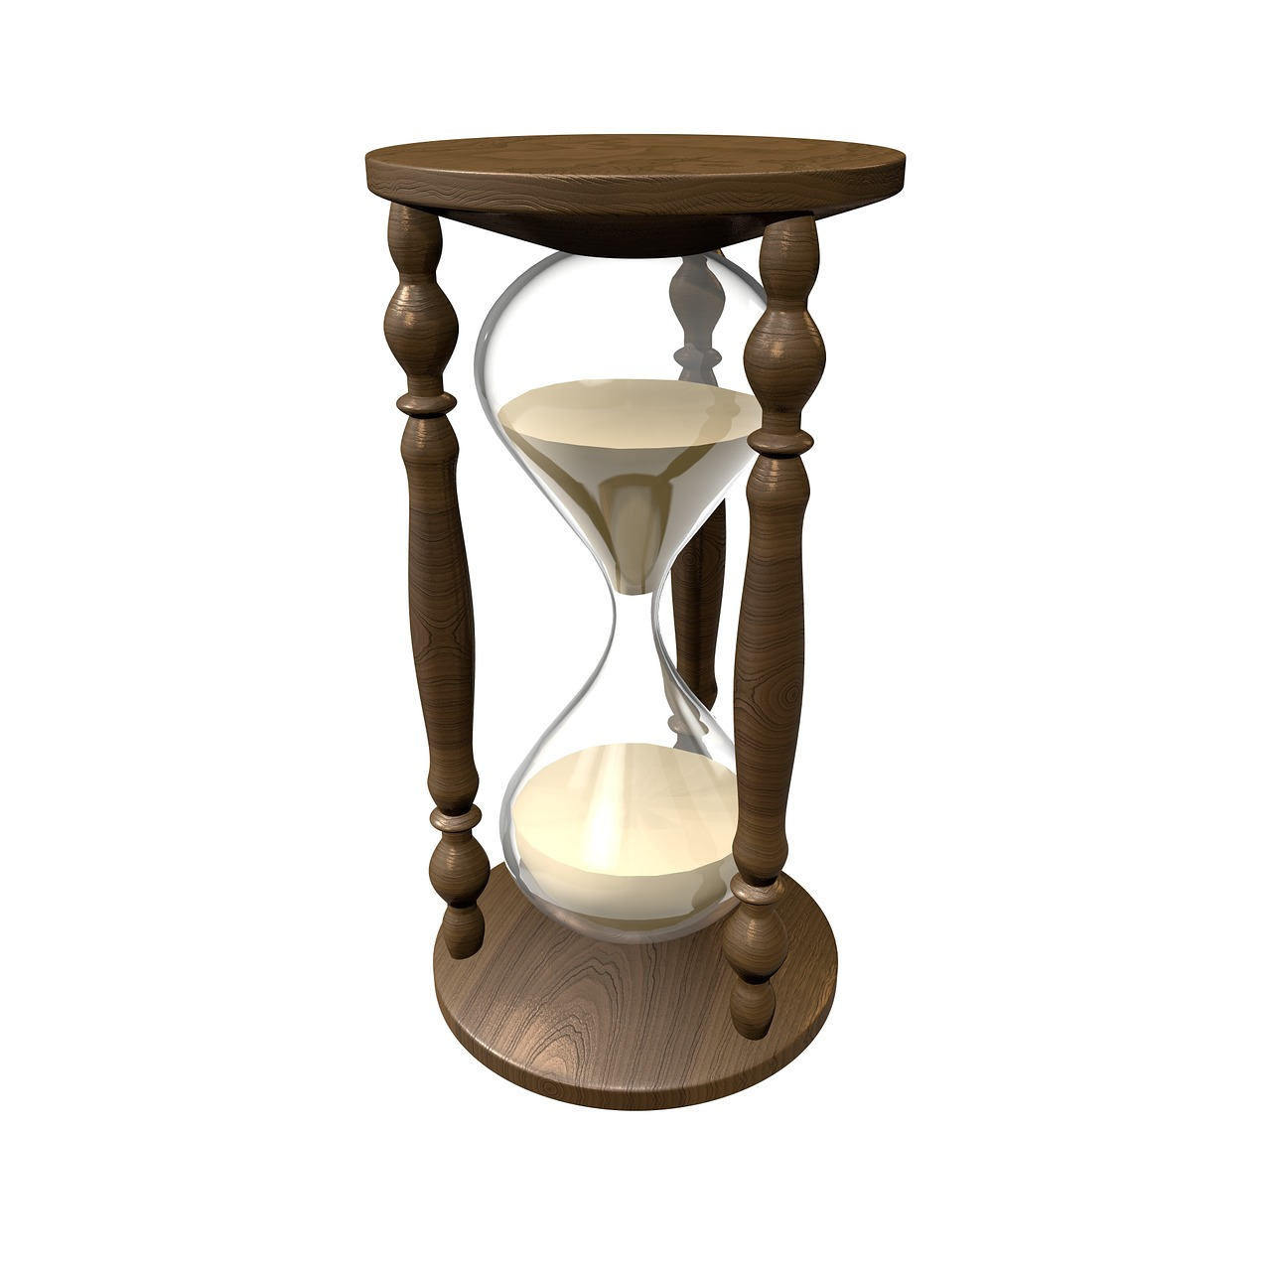
Challenge #4
Filling a 30 minute session,
30 seconds at a time.
Notes:
SLIDE FOURTEEN
Challenge #4: Filling a 30-minute session, 30 seconds at a time
As you can imagine, keeping a baby's attention by quickly switching from one source of stimulus to the next means I have to prepare a TON of material for each baby storytime session.
To illustrate what I'm talking about, recite this rhyme with me:

Slide 16

Leg over Leg, dog went to Dover
Leg over leg
Dog went to Dover.
He came to a fence -
Jump! He went over!
Notes:
SLIDE SIXTEEN
That was five seconds.
I don’t know about you, but when I was first told I’d be doing an infant storytime, I was terrified by the prospect of having to fill a half hour. And if I’m perfectly honest, I’ve observed some programs where I did get the feeling that “time-killing” was going on. And we all know what THAT leads to (see Challenge #3…).
It can be daunting to think of filling a half hour with bite-sized rhymes. And the prep time it would take to pull off such a feat each week?? Forget about it! So I've developed a way to keep the ball rolling through 30 minutes of material without having to memorize dozens of rhymes and songs, and with extremely minimal prep time!

Slide 17
Memorization and
Intensive Prep
Notes:
SLIDE SIXTEEN
Memorization will naturally come with time and repetition, but you don't have to worry about memorization at all. The way I've set up this program allows beginners to hit the ground running, allows substitutes to step in at any time, and reduces prep time to almost nothing.
It's all about the slideshow.

Slide 18

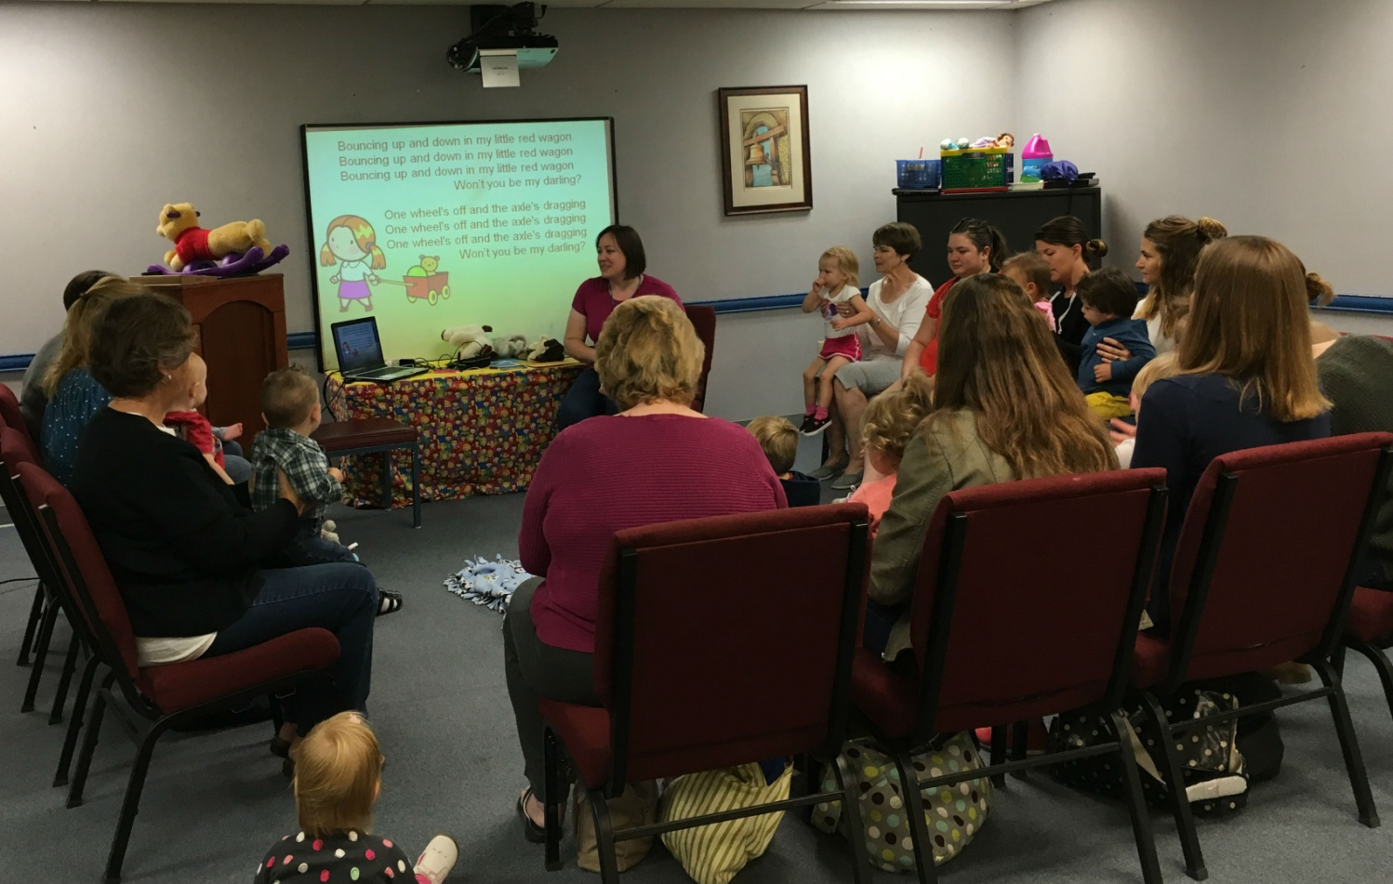
Notes:
SLIDE SEVENTEEN
When I first started doing Baby Rhyme Time, I held a piece of paper on my lap with rhymes printed on it. Because I always hold a baby doll to demonstrate the movements with, that paper really got in the way. And VERY FEW of the grown-ups were participating in reciting the rhymes -- because they didn’t know many of them! (Neither did I, but I had the cheat sheet on my lap.) Baby Rhyme Time had become a performance, rather than a participatory experience, and it clearly needed to change.
So I decided to print each rhyme in as large a font as would fit on a letter-sized paper, which I then clipped to the flannel board. It was a better solution, but still not good. The caregivers at the far end of the circle were still squinting to read the print.
Writing the rhymes on a large flip chart with tabs would have been an acceptable solution, but one day I had a lightbulb moment and decided to create a simple PowerPoint slideshow with one rhyme on each slide, and display it on the television behind me (my former branch had a large-screen television mounted to the wall, which is what I started with.) For me, it was the perfect solution.
Another point I’d like to emphasize is the importance of using chairs. I always allow the little ones to crawl or toddle around if they need to, but having chairs in a circle creates an expectation of participation for both the caregivers and their babies, and really keeps focus on the work at hand. Also, we do a lot of rhymes where we “drop” the babies down between our legs, and you just can’t do that when you’re crawling around on the floor.
In a similar vein, I try to keep toys and books out of the babies’ hands until the end of the program. Why deliberately introduce distractions to the easily distractible? And although they’re easily distractible, I believe that babies are actually capable of far more focus than we tend to give them credit for, if we refrain from making it more difficult for them.

Slide 19
A few thoughts on the slideshow
An effective way to help caregivers participate during the program.
A better way for visual learners to begin to memorize rhymes to use at home.
Allows library staff who are new to infant programming to jump right in without already knowing a lot of rhymes.
A better way for the English Language Learners in your group to follow along and learn the rhymes.
Keeps the rhymes off your lap and out of your way.
Totally customizable and will grow with your program.
Reduces weekly prep time to just a few minutes.
Notes:
READ SLIDE EIGHTEEN
If you can’t use the slideshow, because of budgetary or space constraints, please consider using a flip-chart with tabs.

Slide 20

Notes:
SLIDE NINETEEN
I currently have about 95 slides that I pull from to create my weekly slideshow, and those slides are yours for the low low price of FREE! Woo hoo! You’re welcome to modify and use these slides you see fit.
(I’ve done my best only to use copyright-free images, but if you notice that I’ve accidentally included a copyrighted image, please drop me a line!)
You’ll notice that I've included notes beneath many of the PowerPoint slides, and some of the slides even include a recording of me singing (yikes) -- which is just for your benefit in case you don’t know the song, not necessarily to play for the group. Instructions on how to play the narrations will be included in the notes field of the slides in the PowerPoint file I send you.

Slide 21
My formula:
20 slides (including opening and closing sequence)
+ 2 or 3 books
+ 1 extra song
+ 1 flannel board rhyme/activity
= 30 minutes of infant attention!
Notes:
SLIDE TWENTY
Before each Baby Rhyme Time session, I create a custom show with about 20 slides. Please note that after the first time you set up a 20-slide presentation, it will never take more than about five minutes to prepare future presentations – just change out four or five slides – because babies thrive on repetition, and as Dr. Betsy Diamant-Cohen (Mother Goose on the Loose) has said, you should aim for 80% repetition from one week to the next.
I find that 20 slides (including greeting and farewell slides, which are always the same, because routine and repetition are excellent for babies) + 2 or 3 books + a song and a flannel board rhymes/activities = approx. 30 minutes. It never hurts to have a few extra tricks up your sleeve, just in case, such as an extra song queued up on the iPod.
Typically I'll do a few opening slides, then move on to a story, do a few more slides, then move on to a flannel board rhyme or song, then play a song on my iPod, do a few more slides, another story, a few more slides, etc. If at any point I feel that a book or rhyme isn't holding the babies’ interest, I won't hesitate to set it aside and move on to the next thing.
The point at which I interrupt the slideshow to read a book or play a song depends on what feels right in the moment. I never force anything that doesn’t seem to be working. Is the book I chose not holding their interest? I’ll say, “Well, that’s enough of that one for today. Let’s move on!” Do I regret having chosen the slide that just popped up on the screen? Skip it! Was a particular rhyme well-received? Maybe backtrack and do it again at the close of the program. Are we running out of time? Skip a few slides! When you’re dealing with babies, flexibility is essential.

Slide 22
Notes:
SLIDE TWENTY-ONE
During the program, I sit under/beside the screen. I have a small table beside me with all of my props, flannel board, and my laptop that's connected to the projector. There is a blanket on the floor in front of me, and around that blanket is the semi-circle of chairs. I have my bubble machines and bubble juice at the ready, along with some items to play with after the program is over, such as soft toys, a collapsible fabric tunnel, and a small Winnie the Pooh rocker.
I always invite them to stay and play “as long as they’d like,” during which time I play a sequence of five instrumental songs on my iPod. The routine of the songs is comforting to the babies, and when the songs end after about 15 minutes, the grown-ups get the idea that it’s time to start packing up. ☺

Slide 23
A few thoughts on book selection
Large pages with big, vivid pictures
Only a few words per page
Rhyming and/or interactive elements
Pop-up books are fun and attention-grabbing
Ham it up!
Notes:
A quick aside on book selection for infant storytime. There are wonderful books out there that are better for one-on-one lap time than a storytime setting, so here are some pointers on choosing great books for your infant storytime….
READ SLIDE TWENTY-TWO

Slide 24
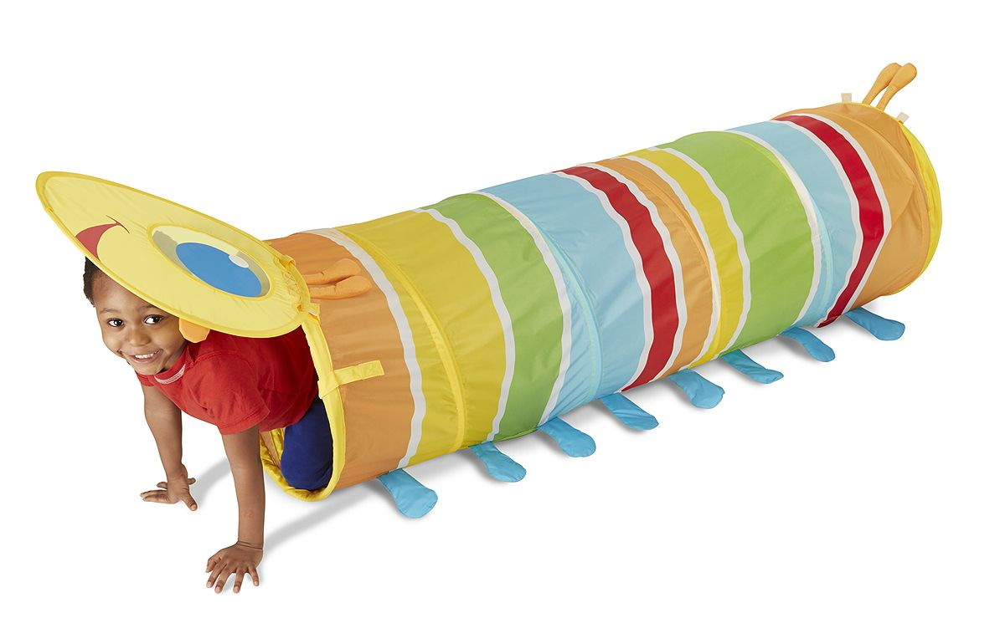
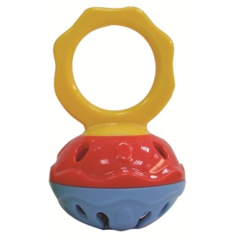
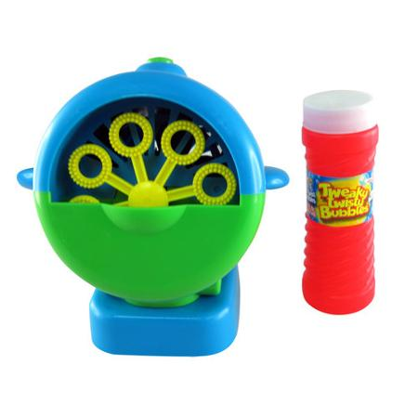
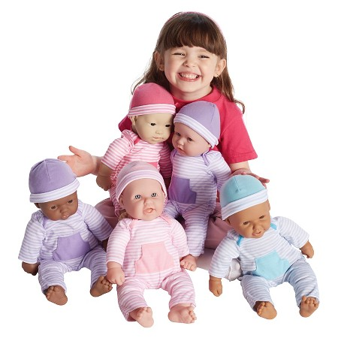
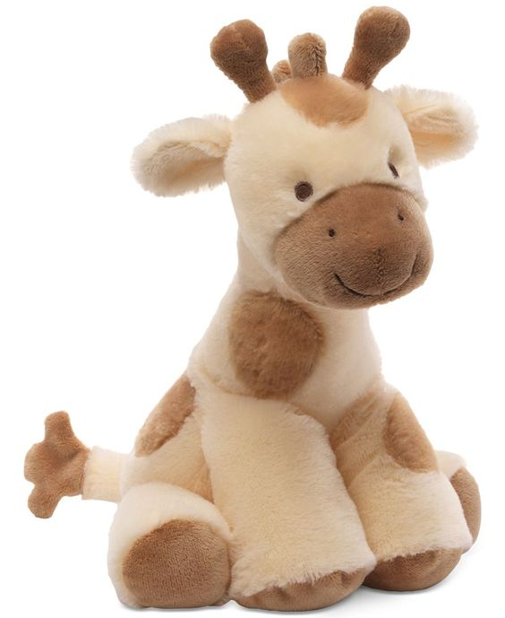
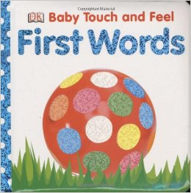
Notes:
Let’s talk about some of the tangible items that I use during Baby Rhyme Time.
I highly recommend having a baby doll on your lap during your infant storytime, in order to demonstrate the movements to the grown-ups. This is my Baby, named Ada. I love this doll because she has soft, flexible arms and legs, and a cute face. She’s a 16” La Baby, available on Amazon for about $20, if you’re interested in getting one like her. It doesn’t matter too much what you use as a baby prop -- a stuffed monkey or bear could work -- but make sure the arms and legs are flexible enough that you can really demonstrate the motions, and make sure it has all the facial features you’ll be pointing at. (It’s also good to have fingers and toes to demonstrate rhymes like “This Little Piggy.”)
I always use hand bells during my concluding sequence of each session. Following an unfortunate incident when a baby cut her tongue on a standard cluster bell, we decided to buy a set of "safety bells.” These are called “mini cage bells,” and they’re available from westmusic.com for about $4 apiece.
Each session ends with bubbles, which has become a cherished and much-anticipated element for the babies at my program. You will definitely want to include this in your storytime -- it seems like a small thing, but I can’t emphasize enough how much your attendees will love bubble time. More than a few of my attendees have reported that “bubble” was one of their baby’s first words! You can use a jar of bubbles or even pass out jars of bubbles for the grown-ups to use, but in order to avoid spills -- and hyperventilation -- I highly recommend using small bubble machine like this one. It’s about eight dollars in the party section of the supermarket. (Fred Meyer and Walmart, for instance.)
I hold the bubble machine and aim it over the heads of the crowd during their free-play time. Again, that’s when I also play that sequence of instrumental songs on my iPod that lasts about 15 minutes.

Slide 25
A quick recap
Focus on the babies.
Reduce chaos by limiting # of attendees.
Keep their attention by eliminating down-time.
You can fill 30 minutes with this formula:
20 slides (including opening and closing sequence)
+ 2 or 3 books
+ 1 extra song
+ 1 flannel board rhyme/activitiy
= 30 minutes of infant attention!
Notes:
A quick recap:
READ SLIDE TWENTY-FOUR

Slide 26
Miscellaneous Tips
Use the term “caregivers” or “grown-ups”
Have opening and closing routines
Feel free to interrupt yourself
Have extra tricks up your sleeve
Put something in the babies’ hands at each session
At least one song with musical accompaniment
Repetition is a good thing!
Create a personalized take-home flyer with your favorite rhymes/songs and contact information
Notes:
READ SLIDE 25
Many of the adults in your program will be nannies, aunts, uncles, grandparents, great-grandparents, you name it.
Babies thrive on routine. Have a special song or sequence that indicates to them, “It’s time for the bouncy games and stories to begin!” and “Now it’s time for bubbles and playing on the floor!”
If something isn’t holding their attention, feel free to stop and move on.
Have extra slides and books ready, just in case something else didn’t work, or to fill any extra time you might have at the end of the program.
Babies are sensory learners, so make sure they get a chance to hold and use something interesting each time they attend your program, such as hand bells, shaker eggs, or scarves.
Singing a cappella is great, but if you can play a song on CD or iPod (or better yet, play a musical instrument!) it will enhance your program and the babies’ experience.
Repetition within your program (repeating short rhymes), and week-to-week (Dr. Betsy Diamant-Cohen of “Mother Goose on the Loose” recommends 80% repetition from week to week) are very important.
Create a flyer to promote your program, and to send the caregivers home with your favorite rhymes and songs. A sample of the one I created for my program is in your folder.

Slide 27
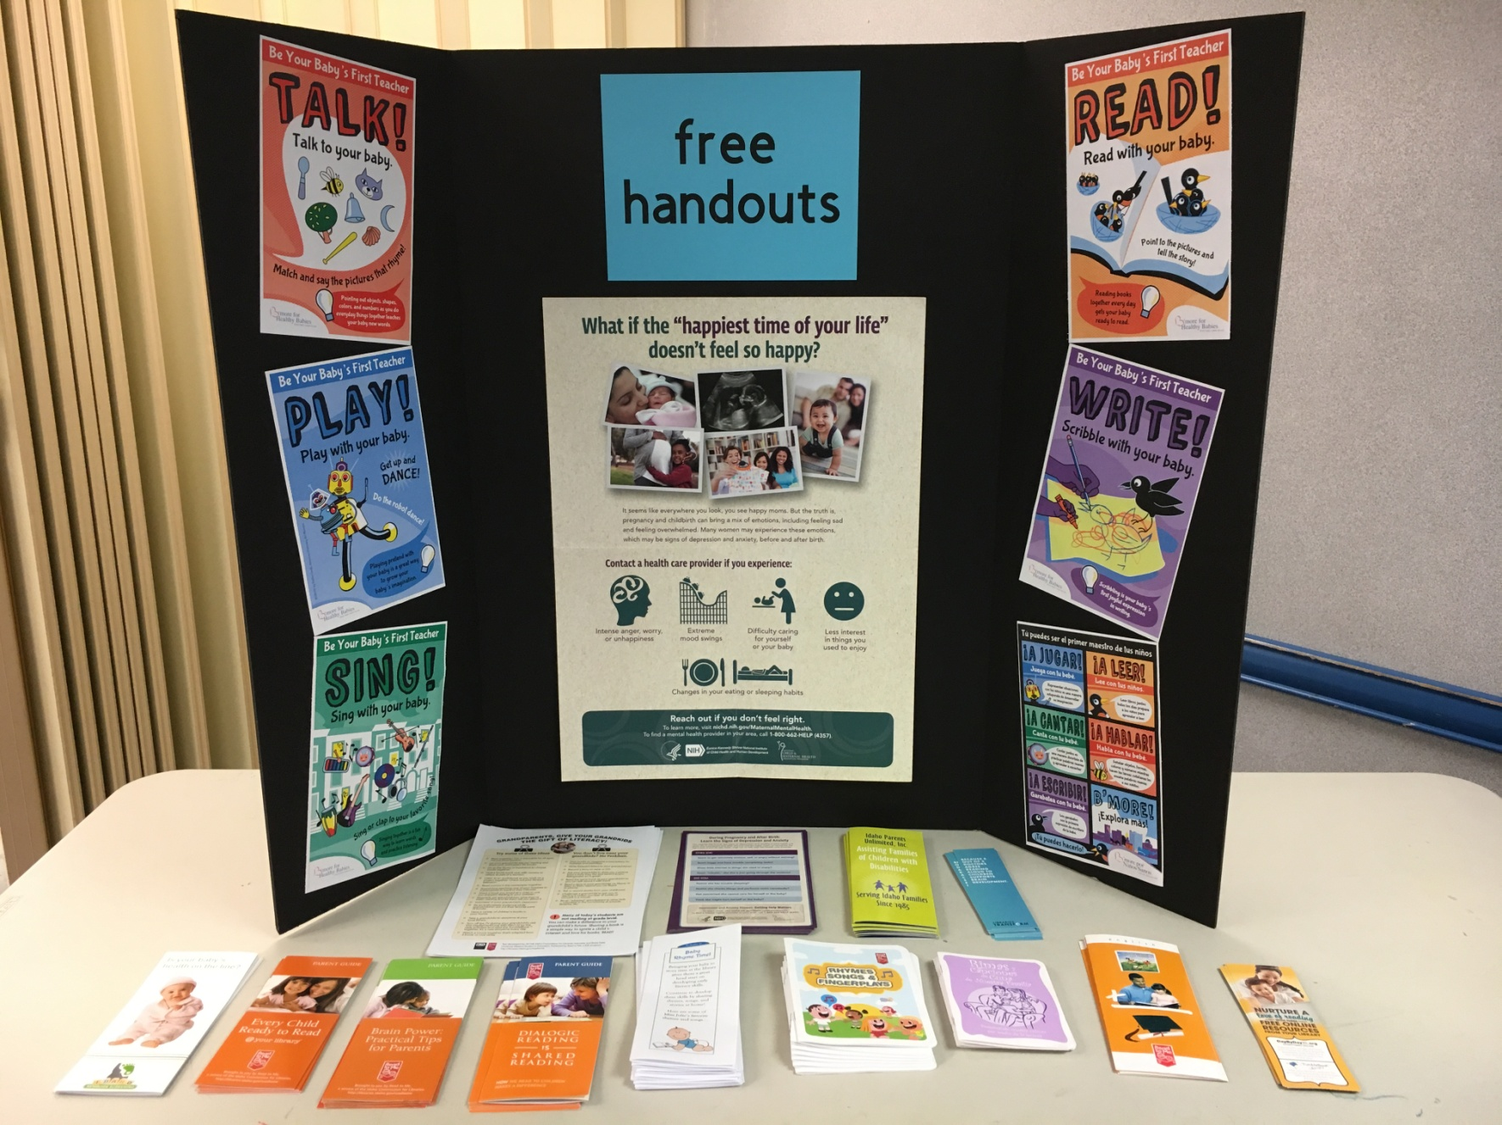
Notes:
Something to think about – use an inexpensive tri-fold board and free pamphlets from the ICfL and other sources to create an informational table for attendees of your program. The addition of a booklet of YOUR favorite rhymes, songs, and stories gives your attendees a way to take your program home with them.

Slide 28
Don’t Let the Babies Rattle You:
Tips and tools for shaking up your infant storytime
Julie Patricia, Associate Librarian
Ada Community Libraries, Victory Branch
Boise, Idaho
jpatricia@adalib.org
Questions?
Comments?
Notes:
Thank you! Questions? Comments?

