Slide 1
Idaho Libraries Engaging Their Communities!

Slide 2
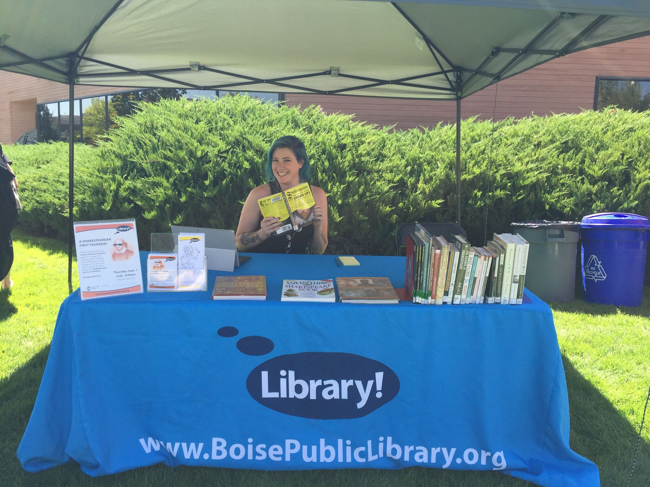
Pop-up Library – Boise Public

Slide 3
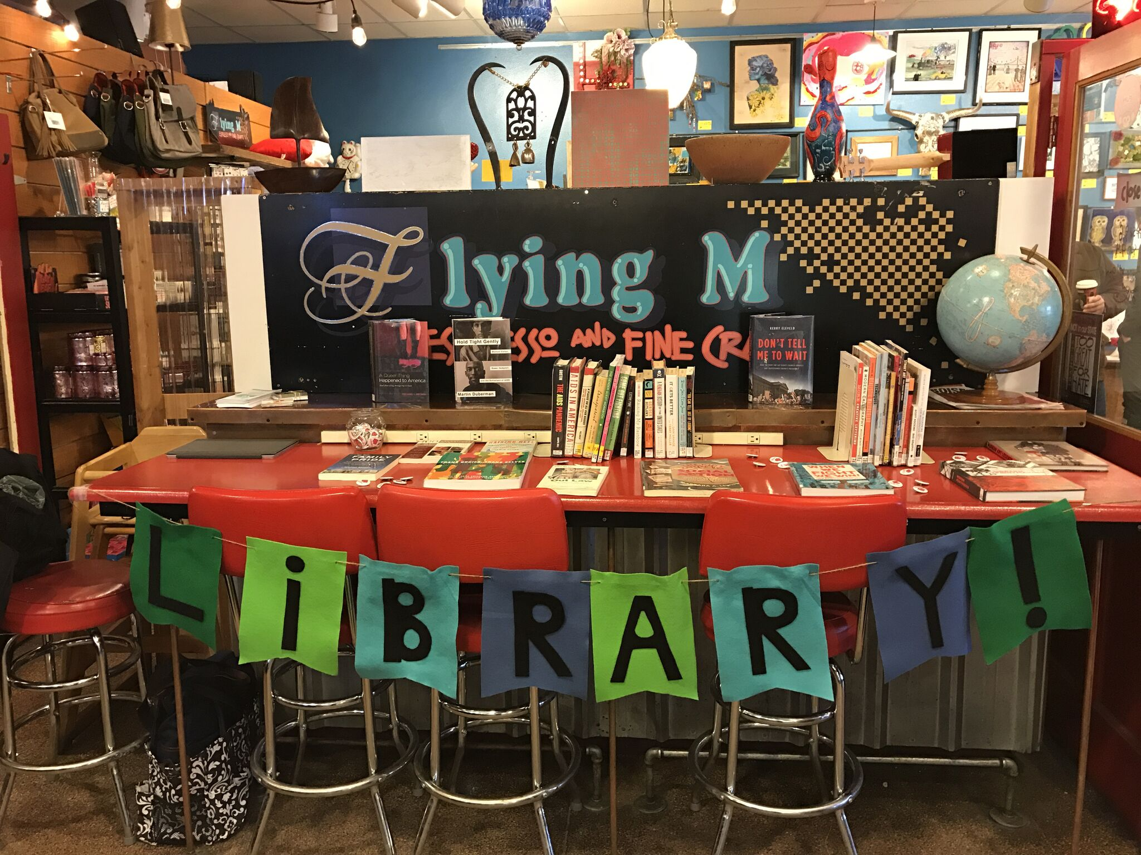
Pop-Up Library – Boise Public

Slide 4
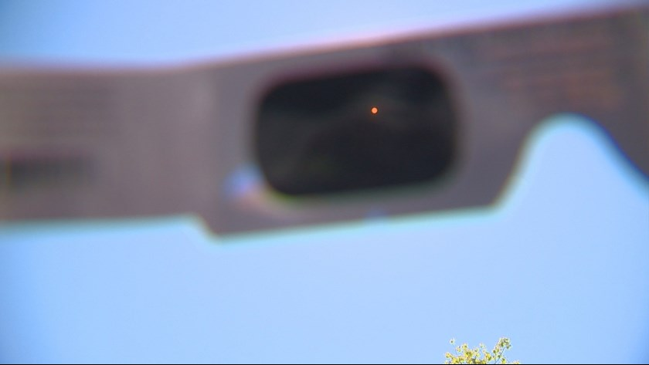
Libraries across the country - including in Idaho - are giving out two million free eclipse-viewing glasses.

Slide 5
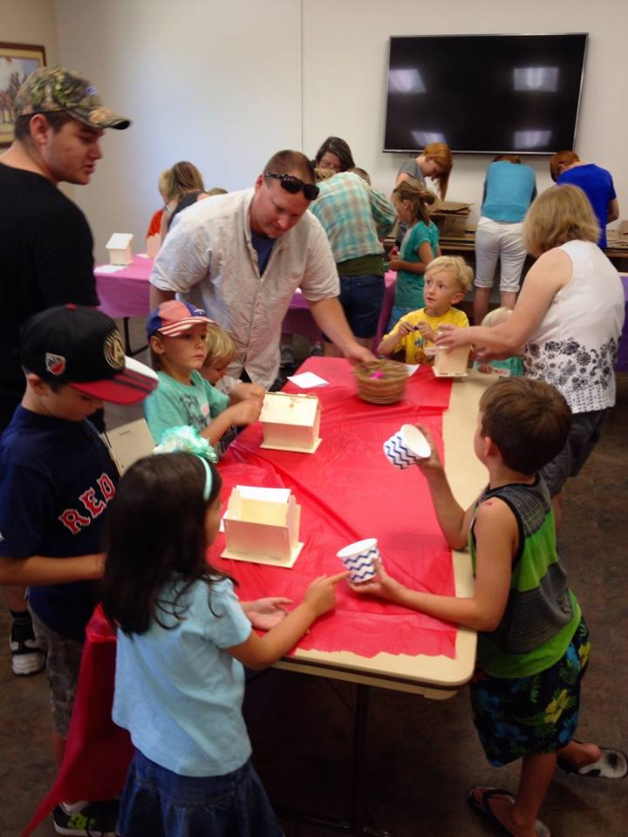
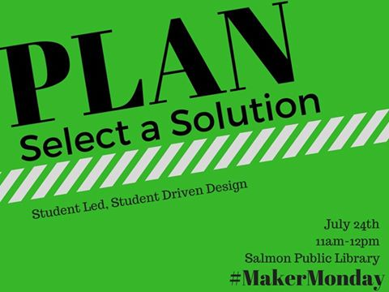

Slide 6
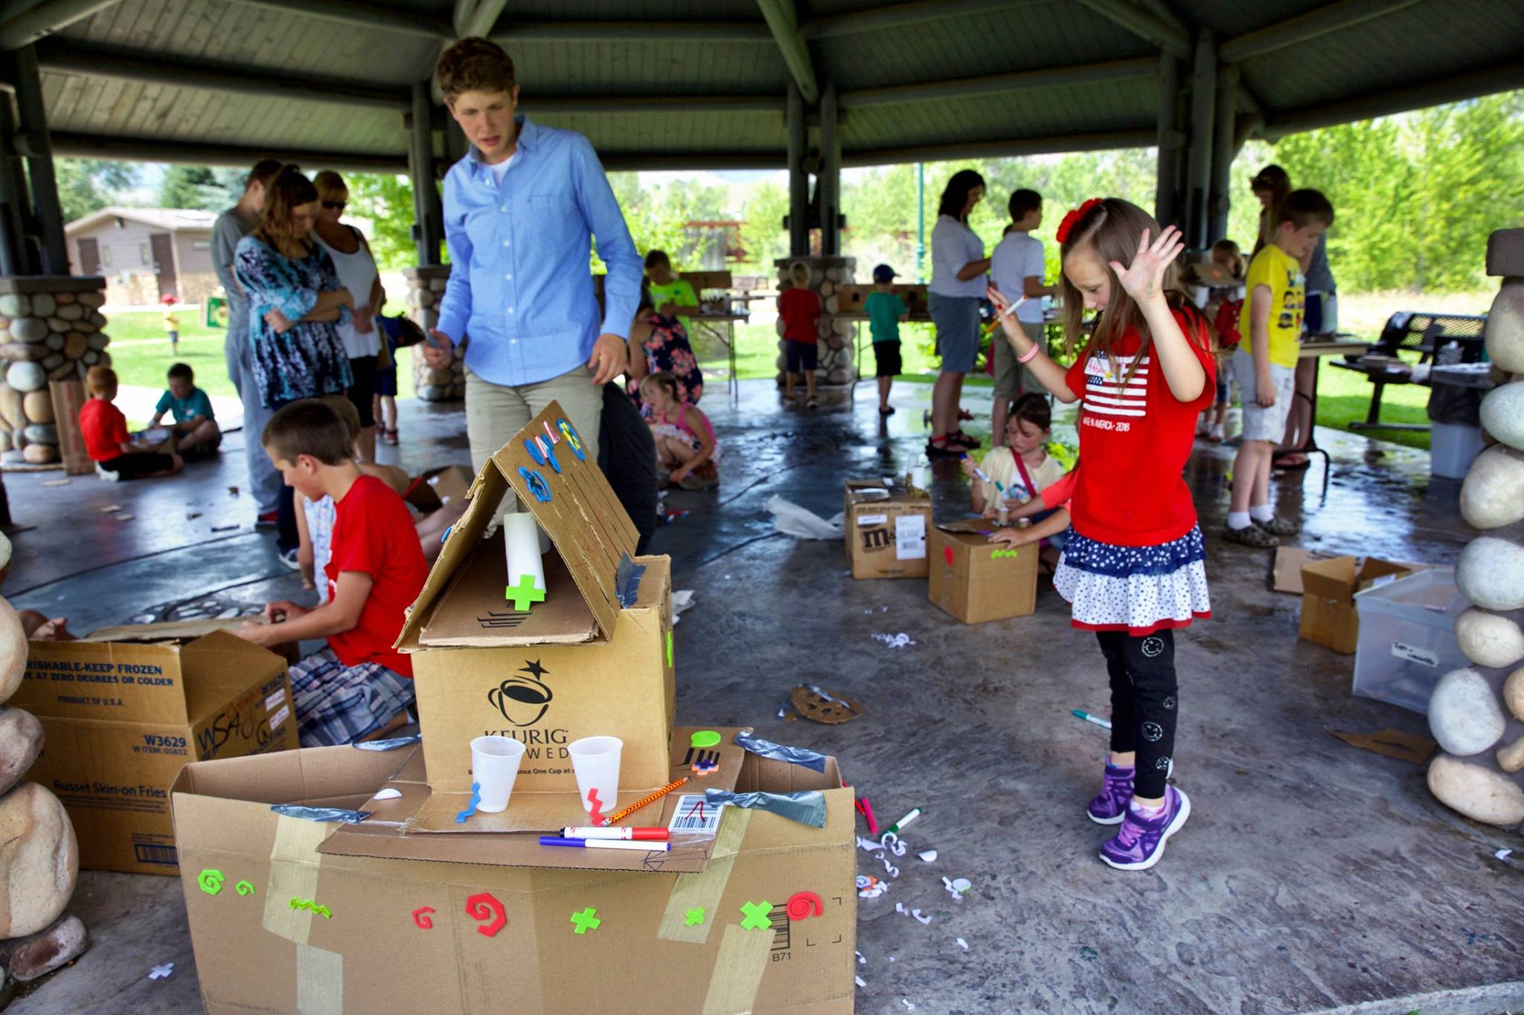
Lemhi County District Library – Salmon

Slide 7
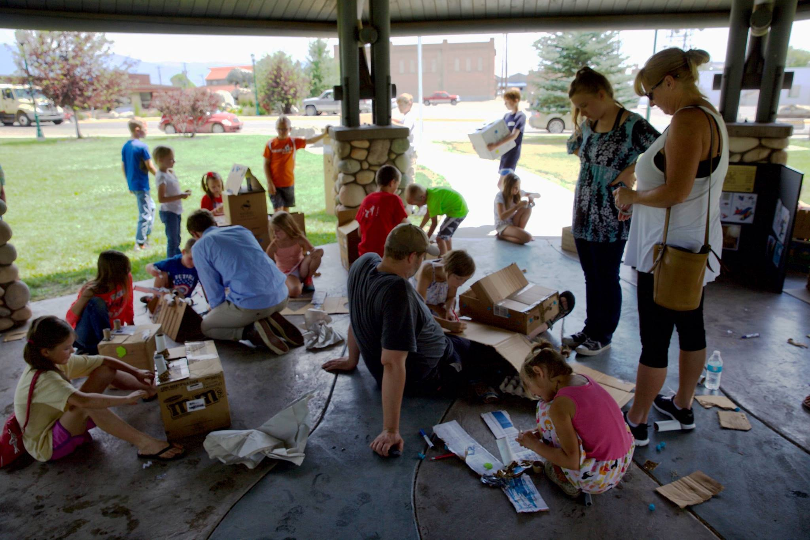
Lemhi County District Library – Salmon

Slide 8
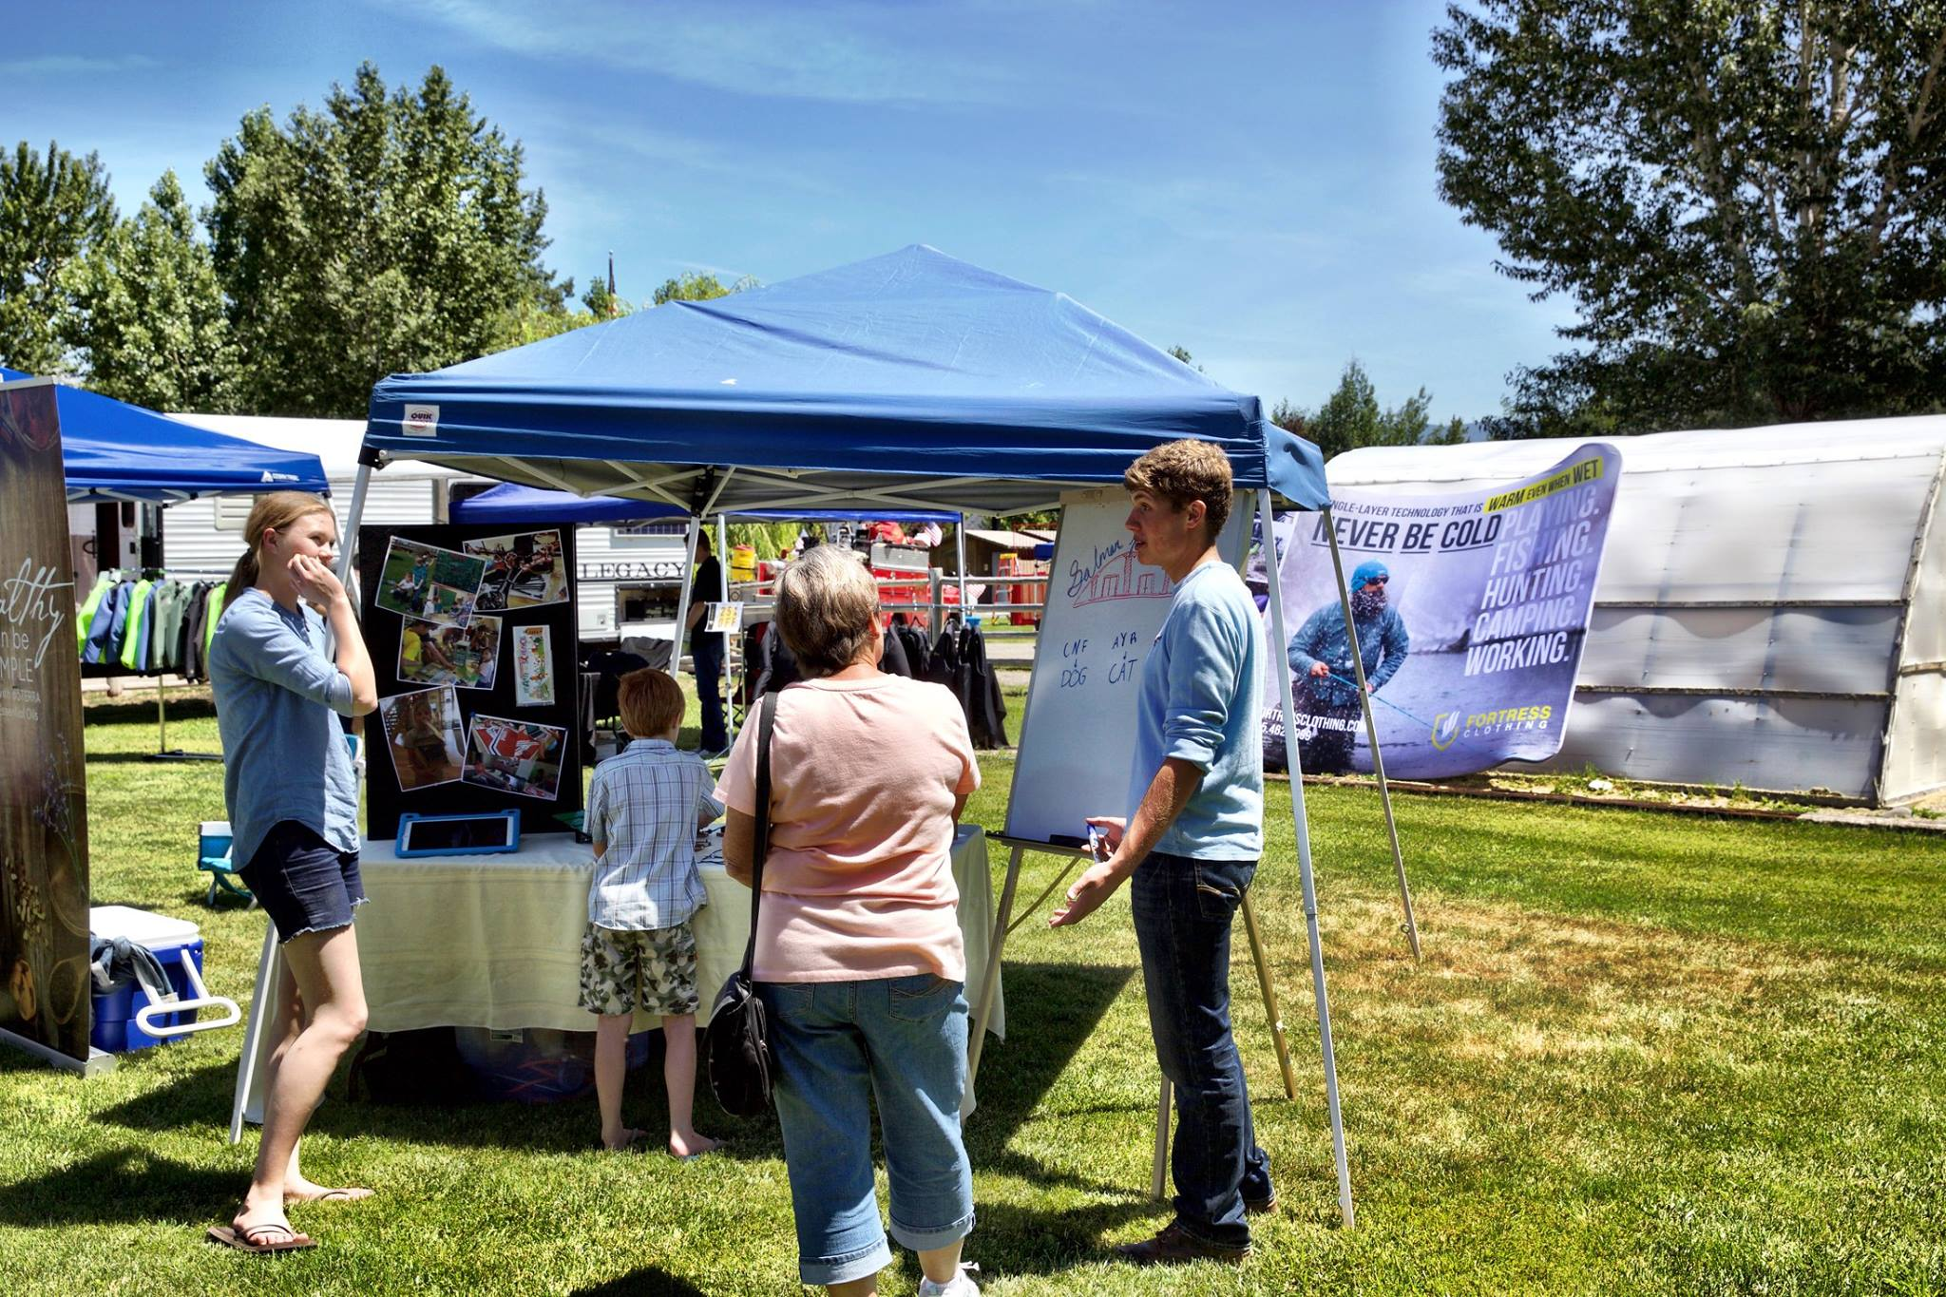
Lemhi County District Library – Salmon

Slide 10
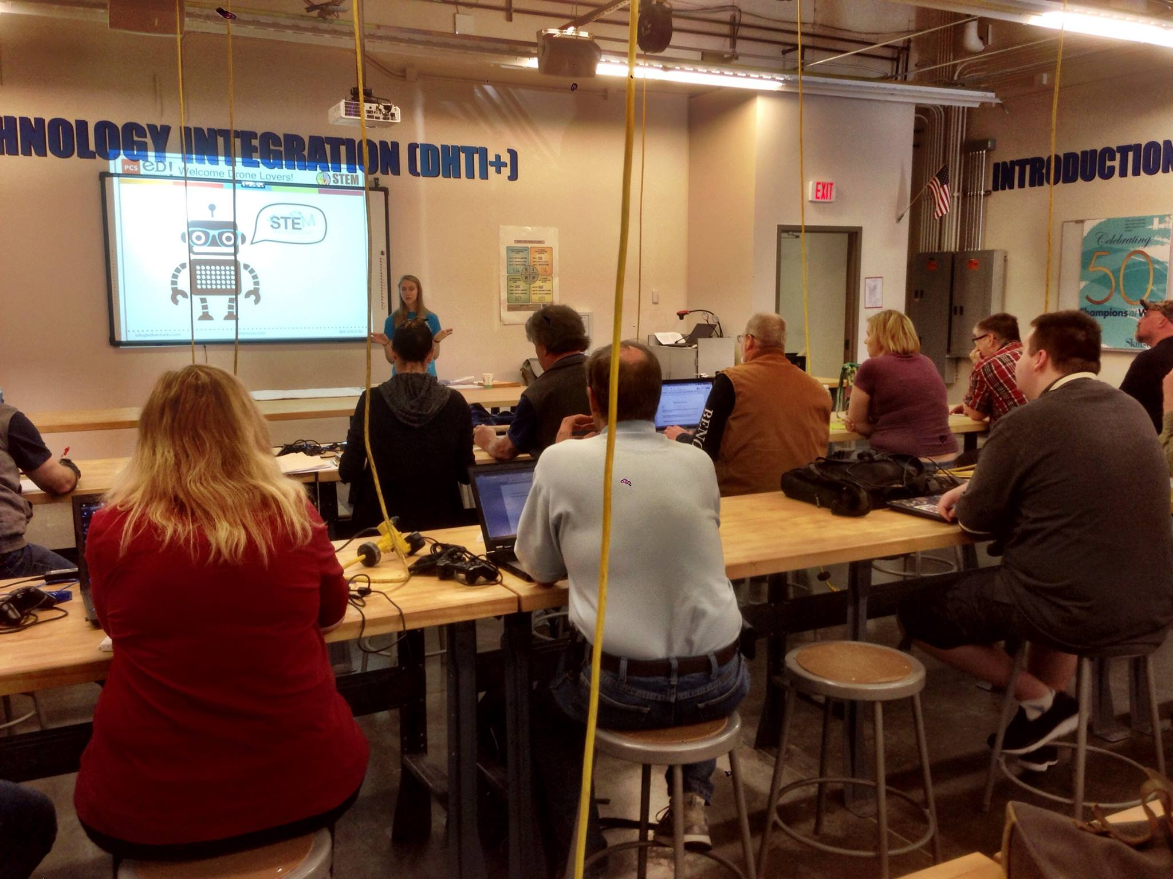
Lemhi County District Library – Salmon

Slide 11
Lemhi County District Library – Salmon

Slide 12
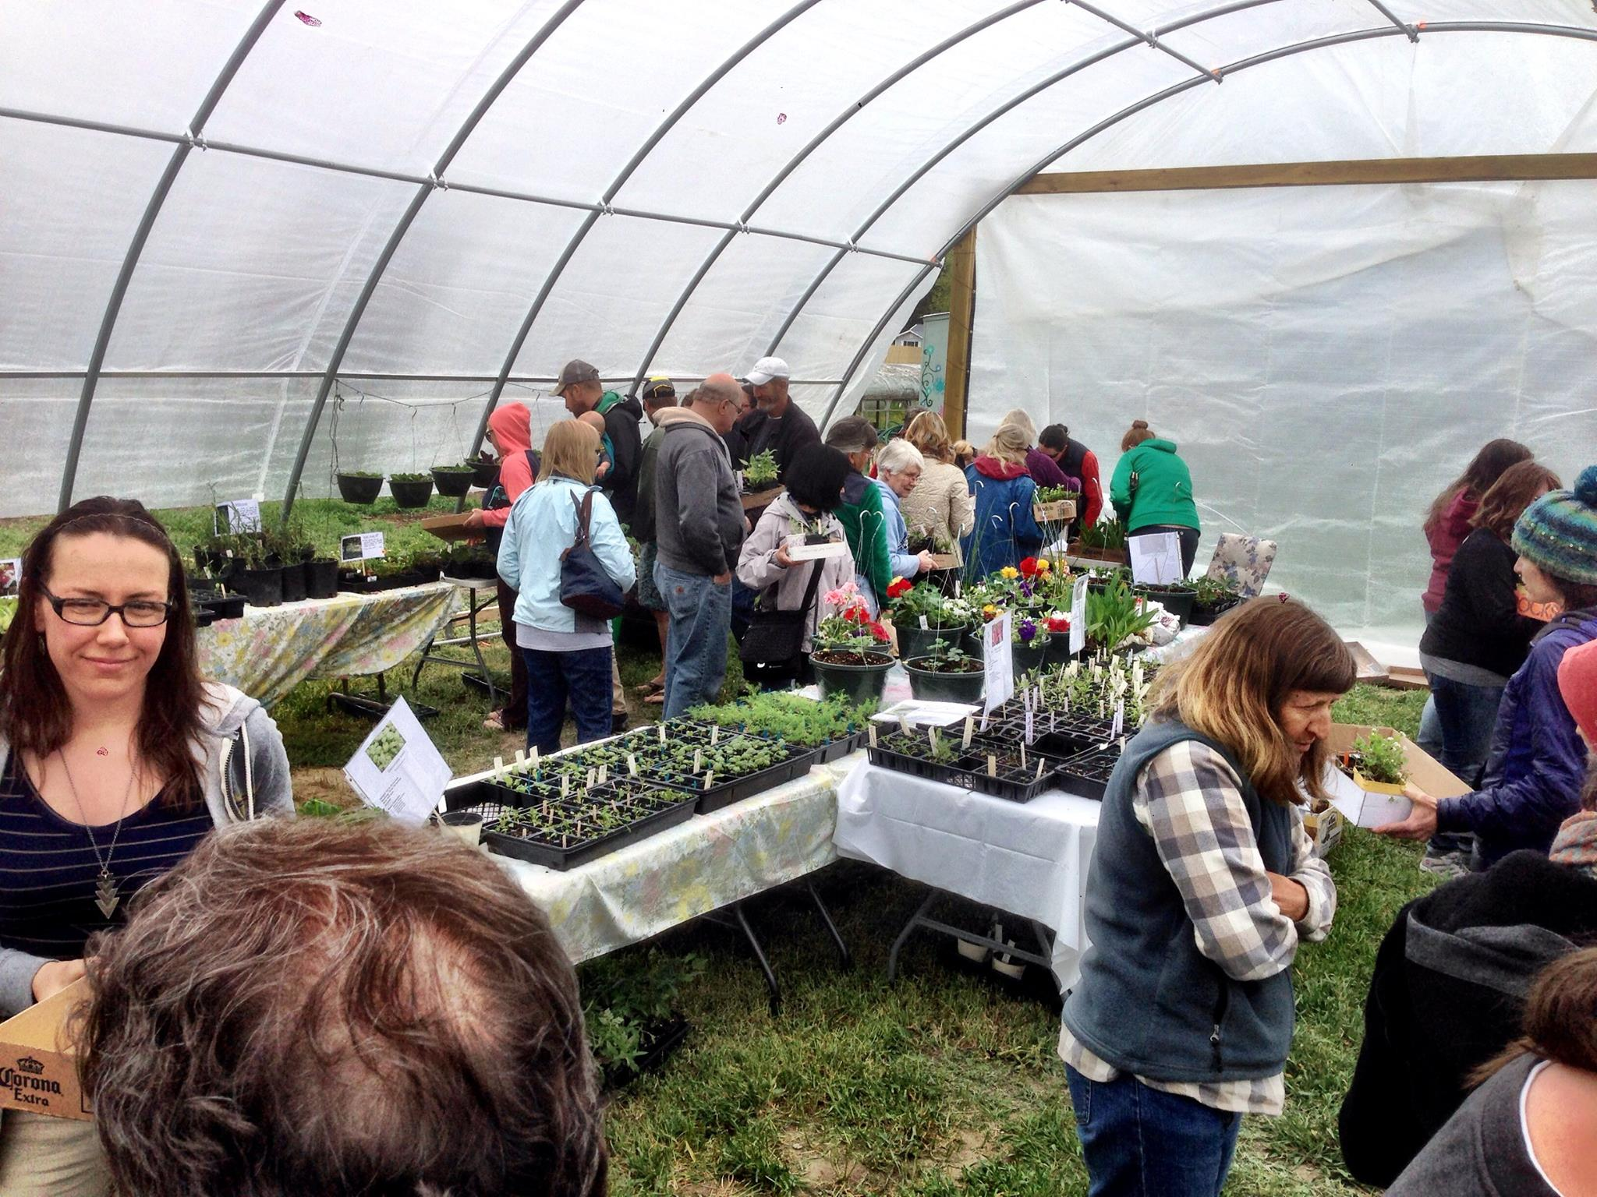

Slide 13
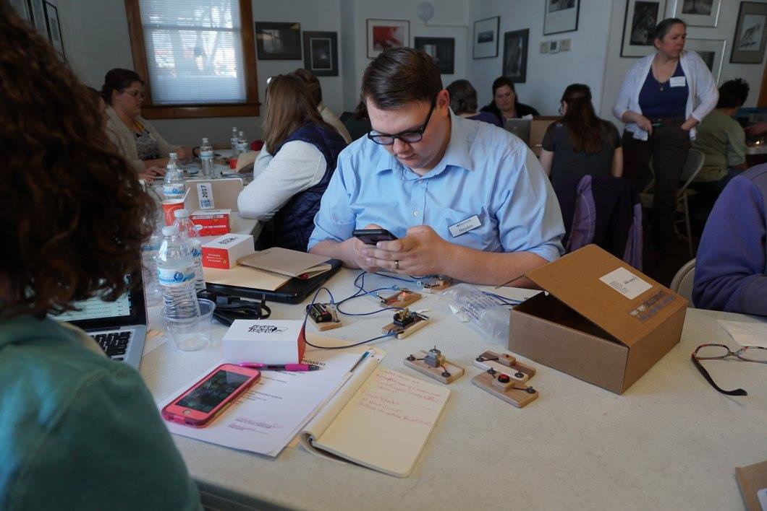

Slide 14
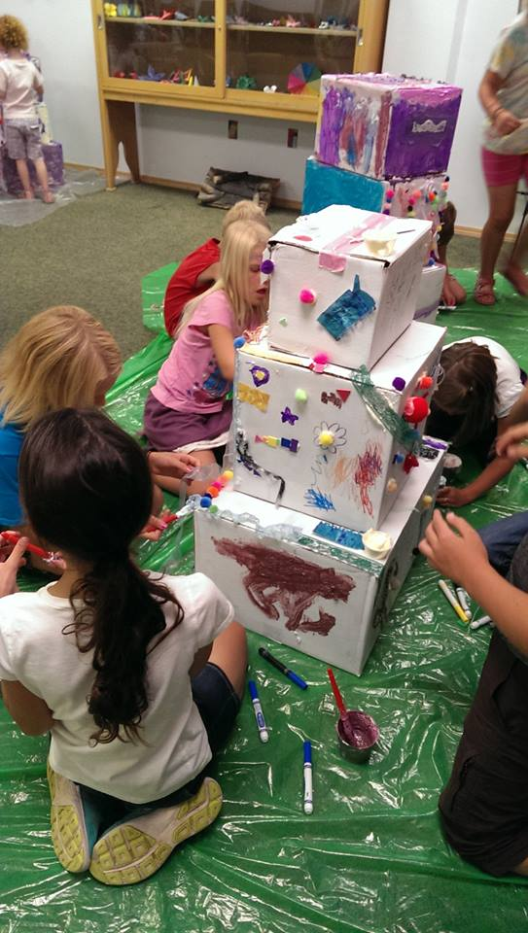
Marshall Public Library

Slide 15
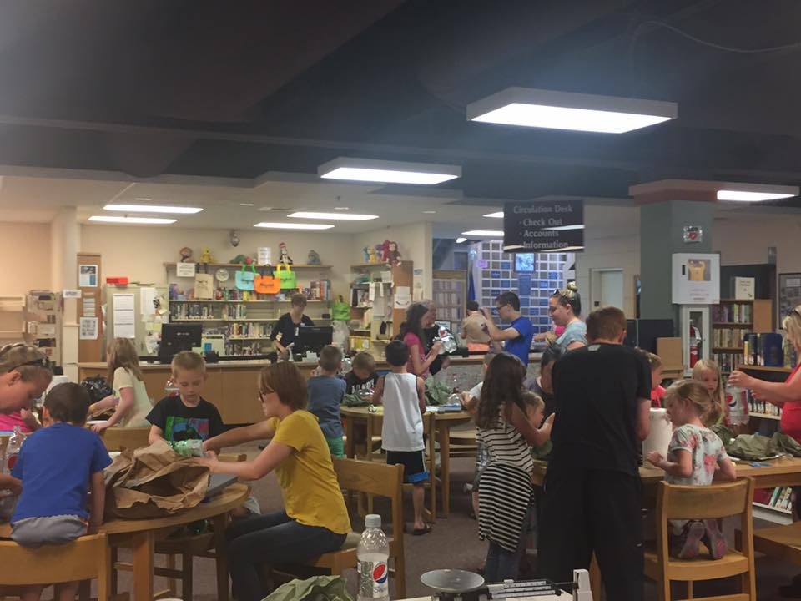
Marshall Public Library

Slide 16
North Bingham County District Library

Slide 17
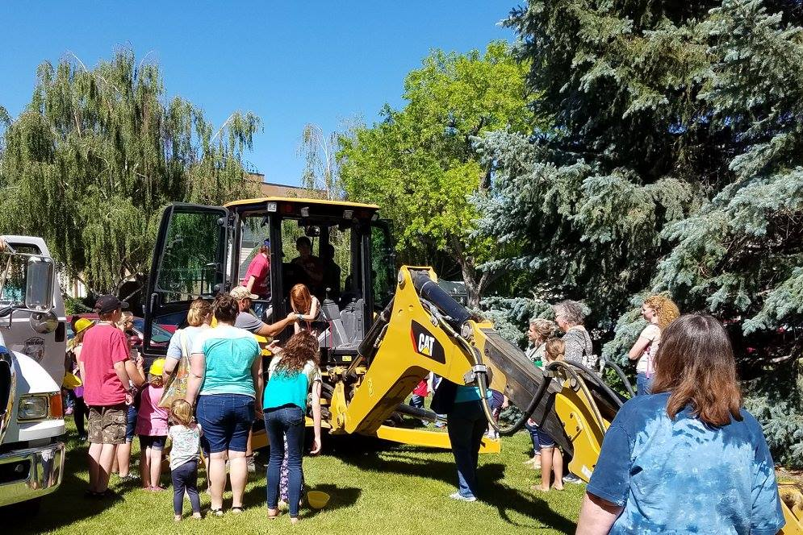

Slide 19
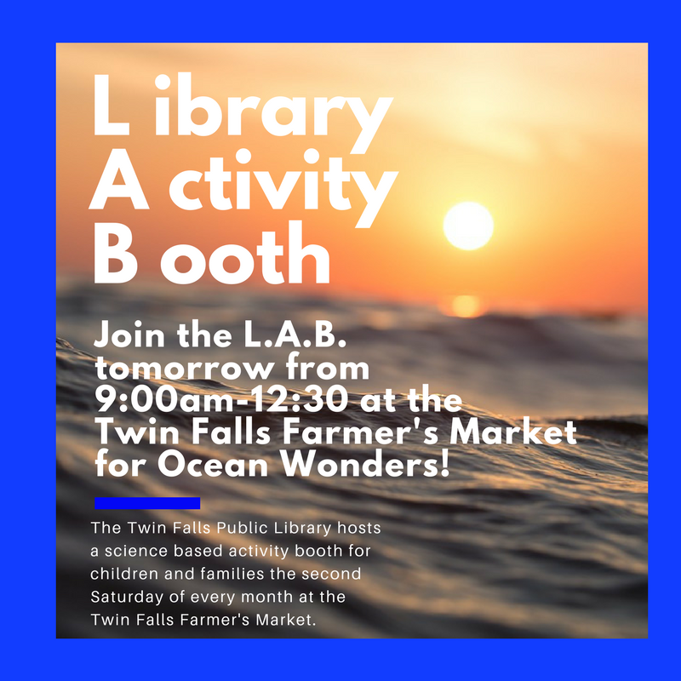

Slide 22
Twin Falls Public Library

Slide 23
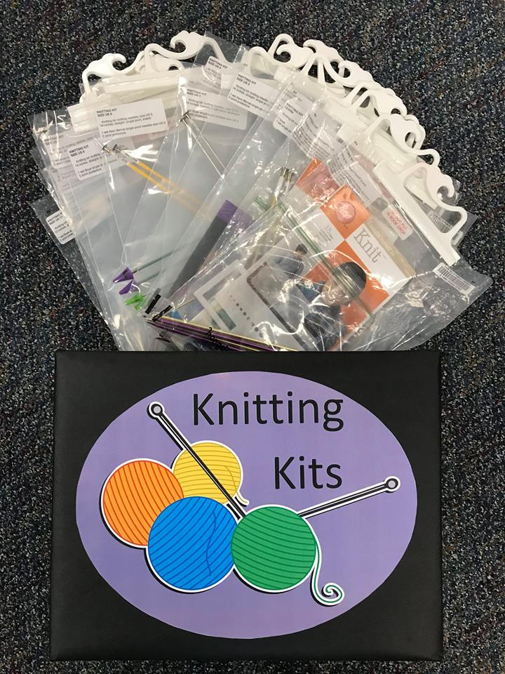

Slide 25
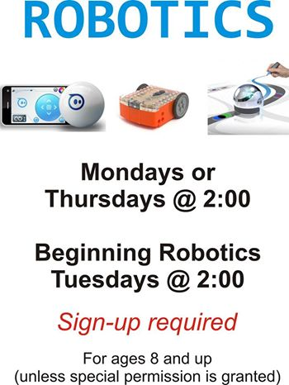

Slide 26
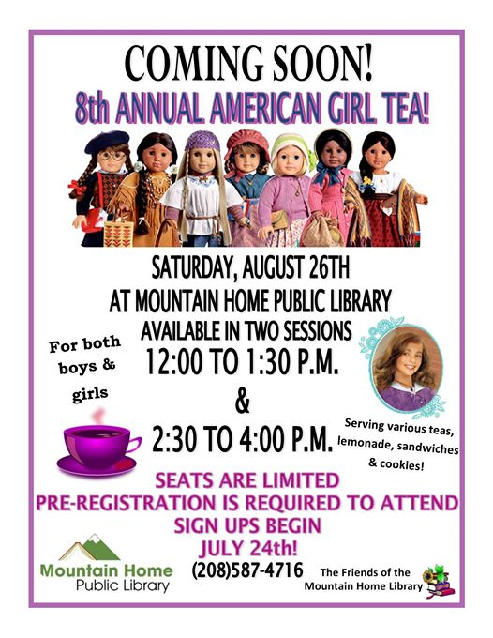

Slide 27
Mountain Home Public Library

Slide 28
Latah County Library District - Moscow

Slide 29
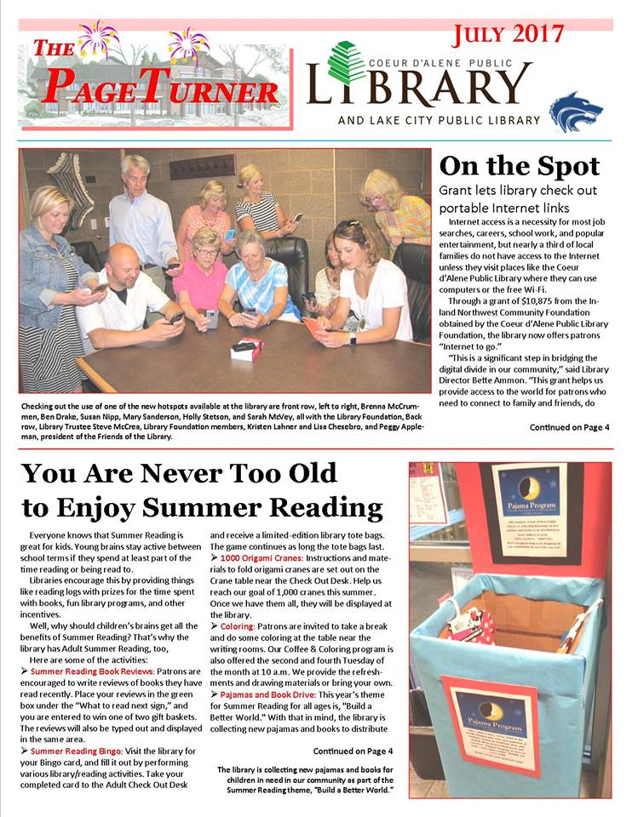
Coeur D’Alene Public Library

Slide 30
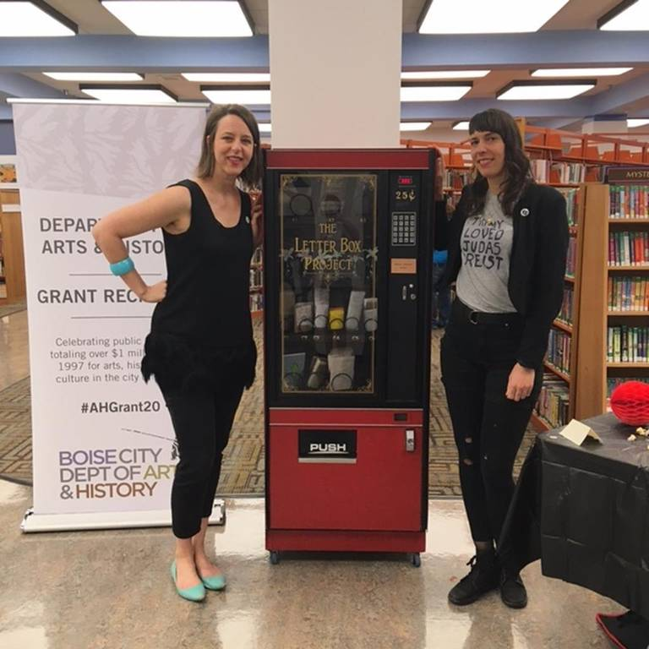
Boise Public Library!

