Slide 1





Jeannie Standal
ICfL
Ch-Ch-Ch
Changes:
2020 Census
Jeannie.standal@libraries.Idaho.gov
208-334-2150
@ICfLibs
Carolina Valderrama-Echavarria
U.S. Census Bureau
carolina.valderrama.echava@2020census.gov
208-863-6256
@CensusCounts

Slide 2

The Road To 2020
Carolina Valderrama-Echavarria
Partnership Specialist

Slide 3
Article 1, Section 2 of the US Constitution
  The actual Enumeration shall be made within three Years after the first Meeting of the Congress of the United States, and within every subsequent Term of ten Years, in such Manner as they shall by Law direct.
Key Purpose is Apportioning the US House of Representatives
Why We Do a Census

Slide 4
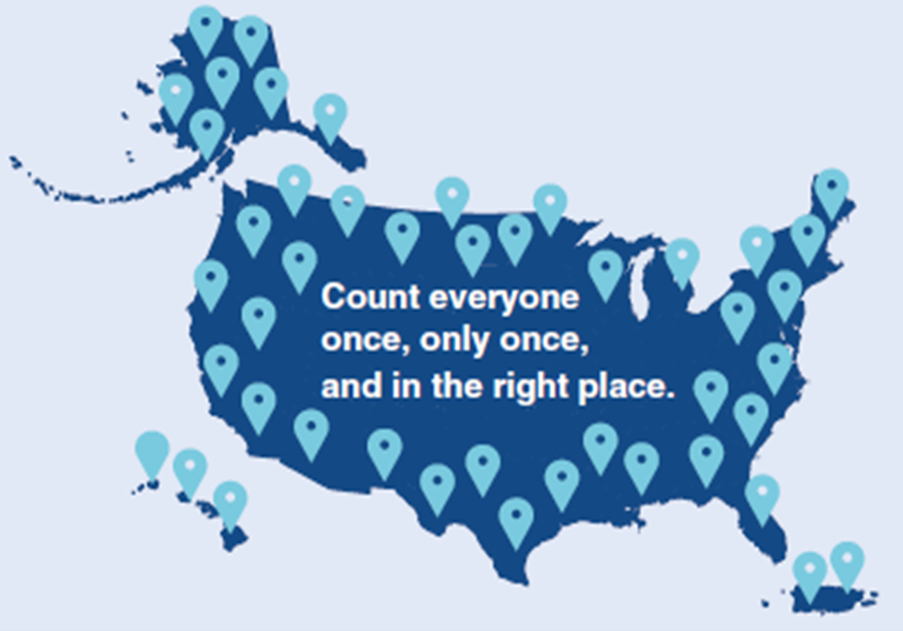
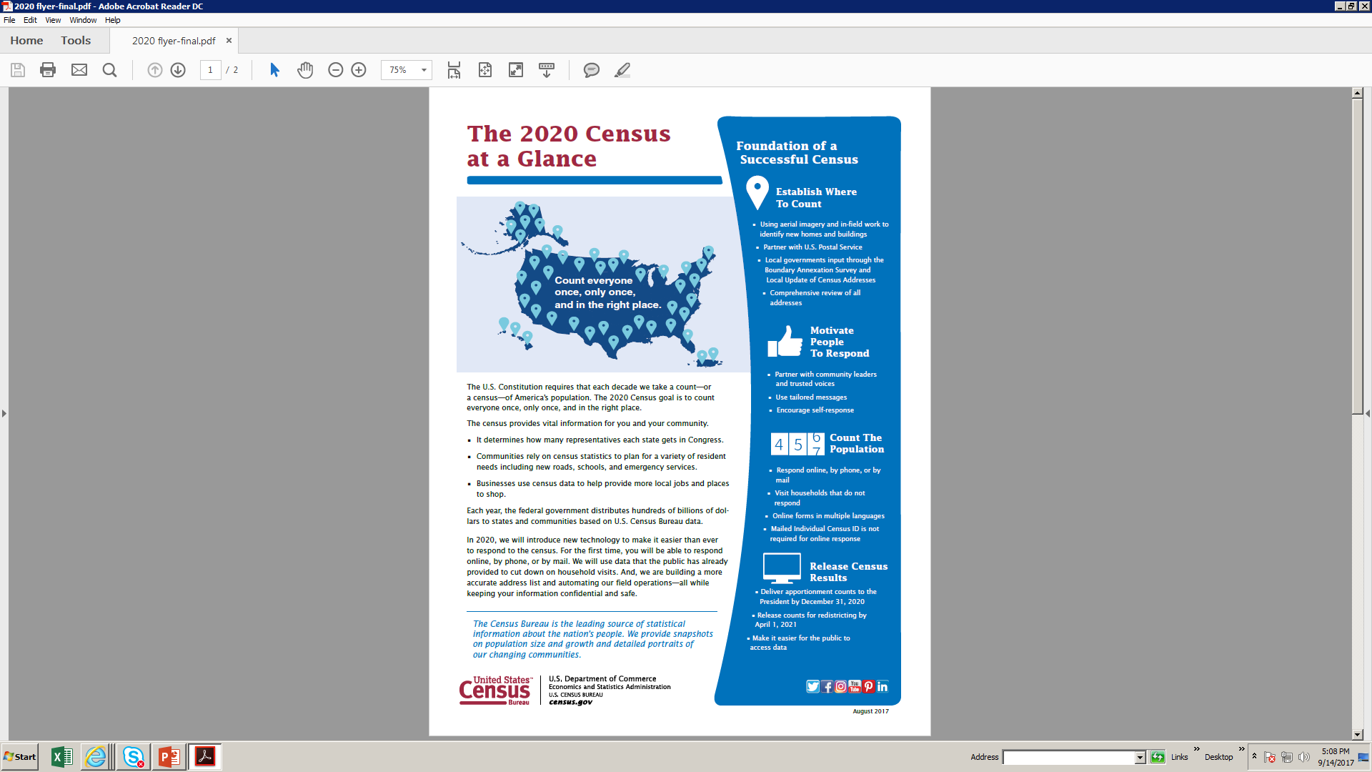
2020 Census
Notes:
Our goal is to count everyone once, only one, and in the right place.

Slide 5
Why does the 2020 Census matter?
Power
Congressional representation
Reapportionment & redistricting
Money
$675 billion distributed annually
Funding distributed based on population
Idaho
In 2010 over $2.4 billion each year to the State
$1,473 approx. per Idahoan counted
Notes:
Our goal is to count everyone once, only one, and in the right place.

Slide 6
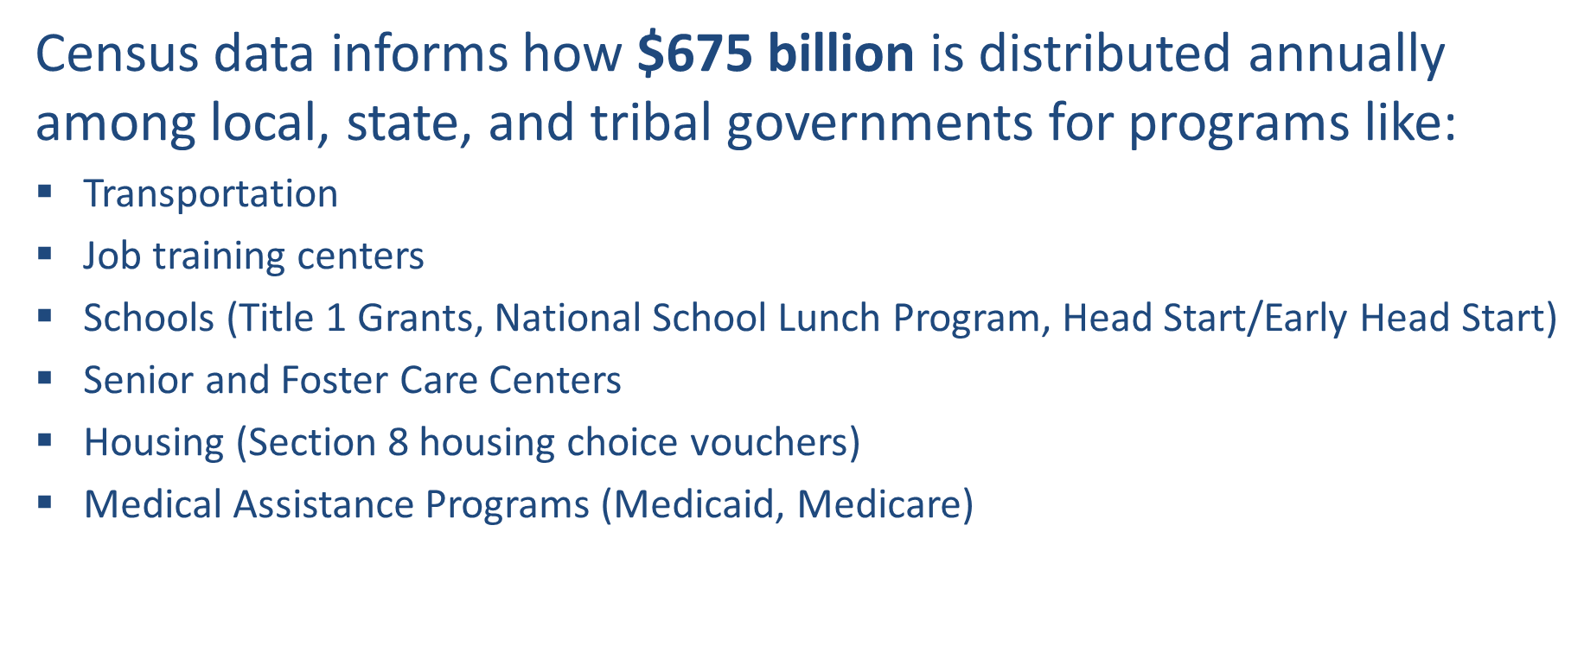

Federal funding
Notes:
We are making it easier to respond with technology.
• For the first time, people will have multiple ways to self-respond – online, by phone, or by mail – and full choice to opt for the mode with
which they feel most comfortable.
• The Census Bureau will be encouraging individuals nationwide to respond whenever and wherever they are. This includes the ability for
folks to respond on the go or at community events, even if they do not have the unique Census ID sent to their address.
Mailing process still being finalized in end-to-end test.

Slide 7






New Ability to Self Respond
Starting March 23, 2020
Internet Phone Paper Form In-person
Notes:
We are making it easier to respond with technology.
• For the first time, people will have multiple ways to self-respond – online, by phone, or by mail – and full choice to opt for the mode with
which they feel most comfortable.
• The Census Bureau will be encouraging individuals nationwide to respond whenever and wherever they are. This includes the ability for
folks to respond on the go or at community events, even if they do not have the unique Census ID sent to their address.
Mailing process still being finalized in end-to-end test.

Slide 8
Impact to REGION
76%
Region Census Mail Participation Rate in 2010
31,500+
Estimated net undercount in 2020 based on 2010 Census
$1,473
Potential per person Federal funds available
Notes:
We are just beginning
Infrastructure starts with the RCC in LA
Wave 1 - manage building the list of addresses – Address canvassing

Slide 9





Hard-to-Count Populations
Racial and ethnic minorities | Lower income | Persons who do not speak English fluently
LGBT | Undocumented immigrants | Children under 5
People experiencing homelessness | Tribal members | Rural Communities
Notes:
Wave 2 – manages peak enumeration activities

Slide 10
Where you can help
Identify community organizations in your city that work directly with hard-to-count populations and who we can partner with to conduct outreach
Incorporate census outreach and education efforts into your existing community engagements
Collaborate with Idaho’s diverse stakeholders to deliver tried and tested messages
Notes:
Wave 2 – manages peak enumeration activities

Slide 11
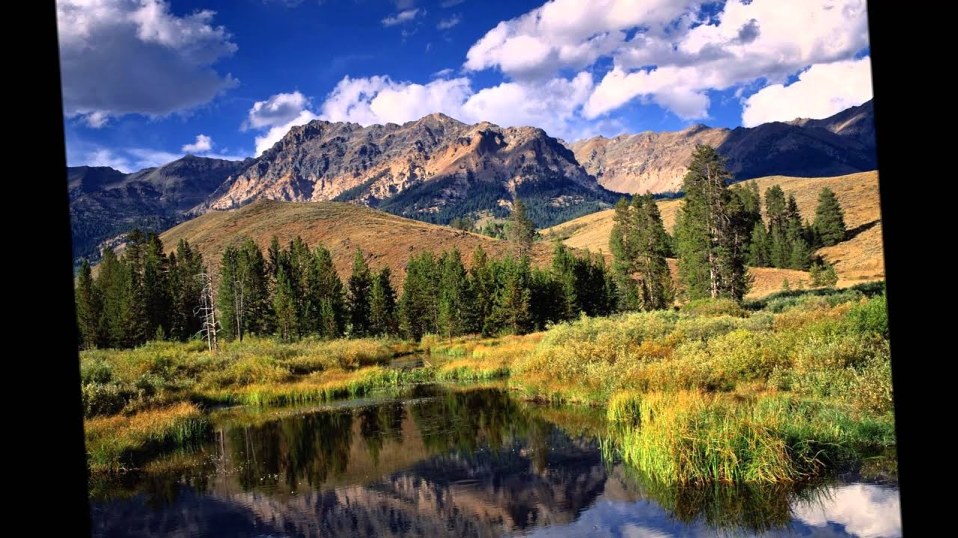
Complete Count Committees
  Tribal, state and local governments work together with partners in their communities to form CCCs to promote the 2020 Census to their constituents. Community-based organizations also establish CCCs that reach out to their members.

Slide 12
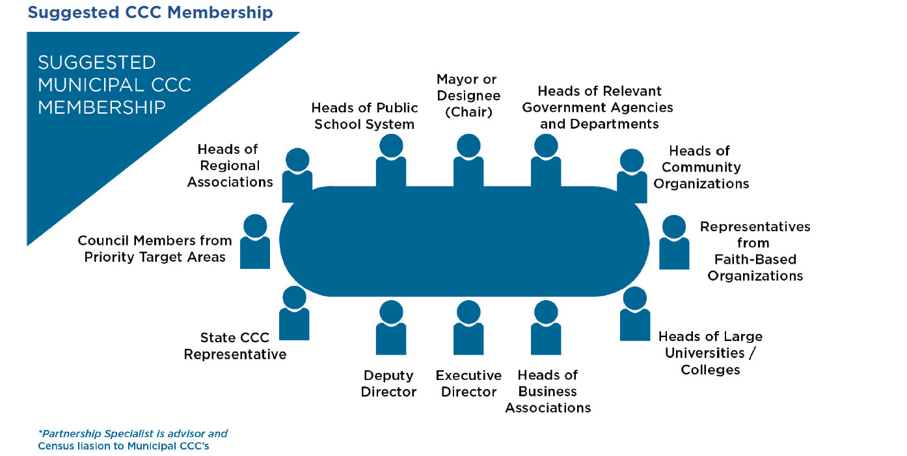
CCCs at a glance:
Notes:
Still on page 8 in their Training Manual. Review and use the slides to prompt you to say the following:
It is essential that a SCCC/CCC subcommittee address and reflect key facets of the community. The decision to form subcommittees is based on community need and the opportunities and challenges in reaching areas or populations that may not respond or may potentially be undercounted.
The Census Bureau recommends including the subcommittees focused on:
Government
Education
Faith-based community
Media
Community-based organizations
Business
Recruiting
It is important to note that in the past, SCCCs/CCCs have also created subcommittees devoted to:
seniors
veterans
youth
homeless
special housing
LGBTQ
tenants
public safety
homeowners associations
recruitment

Slide 13
Timeline – Key Communications
The 2020 Census Phases
  Education Phase – 2018-2019
  Awareness Phase – April 2019
  Motivation Phase – March – May 2020
  Reminder Phase – May – July 2020
  Thank You Phase – Starts July 2020
  Local governments and community leaders throughout Idaho participate in activities highlighting the message that the 2020 Census is imminent and that it is easy, important and safe to participate
Notes:
Please turn to page 11 in your training manual.
Let them know these are the communication phases and processes that continue on page 12.
Review and use the slides to prompt you to say the following:
We have covered what a SCCC/CCC is, the different types of committees, and the types of subcommittees.
During the various phases, the SCCC/CCC implements activities of the work plan through their government, faith-based organization and community-based organization, business, media, and recruitment partners. An effective strategy guarantees that community residents will encounter census messages during times of work, play, leisure, school, and worship.

Slide 14

Census Job Qualifications
Canvassers and Enumerators
U.S. Citizen at least age 18
Pass federal background
  check
Have an Email address and SSN
Driver’s license and vehicle or
transportation
Able to use a Smart Phone
Notes:
Our goal is to count everyone once, only one, and in the right place.

Slide 15
Recruiting
Can you help in hosting a recruiting event?
www.census.gov/fieldjobs
www.usajobs.gov
www.2020census.gov/jobs
1-888-658-5564 (RCC recruiting hotline)

Slide 16
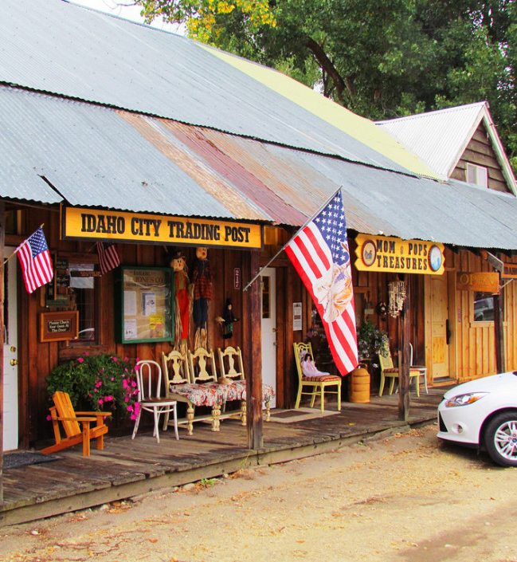
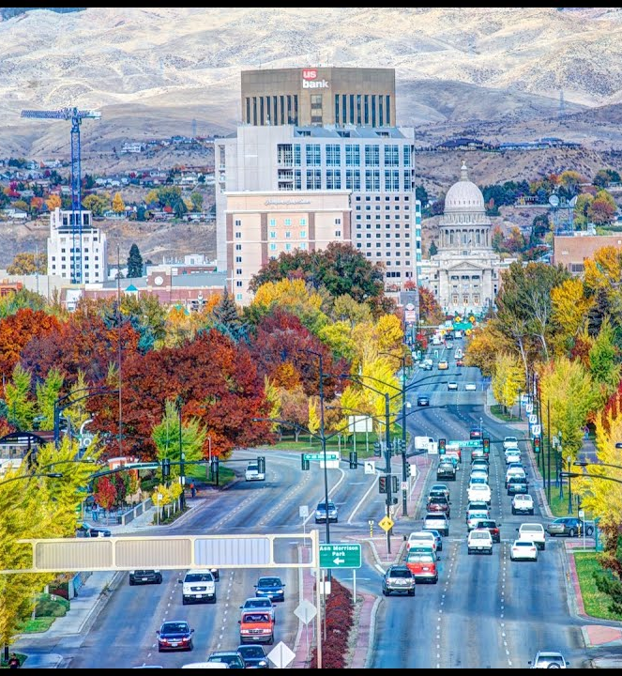

Slide 17

Thank you!!
Carolina Valderrama-Echavarria
(208) 863-6256
Carolina.Valderrama.Echava@2020census.gov

Slide 18


Circular Check List
Write questions & concerns on Post-Its
So, how will this
work in my Library?
Clarify & group questions
Exploring some questions.
Discussion
Feedback

Slide 19
Circular Check List
Internet Access
What will I need?
A little equipment
A little space
A little guidance

Slide 20


Why is a complete
count important
for my library?
IMLS Block Grant formula uses census population data
Census data is used in education funding, and thus affects school library funding

Slide 21




Why worry about it?

Slide 22
Fun Facts About the Census
FOR SMALL TALK AND COCKTAIL PARTY FODDER
1
6
10
72
TIME
QUESTIONS
QUESTIONS
YEARS
2020 is the first time the census is administered online
Were asked by the US Marshalls conducting the 1790 census
Are on the 2020 census (not carried out by US Marshalls)
Before census responses are made available

Slide 23


