Slide 1
Assessing School Readiness
The Kindergarten Readiness Challenge
Idaho Library Association Annual Conference
October 4, 2019
BY Jennifer Redford
Staci Shaw
Kristina Taylor
Notes:
1:30 – 1:35
Settle in
Introduce Jennifer, Staci & Kristina

Slide 2
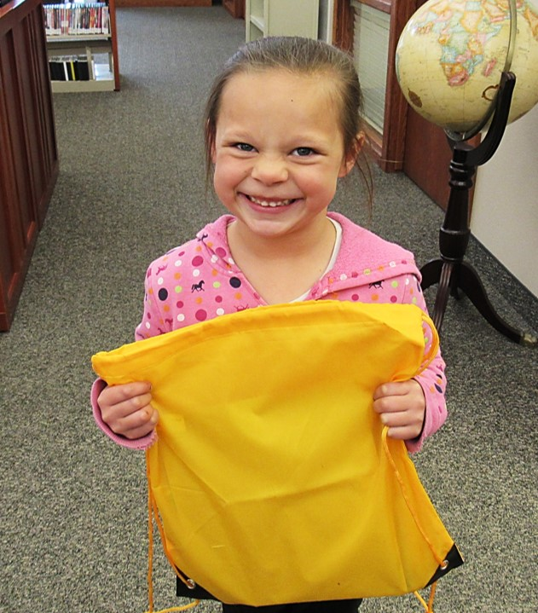
What does it mean to be “ready” for kindergarten?
Notes:
1:35 – 1:45 - Staci
K-Ready Grant FY19 – Lessons Learned

Slide 3
Kindergarten Readiness Grants: Lessons Learned
“Need” must be identified collaboratively with schools/collaboratives
The stronger the collaboration with community partner(s), the more impactful the project
Direct evaluation of participants was more impactful than self-reporting surveys
Myth: “If you build it, they will come”
Notes:
1:35 – 1:45 - Staci
K-Ready Grant FY19 – Lessons Learned

Slide 4
K Ready Grant Recipients 2019-2020
American Falls District Library
Cascade Public Library
Community Library Network, Hayden Branch
Jerome Public Library
Lemhi County District Library, Salmon
Nampa Public Library
Prairie River Library District
https://libraries.idaho.gov/rtm/kinder-grant/

Slide 5
Kindergarten Readiness Challenge: a toolkit
“ICfL believes Idaho libraries have a role to play in filling the preschool gap and addressing the issue of kindergarten readiness in their communities.”
We hope this tool will help…
Part 1: Assessing Community/Family Needs – The Needs Statement
Part 2: Understanding the Needs of Schools and School Libraries
Part 3: Mapping Community Assets/Partners
Part 4: Assess Library Staff Capacity/Resources to Address Kindergarten Readiness Needs
Part 5: Compile an Overview and Create a Plan for Kindergarten Readiness in Your Community
We are seeking up to 5 public libraries to pilot the KRC toolkit and complete by May 2020.
Interested? Contact Staci Shaw @ staci.shaw@libraries.Idaho.gov
Notes:
1:45 – 2:00
Jennifer & Kristina
Notes:
-It’s a process – meant to take 3-6 months and completed with the help of others.
-You will walk away with a clear picture of what gaps exist in your community in terms of Kindergarten readiness – removes the guessing and duplicative efforts.
-Elements from other tools like “The Engaged Library Toolkit” from Chicago Public Library
-Fillable pdf – notes within the steps – or print version
-Deep Dive elements are extra, in-depth activities you can choose to complete.
-Can also use to apply for grants once assessment is complete.

Slide 6
Questions?
Kindergarten Readiness Challenge
Notes:
2:00 – 2:10
Time to answer questions/discussion of KRC
*How does KRC fit in with your library's strategic plan?
*Do you need any additional support in terms of advocacy

Slide 7
NEW Outreach Workshops
Additional ICfL resources
to support Kindergarten readiness…
Based on Every Child Ready to Read workshops
Five to choose from:
Positive Play Time
Family Storytime
Family Cardmaking
Growing with Music
Telling Family Stories
Rolling Registration
Launches early 2020
Notes:
2:10 – 2:25 Other YS programs to support kindergarten readiness
Jennifer – Outreach Workshops (5 minutes)

Slide 8
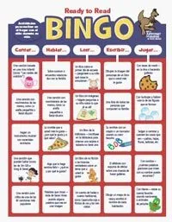
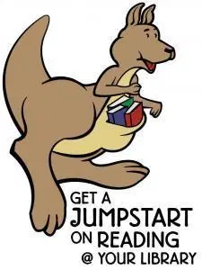
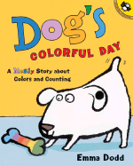
Jump Start Kindergarten
Old program – New additions:
Available year-round…
…for more than just Kindergarten Registration events – get creative!
Updated books…
…more choices and focused on K skills
-Bilingual book: What Will We Build Today
-English-only book: Dog’s Colorful Day
Take-home literacy activities…
…matched to book topics/K skills and for parent education/involvement
Notes:
2:10 – 2:25 Other YS programs to support kindergarten readiness

Slide 9
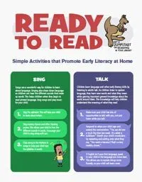
Outreach for Underserved Children
Old program simplified:
Available year-round…
…to support all your creative community outreach efforts
….this program absorbed “Bright Futures: Summer Outreach”
Adjusted limits…
…public libraries can request paperback book support for outreach efforts based on:
2 times for school-year outreach
1 time for summer outreach
(Only time application is closed is during the month of July. Please plan accordingly.)
For your outreach event, Ready to Read Parent Handout, Bingo Cards and other materials can also be requested from the RTM Support Materials form.
Notes:
2:10 – 2:25 Other YS programs to support kindergarten readiness

Slide 10
Questions?
Kindergarten Readiness Challenge
Notes:
2:25

Slide 11
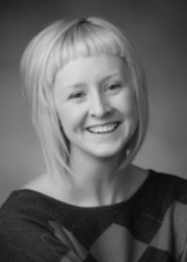
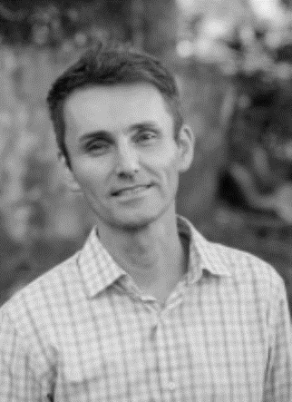
Read to Me Rendezvous: Building Bridges, Connecting Community
Katie Scherrer
November 6 – 7, 2019
Libraries.Idaho.gov/event/rtm-rendezvous-2019/
Dr. Jamie Campbell-
Naidoo
Notes:
Reserved for Rendezvous info

Slide 12
Jennifer Redford: jennifer.redford@libraries.idaho.gov
Staci Shaw:
staci.shaw@libraries.idaho.gov
Kristina Taylor:
kristina.taylor@libraries.idaho.gov
Thank You
Notes:
2:25 – 2:30
Wrap up and questions

