Slide 1
Identifying & Confronting Microaggressions in Our Libraries
Based in part on a workshop (Confronting Microaggressions in the Classroom: What Are They and What Can I Do About Them) presented by Tasha Souza, Associate Director of the Center for Teaching & Learning, Professor of Communication, Boise State University. Shared with permission.

Slide 2
Our Goal and Outcomes
Workshop goal: to feel more empowered to respond when confronted with a microaggression.
Learning outcomes:
Identify examples of microaggressions
Weigh key considerations when faced with a microaggression
Engage positively when faced with a microaggression

Slide 3
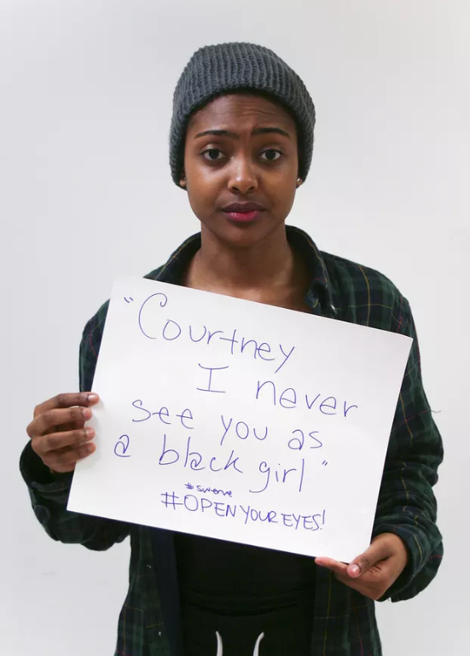
Defining Microaggressions
Subtle verbal or nonverbal communication, intentional or not, resulting in harmful consequences to members of marginalized groups
(Solorzano, Ceja & Yosso, 2000)
Notes:
POLL 1 NEXT

Slide 4
Poll
Have you ever been the victim of a microaggression?
2. Have you ever witnessed a microaggression against another person?
3. Have you ever committed a microaggression?

Slide 5
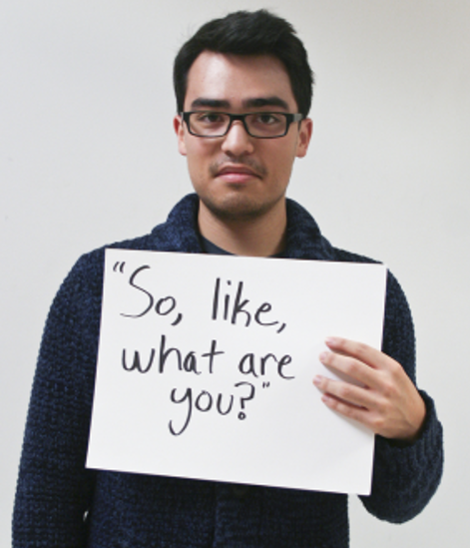
Why do microaggressions matter?
“...microaggressions point out cultural difference in ways that put the recipient’s non-conformity into sharp relief, often causing anxiety and crises of belonging on the part of minorities.”
(Runowya, 2015)

Slide 6
Considerations
Contextual considerations: aggressor characteristics, relational conditions, personal conditions, environmental conditions
Nature of microaggression: potential intent and possible outcomes
Choices based on considerations: private/public, direct/indirect

Slide 7
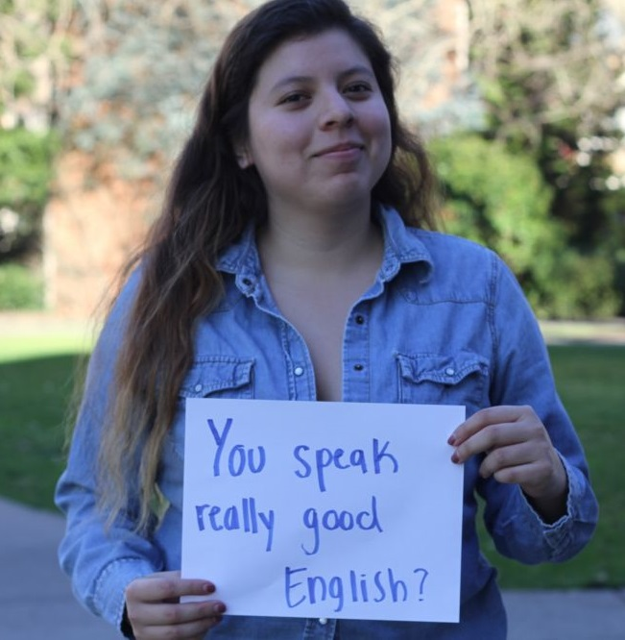
A Communication Strategy
1. Note the observed behavior.
2. Perhaps ask a follow up question: “why did you say that?” “what do you mean?”
3. Explain how the slight may be interpreted by others.
4. Express how the slight made you feel.
5. Request appropriate action.

Slide 8
Some Practice
You hear someone you supervise at the reference desk jokingly say to a tall African American man, “You must play basketball.”

Slide 9
A Possible Response
I heard you say that the man who just checked out his books must play basketball.
What made you say that?
I think that this is a generalization based on stereotypes, and that it might make him uncomfortable if he heard.
I feel uncomfortable with this generalization.
I would like you to consider where the stereotype came from and why it might not be appropriate to express.

Slide 10
A Little More Practice
A colleague points to a patron wearing a headscarf, “Those people always let their children run wild in the library.”
A patron at the circulation desk overhears someone speaking in Spanish and says loudly, “You’re in America now. Speak English.”
A child in your reading group makes a face and moves when a child of another ethnicity sits next to them.

Slide 11
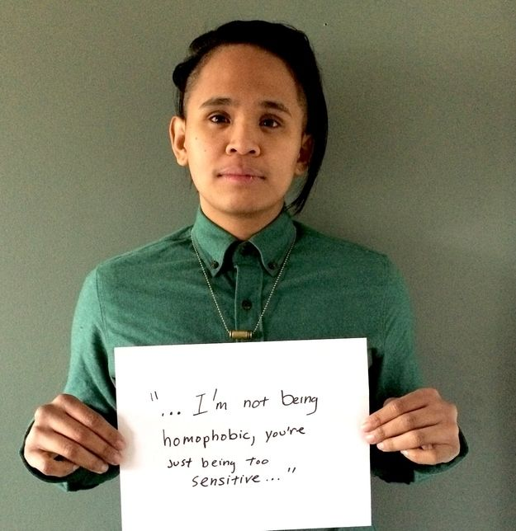
Some Possible Reactions
Oh, you’re being overly sensitive.
It was just a joke.
Who are you, the PC police?

Slide 12
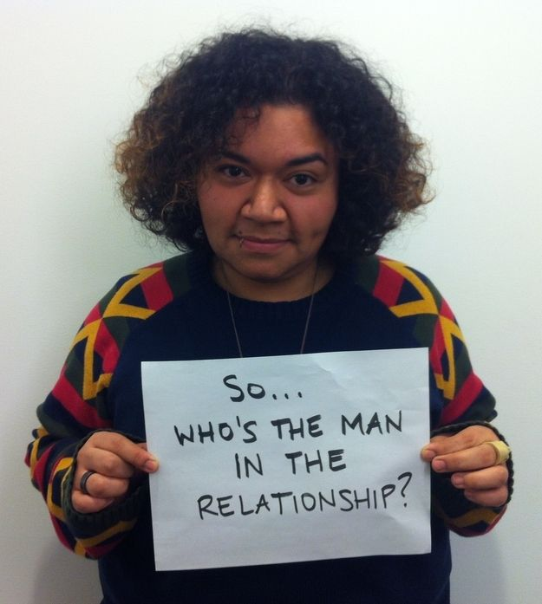
Microresistance in Response to Microaggression
Incremental daily efforts to challenge privilege based on race, gender, sexuality, class, etc. that help targeted people.
(Irey, 2013)

Slide 13
Strengthening Our Abilities
Recognize that dismissive attitudes are harmful.
Engage in self-reflection to identify times that you may have been microaggressive in your personal and work life.
Participate in continuing education activities.
Avoid making assumptions and labeling individuals.

Slide 14
Strengthening Our Institutions
• Foster inclusive and supportive environments.
• Collaborate with groups and organizations who are committed to addressing issues of diversity and inclusion.
• Offer trainings and opportunities for continuing education and diversity workshops.

