Slide 1
My first books
Helping libraries build capacity to serve their communities.

Slide 2
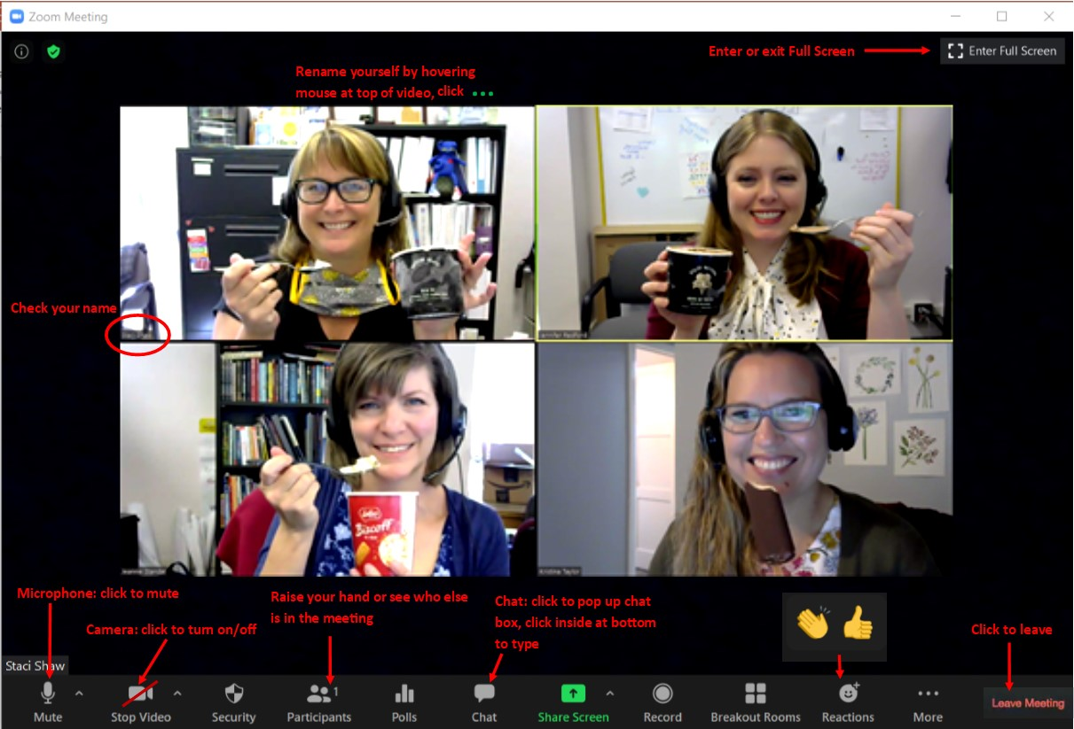
Notes:
Let’s try out some buttons:
Best practices for meetings is to mute your microphone unless you are talking.
We’d love to see everyone today! Please consider turning on your camera.
If your mic or camera are not working, click the up arrow next to the mic or camera and make sure the correct device is plugged in.
Doublecheck your name and rename yourself if necessary. Preferably with your real name.
To minimize the screen in order to see your toolbar or Zoom controls, click the square at the top right.
Find your chat box and type one word that describes how you’re feeling about the My First Books program this year.
Check out the participants list and find where you can raise your hand; however, once I start the presentation today I may not be able to see your hand on my screen so do feel free to just unmute and shout out.
Stop sharing
If you’re cool with the controls, give me a thumbs up! Any questions?
Share screen again

Slide 3
Desired Outcomes:
Participants understand expected outcomes for My First Books
Participants understand timeline and program requirements
Participants have information and resources for book distributions, especially for visits during the pandemic
Notes:
For those of you who are a bit anxious or nervous, we hope you’ll feel more at ease and excited by the end of the training today.

Slide 4
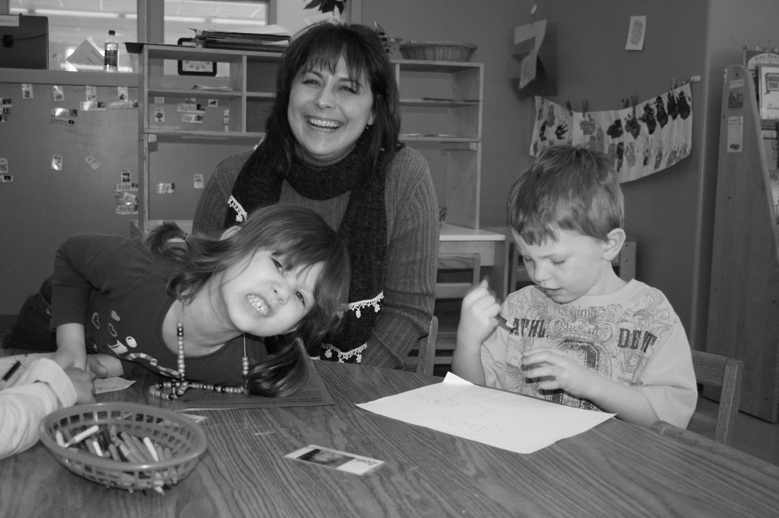
agenda
Welcome and Introductions
My First Book Vision and Outcomes
Setting Up for Success
Books and Book Distribution
Working with Community Partners
Communication
Virtual Storytimes and Parent Events
Next Steps

Slide 5
My First Books Team
Staci Shaw
Kristina Taylor
Tina Schilling
Notes:
Introduce yourself and your library, share whether this is first time library has participated, or if this is your first year you are participating, or if you are joining us to learn more about the program.

Slide 6
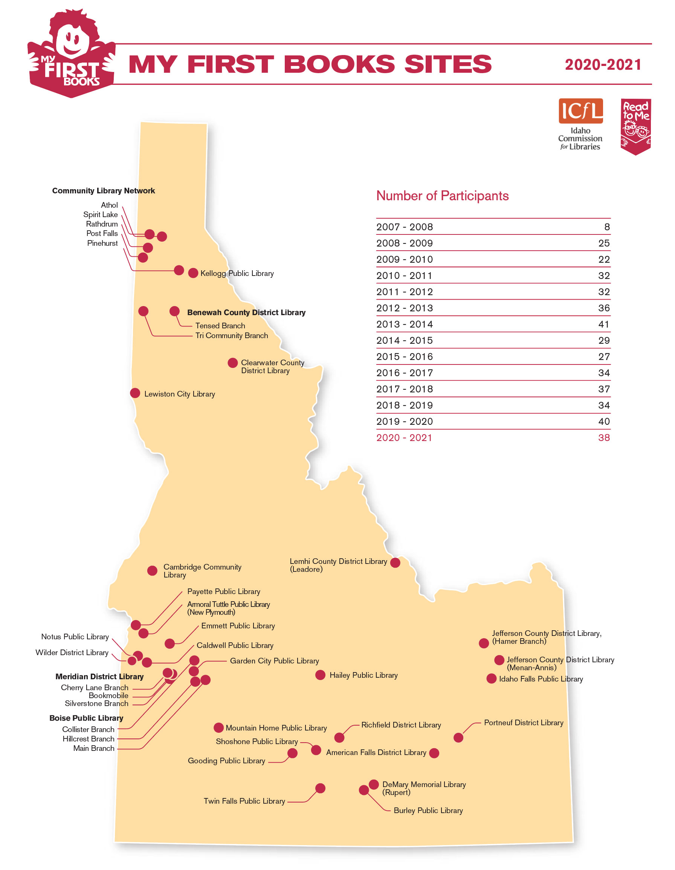
4300 Children
38 libraries

Slide 7
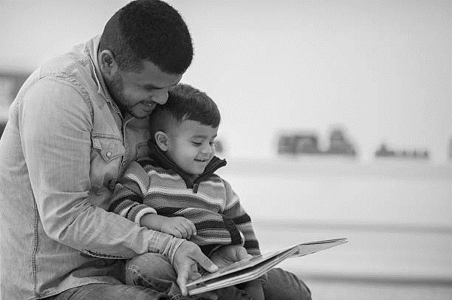
Follow along in your binder
A
Handout: First section
Handout: Appendix
Changes due to Pandemic

Slide 8
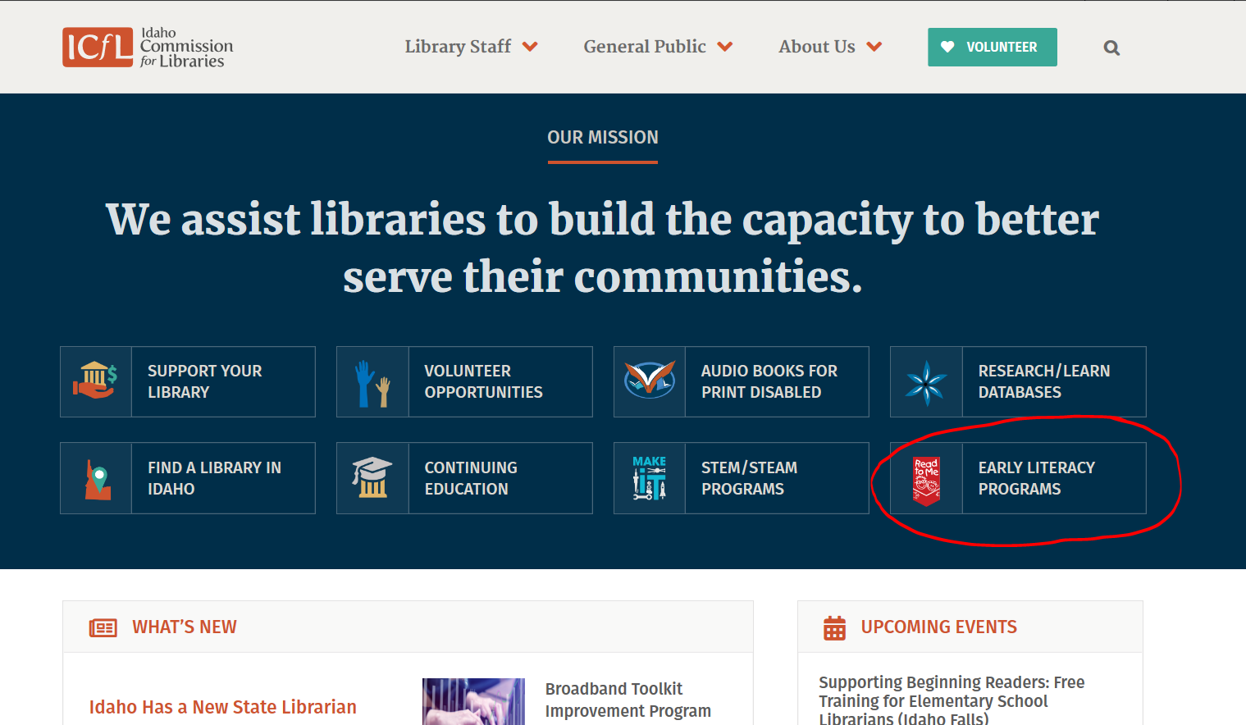
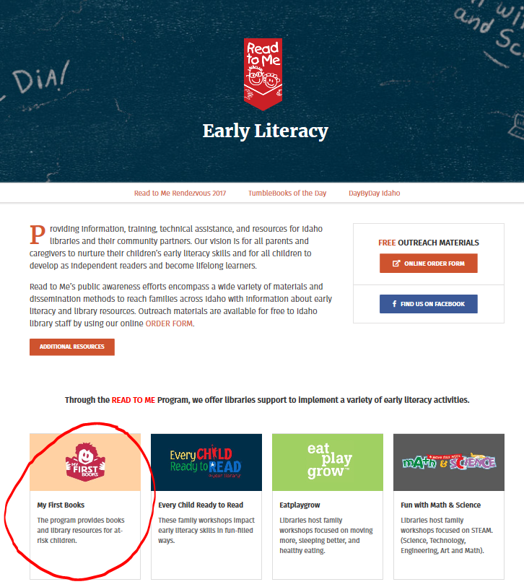
All forms and information are on our website:
Notes:
Share screen

Slide 9
Why icfl invests in my first books:
The availability of reading material in the home, whether owned or borrowed from the library, is directly associated with children’s achievement in reading comprehension.
61% of low-income families (nationally) have no children’s books in their home.
80% of preschool and after-school programs serving low-income populations have no age-appropriate books for their children.
A look at some facts and figures
Notes:
Could also have more limited access to school libraries this year.

Slide 10
Why icfl invests in my first books:
One possible remedy to the socioeconomic gaps in academic achievement is to make sure that children of low-income families have access to high-quality, age-appropriate books. Having books can facilitate children’s reading and shared reading between children and their caregivers.
Access to Print Materials: A Meta-Analysis
(from “Access to Print Materials Improves Children’s Reading: A Meta-Analysis of 108 Most Relevant Studies Shows Positive Impacts,” Learning Point Associates, 2010. Study commissioned by Reading is Fundamental.)
Notes:
Research-based

Slide 11
My first books outcomes
Participating children increase their access to books by starting a home library.
More underserved families have library cards and use the public library.
Participating children increase early literacy skills.
Parents of participating children increase their knowledge about early literacy.
Parents of participating children increase home literacy activities.
Libraries strengthen community partnerships.
Notes:
Unlisted outcome: Library staff develop personal relationships with community partners, children, and families.

Slide 12
2020-2021
Sometimes I start a sentence, and I don’t even know where it’s going. I just hope I find it along the way.
~ Michael Scott, The Office
Notes:
This is an extraordinary year, with extraordinary challenges– but you are all extraordinary people, so we’re just going to have to figure it out together and do the best we can!

Slide 13
Connect with your partners!
Child Care Crisis
Head Start and District Preschools: decreased capacity
Child Care Reopening Plans
Local Health Department Metrics and Safety Measures
Notes:
Make sure your partners are still on board with participating in the program. It may be hard to connect as they are scurrying trying to get their year launched. Phyllis Vernon from Wicap Head Start used this analogy (Etch-a-Sketch)

Slide 14
Requirements: community partner
Provide services for “underserved” children and families
Offer consistent enrollment for childcare or preschool services from September through May
Agree to participate for the whole year

Slide 15
Program requirements: summary
Monthly storytime visit, read title of the month
Distribute title of the month, Bookworm newsletter
Early Literacy Event
Parent Surveys
Final Report

Slide 16
Book distributions
Notes:
Supposed to go:
We send you books a couple of weeks before start of month, you go to partner site and do storytime, hand out books and Bookworms.
You can see by this photo of a distribution by the Emmett Public Library at their Head Start site that there may be a few issues with the program this year.
But we’re going to work through things one at a time…

Slide 17
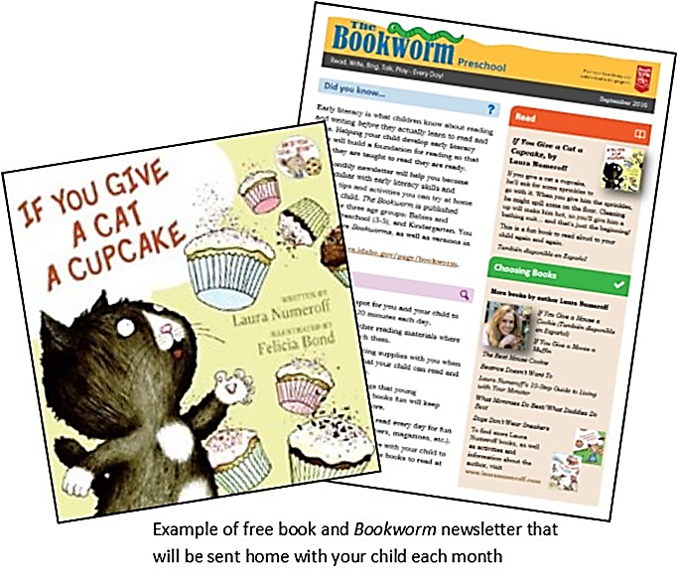
Requirements: book distributions
Every child receives the Book of the Month and “The Bookworm” newsletter
Notes:
Let’s talk books!
Children will have 9 books by the end of the year in their new home libraries.

Slide 18
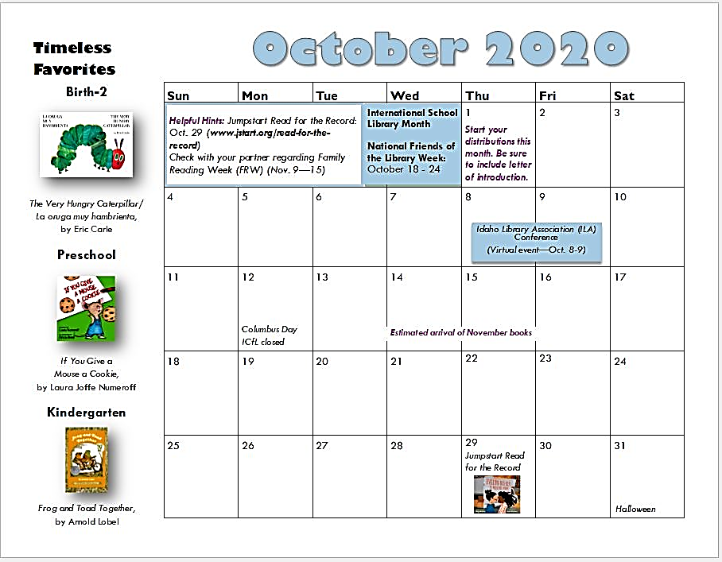
Requirements: book distributions
Book titles: Designated age group, title, month!

Slide 19
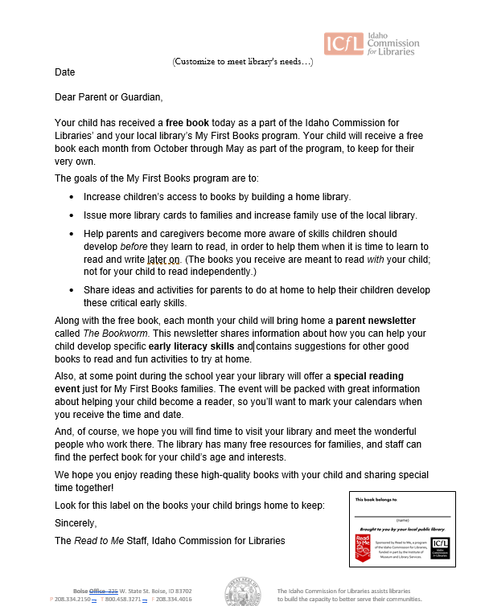
Requirements: book distributions
Send letter of introduction with first distribution

Slide 20
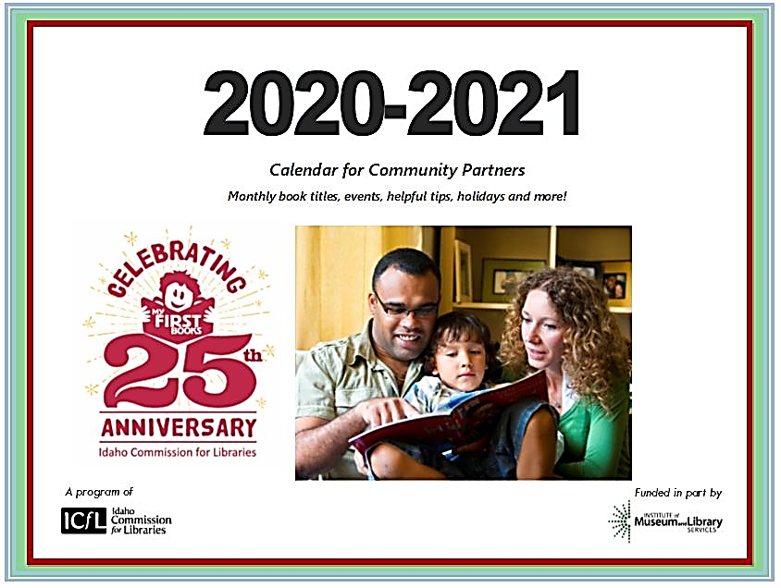
October – May
Extra self-selected book in May
Inventory books upon arrival
Notes:
Calendars are just being printed, so we’ll send with first shipment of books. A PDF is available on our website.
Timeline moved up a few days, so you have a couple more days to quarantine boxes. Whereas estimated delivery used to be 15 – 18th, now 13th – 15th.
A couple notes about titles this year:
October: It’s the 50th Anniversary of Frog and Toad. Snafu with ordering—originally ordered Frog and Toad Are Friends, a regular picture book, but ended up with Frog and Toad Together, an I Can Read version. Try to remind partners that we want parents and caregivers to be reading books TO and WITH the child, not having the child read independently. This really sets a bad precedent for the year, but I’ll put something in the Bookworm to hopefully drive home the point. Nothing we can do about it…
January: Hardcovers. There were available from First Book for $1.99, so we assumed they were paperbacks, but they are actually hardcovers. Click, click
May: Book of the Month, and self-selected title.
Braille books: Need numbers ASAP. Would also be helpful to know if these are same kids as last year. Braille selection not super extensive for preschool.

Slide 21
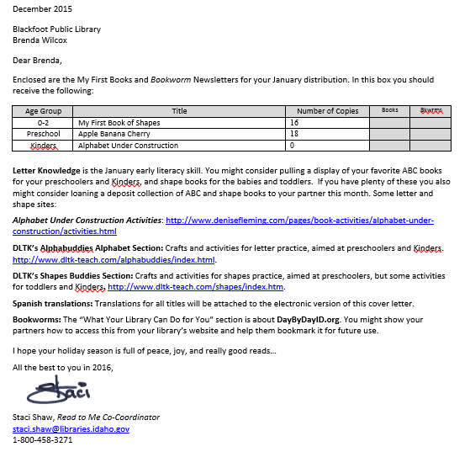
Cover Letters with shipment of books

Slide 22
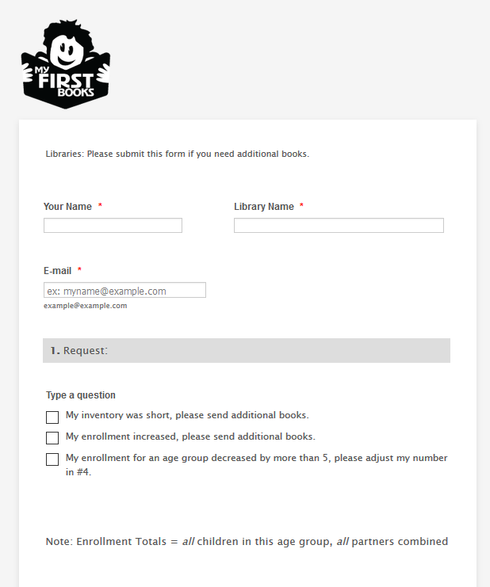
Requirements: book distributions
Report enrollment number increases

Slide 23
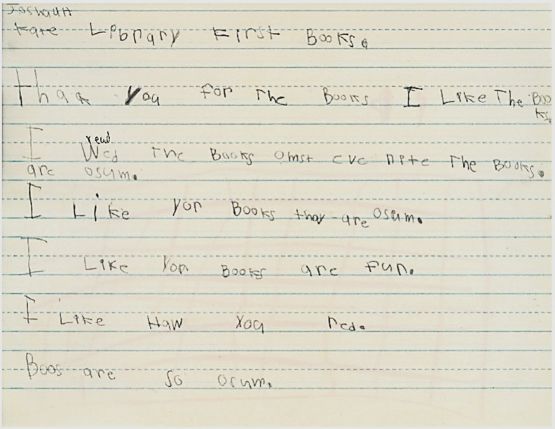
break
Notes:
Use break to refill coffee, use the restroom, which shouldn’t have a long line, stretch a little, and check out the My First Books website, where you can find all the titles for the year.
Stop share
As come back, use chat box to type the title of a favorite picture book you read recently.

Slide 24
pandemic contingency plans
Shipping and delivery
Early literacy event
Book distributions
Notes:
Shipping: Talk with other library staff about what will happen if the library closes due to the pandemic.
Will library be accepting deliveries?
Will staff involved with MFB still be given permission to get books to teachers? (delivery to school, curbside pickup for teachers, etc.)
Provide an alternate shipping address to ICfL MFB coordinators (this will be on the form where you confirm partner enrollment numbers), as well as delivery instructions. This will ensure your books make it to you regardless of whether the library is open.
Let shipments of books from ICfL quarantine for at least three days. You might consider taking books to partners a few days early, so they can quarantine them as well.
Literacy Event: Optional
Consider virtual workshops, such as the Ready for Kindergarten workshops some of you signed up for. We’ll come back to this one in a few minutes.
Book distributions, next slide

Slide 25
Requirements: book distributions
Books should go to the same children every month.
Book distributions are face-to-face with child.
Storytimes

Slide 26
pandemic contingency plans: book distributions
In-Person
Outside storytime visits
Virtual
Tech available to partners
Book handling protocols
Safety measures
Live stream preferred
Speakers and projectors
Recording storytimes
Volunteer to do some basic training?
Notes:
Two main goals we want to maintain: 1) Get books in the home; 2) Maintain relationship between library staff and children
We’d like to avoid doing what we did last spring with dropping books off and letting teachers send books home with children. That is something we may need to do again in an emergency situation where schools are closed for more than a month, but let’s explore other options first.
Talk with your partners, and your library supervisors. Even if schools are allowing in-person visits, your library management team may not want you going in-person while community spread is high.
If schools are restricting visitors, ask if you could do your storytimes outside, while the weather permits.
Think through a typical visit from last year:
Determine book handling procedures with your partners, so that the fewest number of hands touch the books as possible, or use gloves. Meet with partners (virtually, phone call) prior to first visit to determine how books and Bookworms will be handed out in order to prevent unintended spread of germs on materials.
Wear a face covering when visiting community partners, take hand sanitizer.
Limit storytime aids, such as puppets, scarves, shakers, flannel board pieces, etc. that will be handled by children; consider turning crafts into individually packaged “take and make” bags.
Children may not be permitted to sit in a circle or group for storytimes; be prepared to do storytime while they are at their desks.
Virtual:
Deliver books a few days ahead of your scheduled visit and stream your visit live via Zoom, Google Hangout, Skype, etc. Be sure to practice using the technology with teachers prior to visit!
Find out from partners what kind of tech is available to them—
computer with projector,
iPad,
laptop, etc.
Do teachers need to check out a laptop or iPad from library? Or a portable projector?
Do they have internet access, or would you need to provide a mobile hotspot,
Is there any way to hook up an external speaker so kids can hear you better?
As a last resort you can record your storytime and allow teachers to share it with students and/or send home so students can view at home.

Slide 27
Pandemic contingency plans: Pre-plan!
Planning for the year
Notes:
Locate this document in your materials.

Slide 28
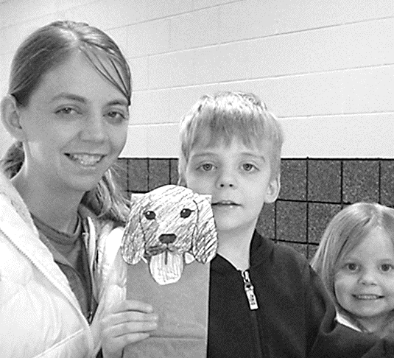
Requirements: Early literacy event
Optional!
Provide one workshop for parents of participating children or one family event held for My First Books families.
Notes:
Click: Optional

Slide 29
Requirements: evaluation
Parent surveys
Partner surveys (online)
Final Summary Report (online)
Notes:
Add Appendix photos

Slide 30
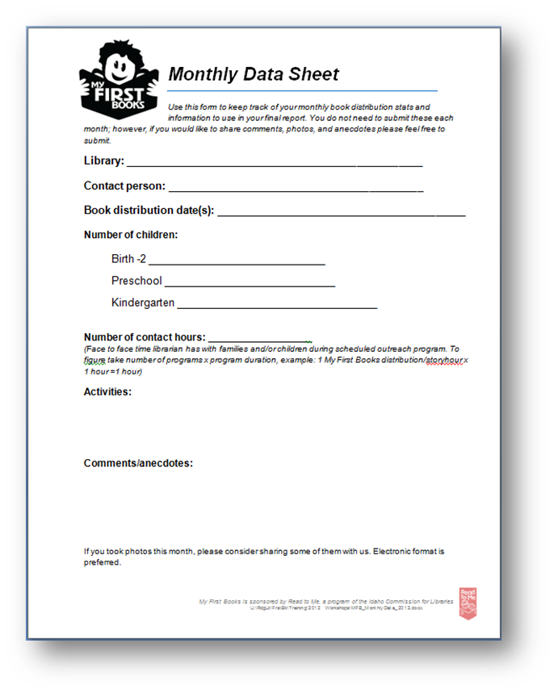
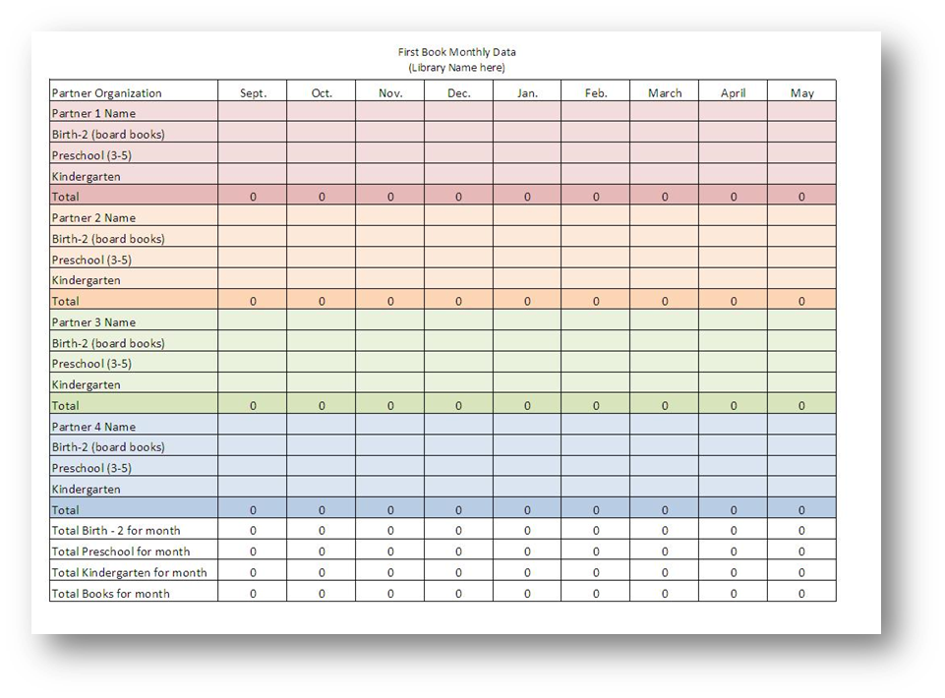
Resources to help you fill out final report
Monthly Data Sheets

Slide 31
Resources to help you keep track

Slide 32
Resources for my first books participants
https://libraries.idaho.gov/rtm/my-first-books/
All requirements, handouts, templates
Book list and calendars
Final Report
Request additional books
Link to “The Bookworm”

Slide 33
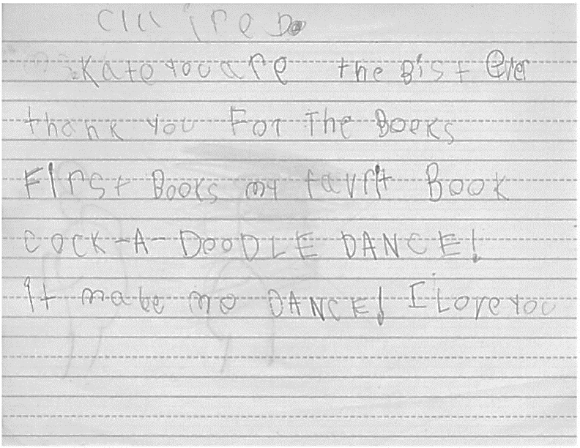
break
Notes:
Stop share
When you come back use the chat box to tell us if you are open for browsing, completely closed, doing curbside and/or browsing by appointment.

Slide 34
Resources for Spanish-speaking families

Slide 35
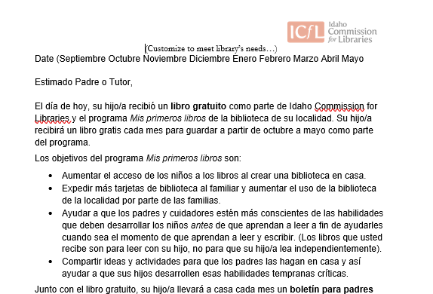
Resources for Spanish-speaking families
Letter of introduction for parents
Notes:
Re-snip and paste

Slide 36
Resources for Spanish-speaking families
“The Bookworm” newsletter for parents
Notes:
Re-snip and paste

Slide 37
Resources for Spanish-speaking families
Bilingual Titles
Notes:
Re-snip and paste

Slide 38
Resources for Spanish-speaking families
Translation of text
Notes:
Re-snip and paste

Slide 39
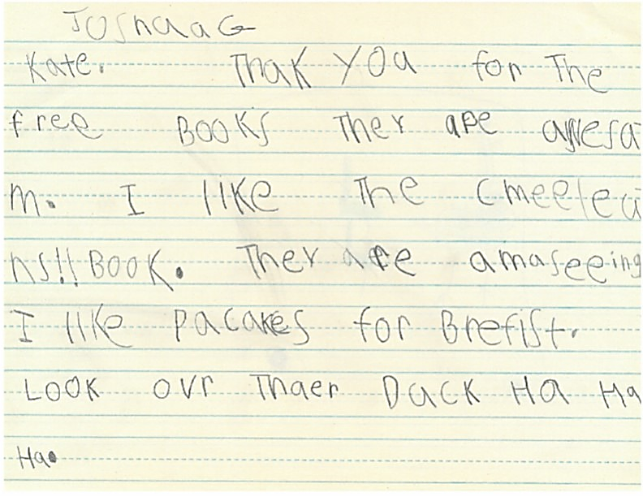
break
Notes:
Stop share.
When you come back, use the chat box to tell us if your closest schools are opening in person, online, or a hybrid.

Slide 40
recommendations and tips
Library Cards
Working with your partner
Book distributions
Parent communication/publicity
Early Literacy Event

Slide 41
A word about library cards
Getting applications to parents
Tracking applications
Amnesty for previous fines
Nonresidents:
Fee waivers
Fee reduction
Sponsorships

Slide 42
Library cards and resources
Flyer or bookmark with resources
On back of Welcome letter
Short video from you
Promote Facebook/Twitter
Notes:
Library cards: Even more important to try to get cards issued to families. If school closes again, they may lose access to school libraries.
“Resources” are library resources such as virtual library cards, virtual storytime or early learning programming, e-books/audio books or other media for streaming, curbside pickup, information about how to access computers or Wi-Fi,
And at-home learning resources, if you’ve pulled some of those together in a handy flyer or brochure, or have them listed on your website.

Slide 43
Recommendations and tips: working with your partner
Communication
Information for Community Partners
Tips and Recommendations for Community Partners
Calendar
First Meeting

Slide 44
Pandemic contingency plans: Pre-plan!
Planning for the year
Notes:
Give copy of plan to principal. Might want to invite principal to meeting.

Slide 45
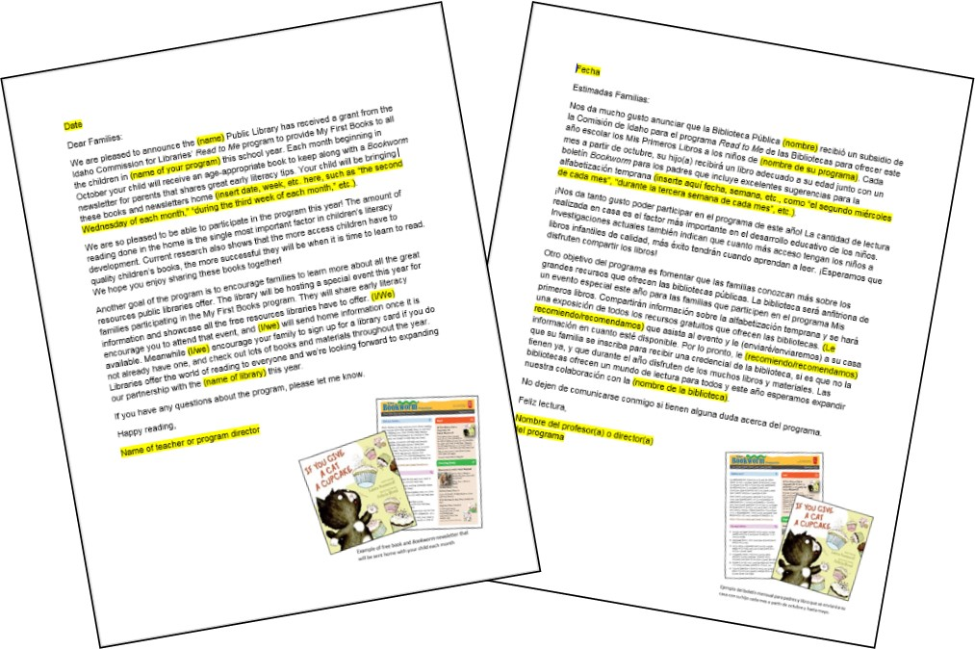
Recommendations and tips: working with your partner
Template for letter to parents from community partner (English and Spanish)
Notes:
Re-snip?

Slide 46
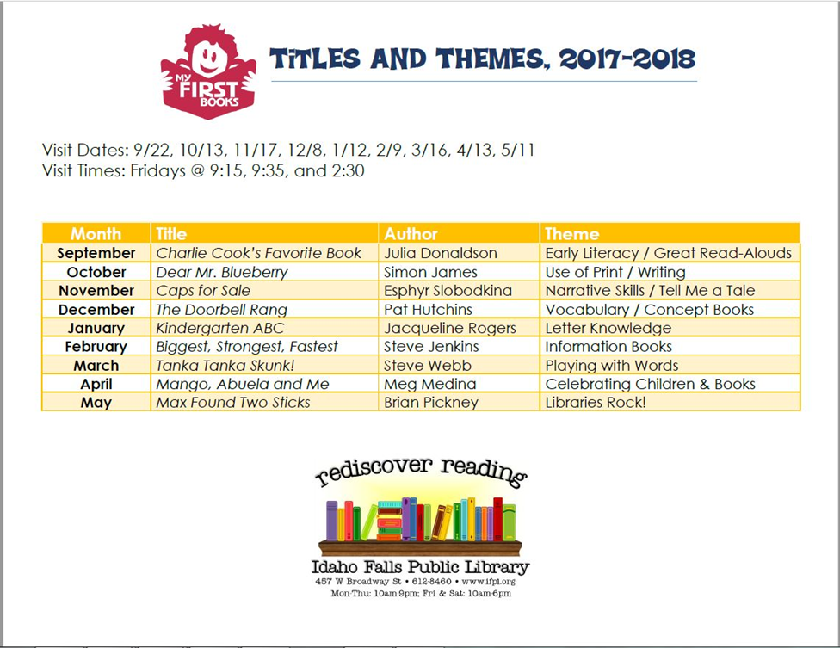
Recommendations and tips: working with your partner
One-page list of books
Notes:
Re-snip?

Slide 47
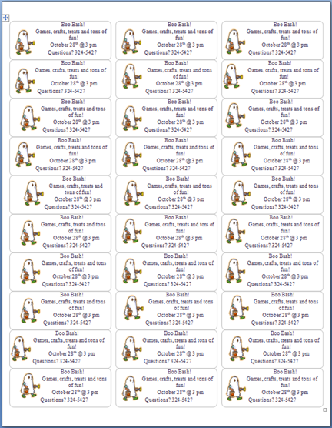
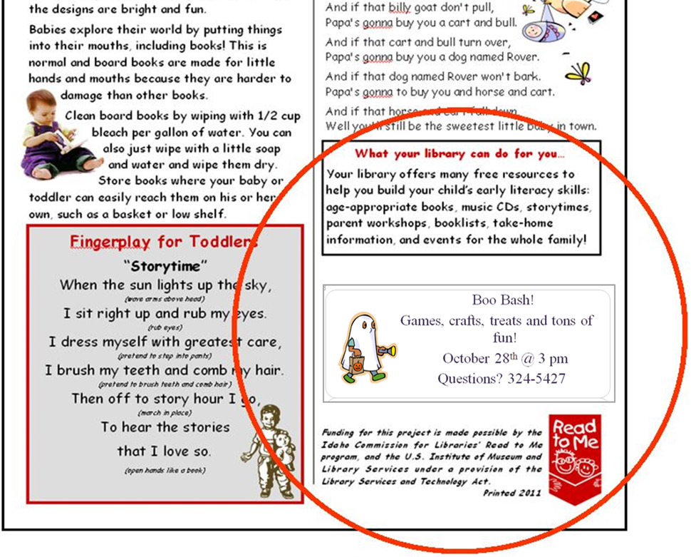
Recommendations and tips: book distributions
Using space provided on “Bookworm”
Notes:
Re-snip and paste

Slide 48
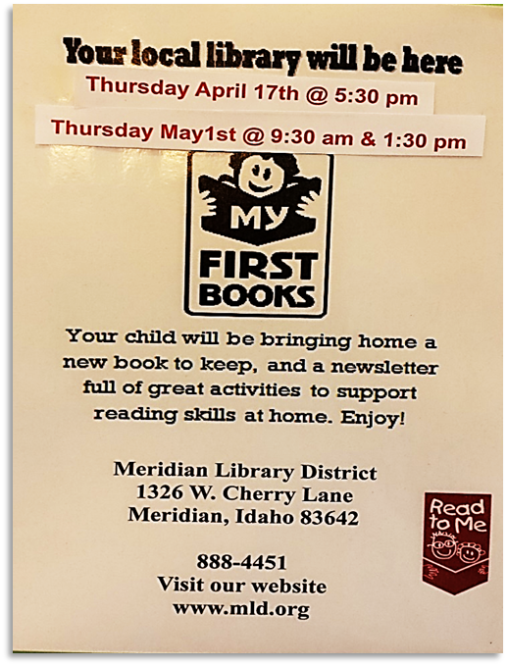
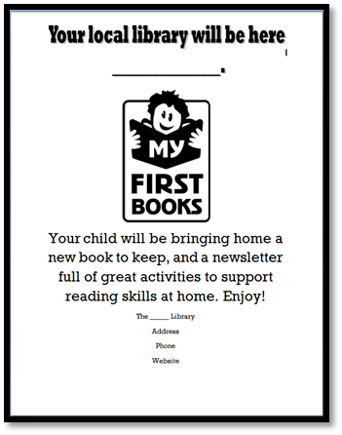
Recommendations and tips: book distributions
Communication with parents
Notes:
Re-snip?

Slide 49
publicity
Press Release
Photos
Library or Partner Newsletters

Slide 50
Early literacy event: optional
Parent Workshop
Ready! for Kindergarten
Library-created workshop
Videos
Family Event
Notes:
Have not had time to put something together on virtual parent events, but hope to do that when things calm down in September/October…
Share screen for all these
Links to include in chat:
IAEYC Ready! for Kindergarten: https://idahoaeyc.org/ready
Summer Reading Google Doc with Salmon Library’s videos: https://docs.google.com/document/d/1jJlEdpMMTi-PNp_d8uS3qXESImsX9iGISJFlrhgG9CY/edit#
PDG-B5 videos: https://idahoaeyc.org/

Slide 51
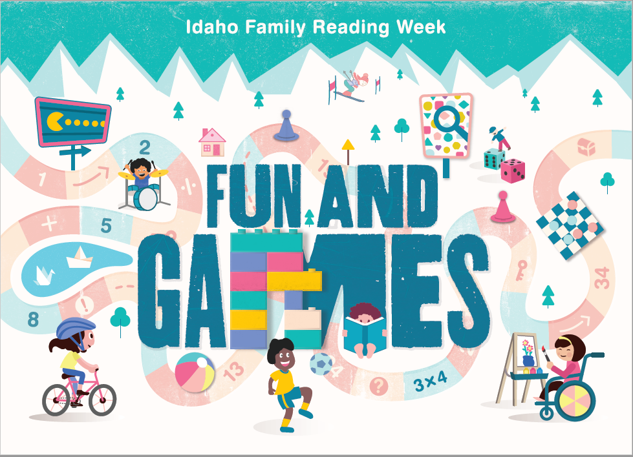
Idaho family reading week
Third week of November
Books and resources to support a family event
Registration opens September 21
Notes:
This year it’s Nov. 9 - 15

Slide 52
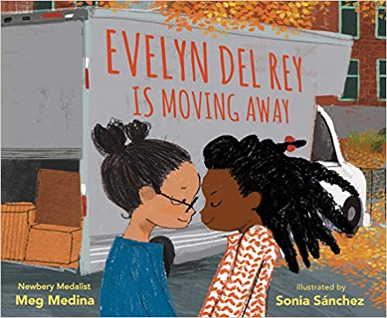
October 29
A national effort to read the same book to thousands of children around the country on the same day
Copy of book is provided to each library that orders one
2020 Title: Evelyn Del Rey Is Moving Away
Pledge to read: Fill out form on website
Read!
Read to kids in person or virtually at storytimes, daycares, schools, anywhere!
Keep track of how many children you read to on October 29
Ask partners to pledge to read
Check out resources on website: www.jstart.org/read-for-the-record/
Submit number on website
Be a part of this nationwide annual event to break the record!

Slide 53
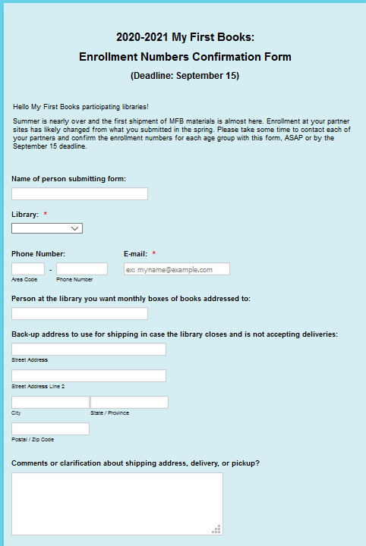
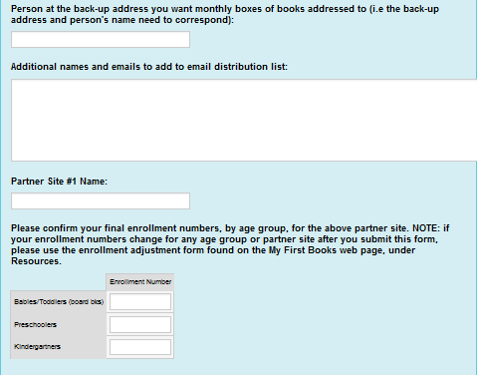
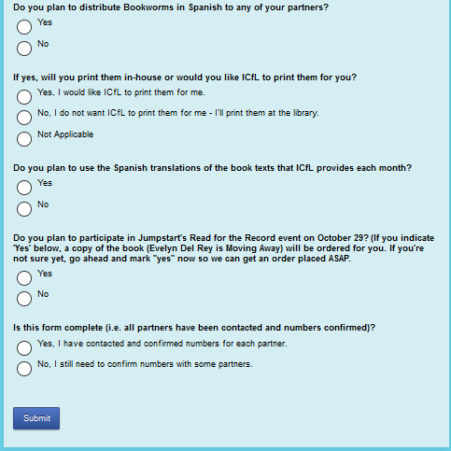
Contact
Backup delivery info
Confirm each partner and number of children enrolled for each age group
Spanish materials
Read for the Record book
www.jotform.com/icfl/MFB-final-enrollment-numbers

Slide 54
Q and A
Frequently Asked Questions
Other Questions
Concerns
Next Steps

Slide 55
NEXT STEPS
1
Contact all Partners!
2
Meet with each
3
Read for the Record: Decide plans
Confirm number of children in each age group
Use worksheet to plan visits and contingency plans
Send confirmed enrollment numbers for each partner in JotForm by Sept. 15
https://form.jotform.com/icfl/MFB-final-enrollment-numbers

Slide 56
